Slide 1
The power of co-operation
Ed Mayo @edmayo1 #coops

Slide 2
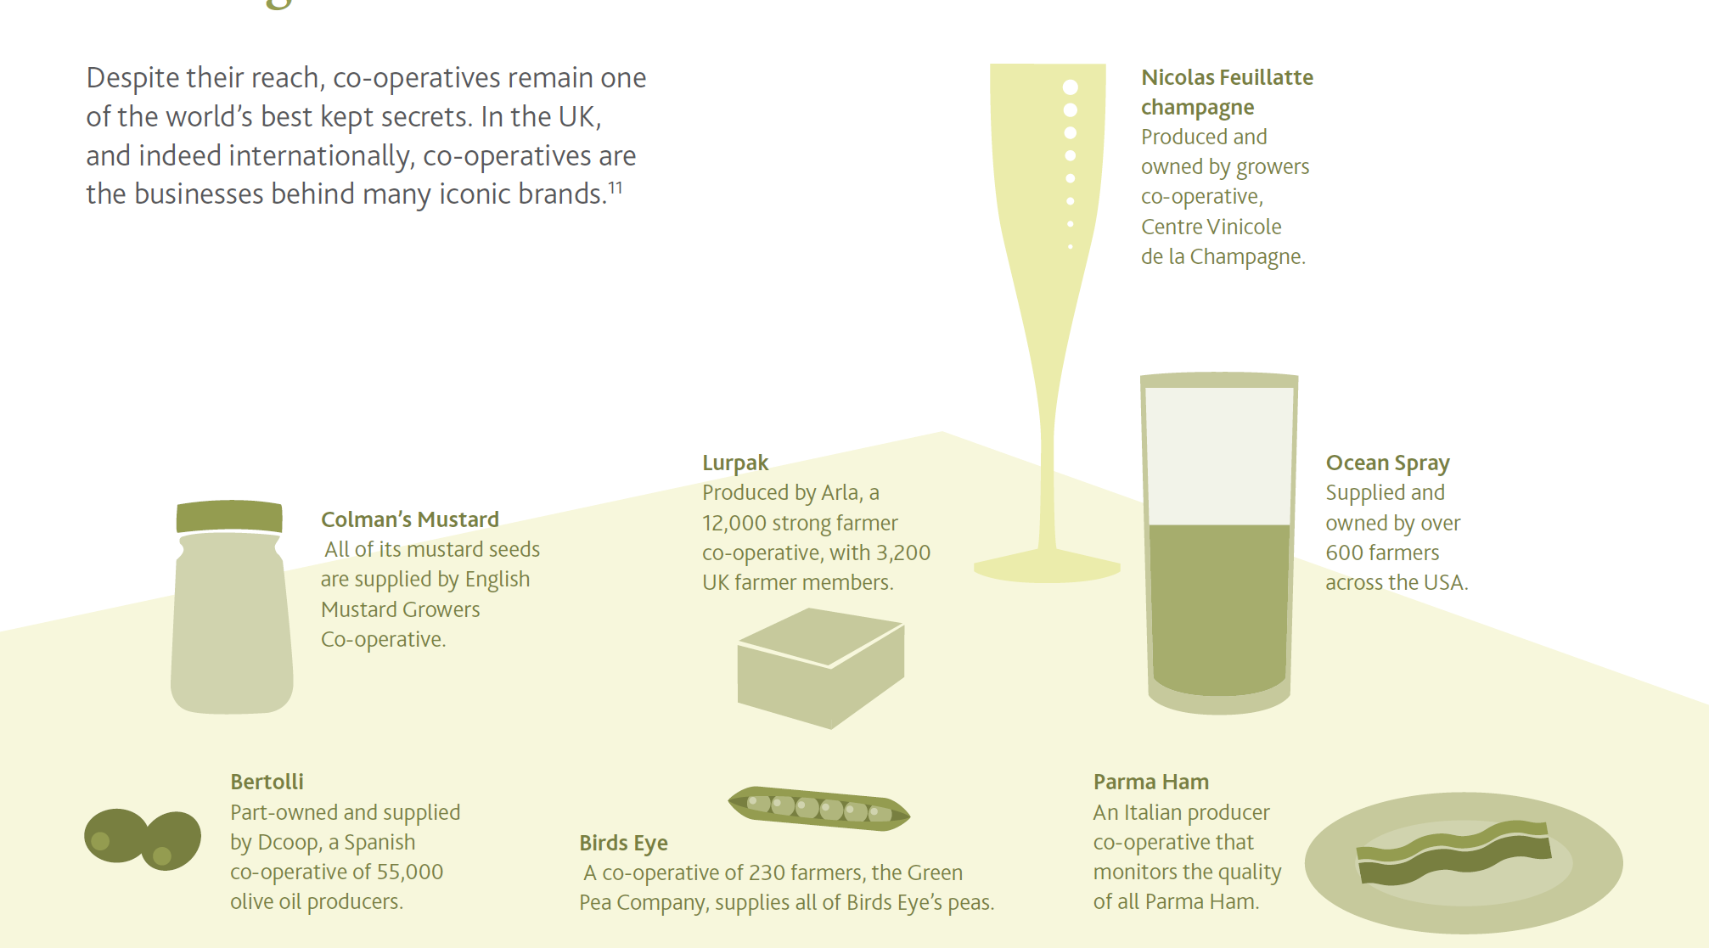

Slide 3
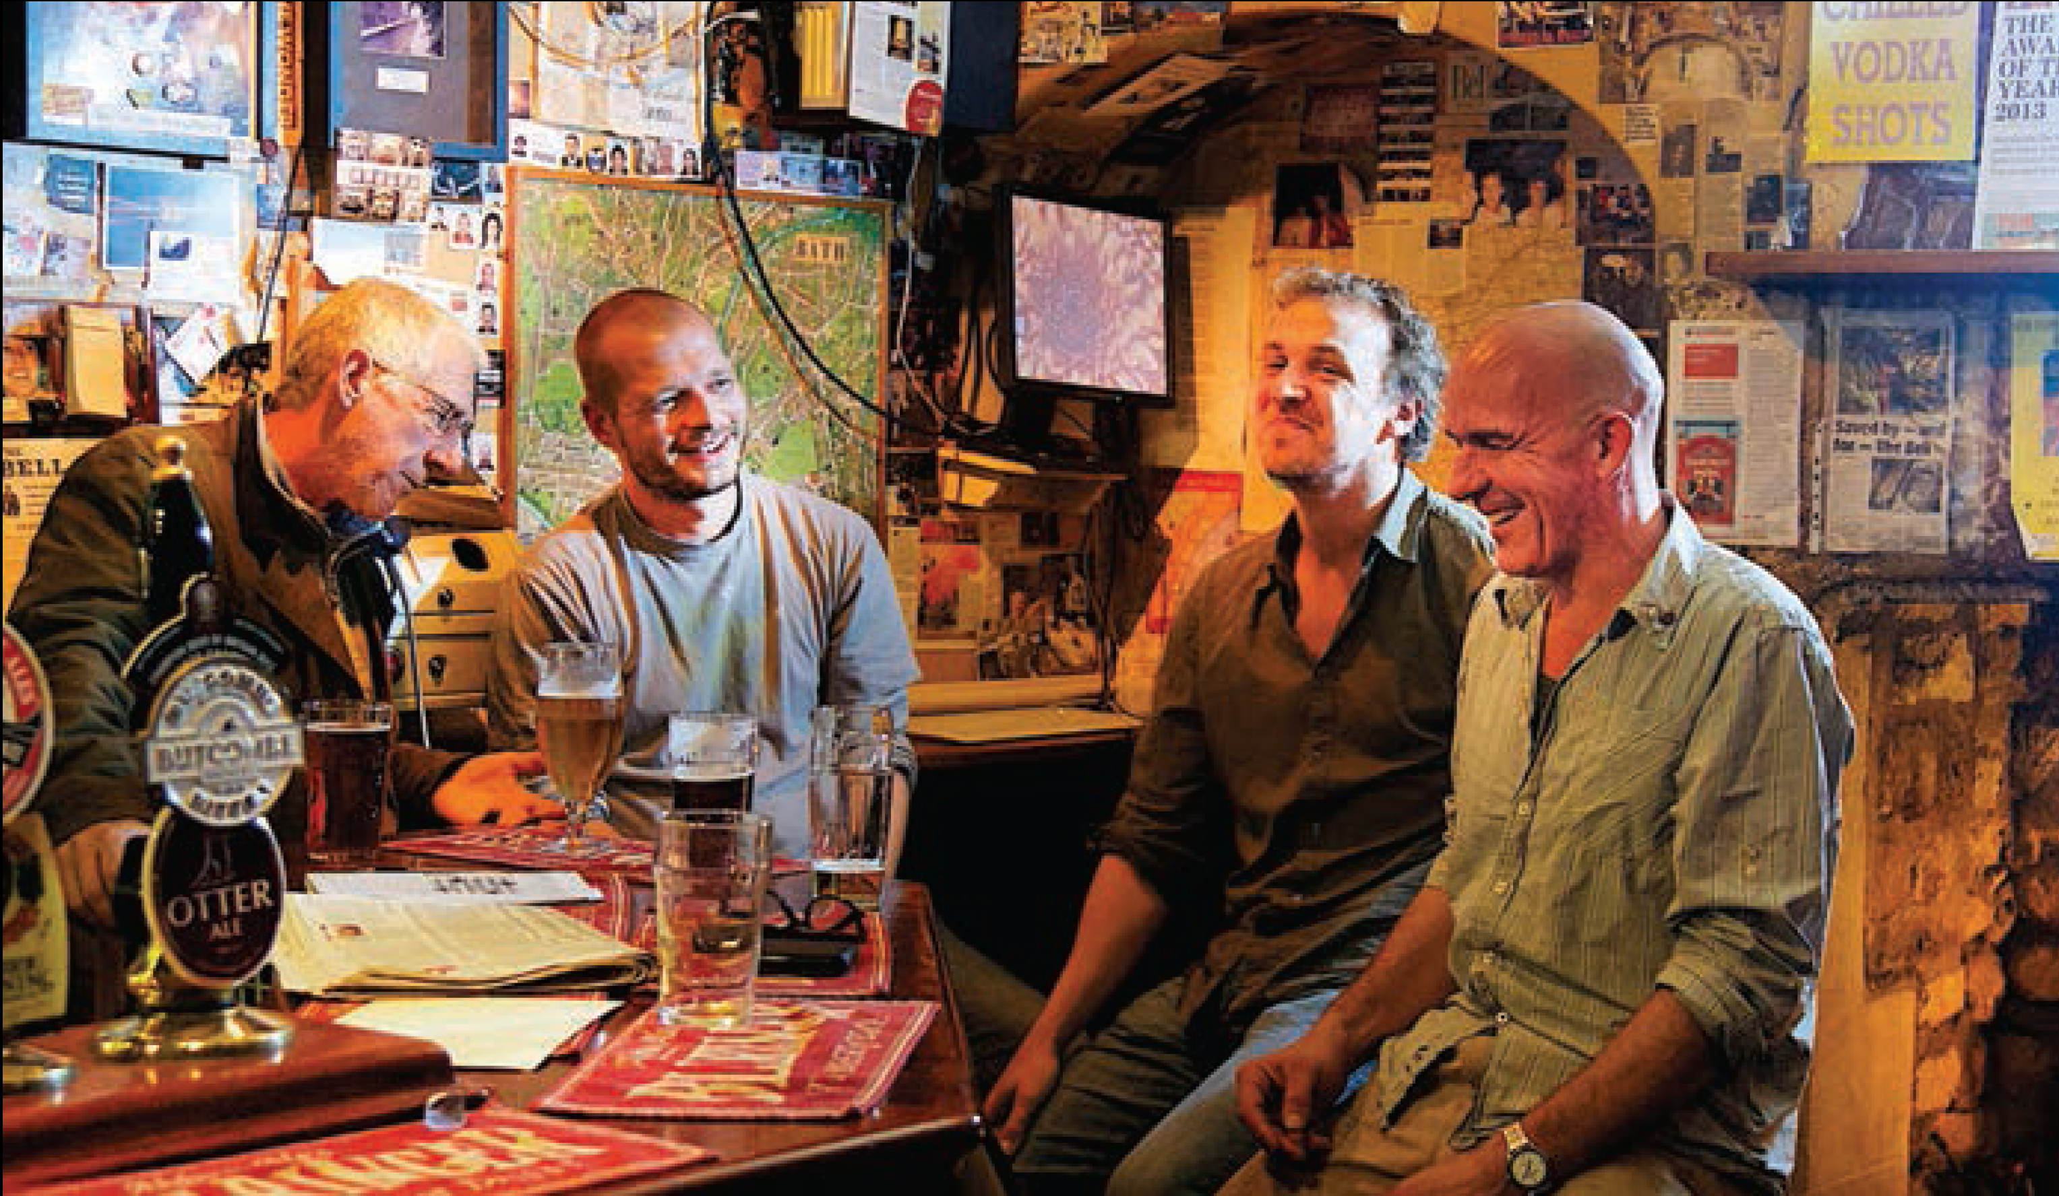

Slide 4
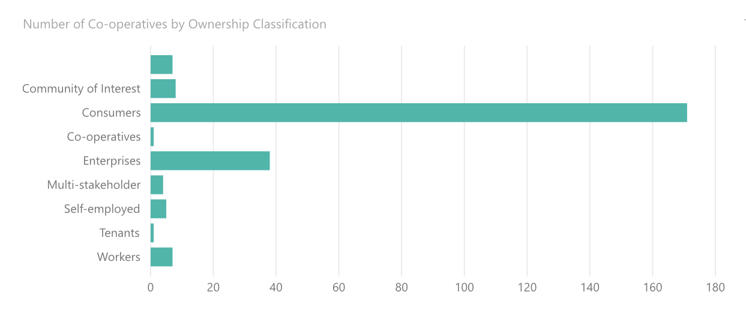
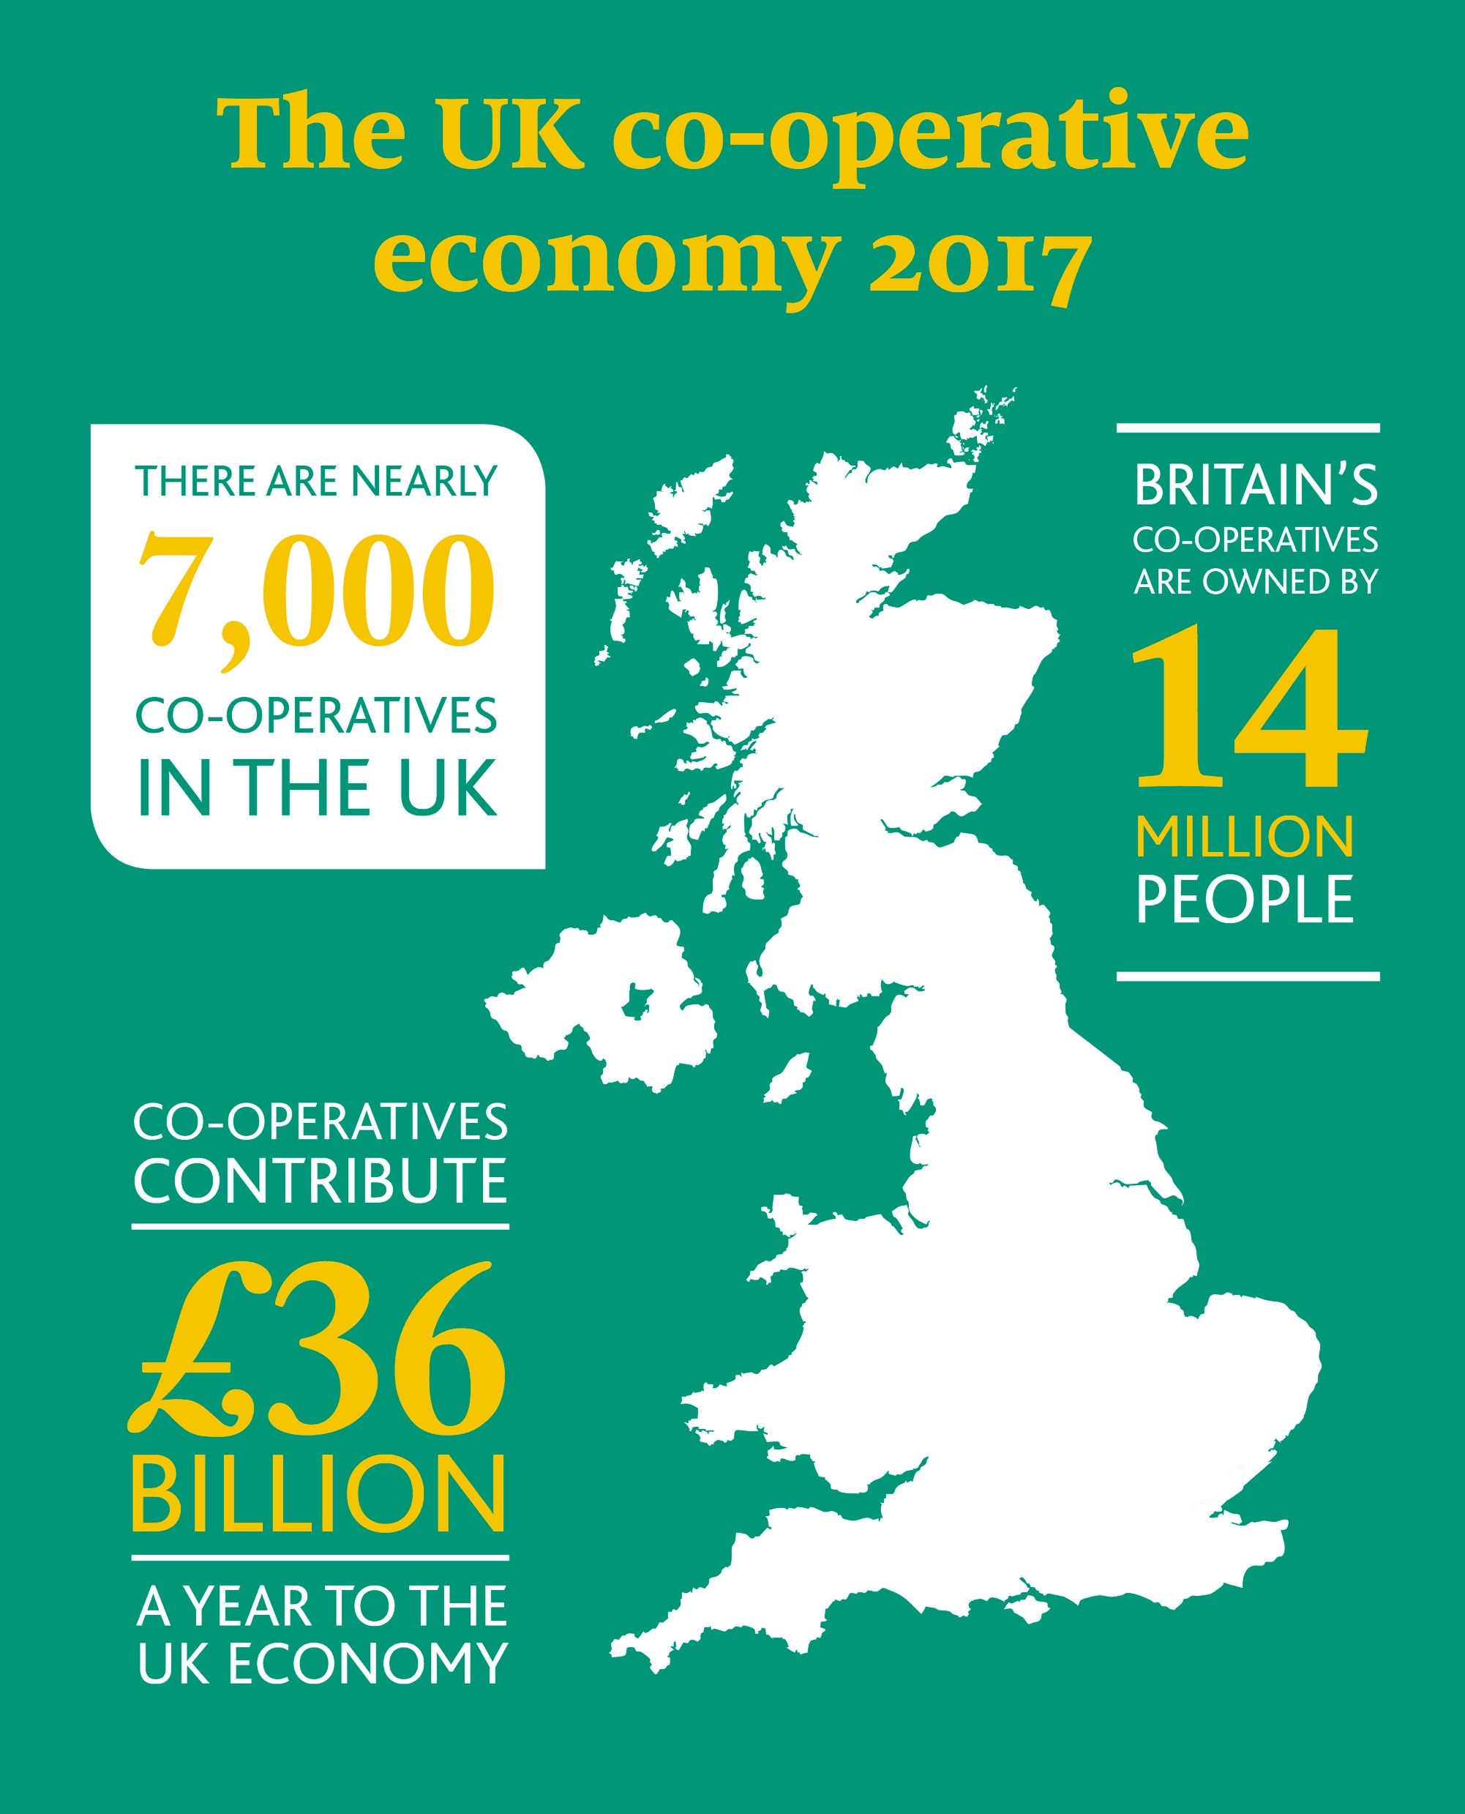

Slide 5
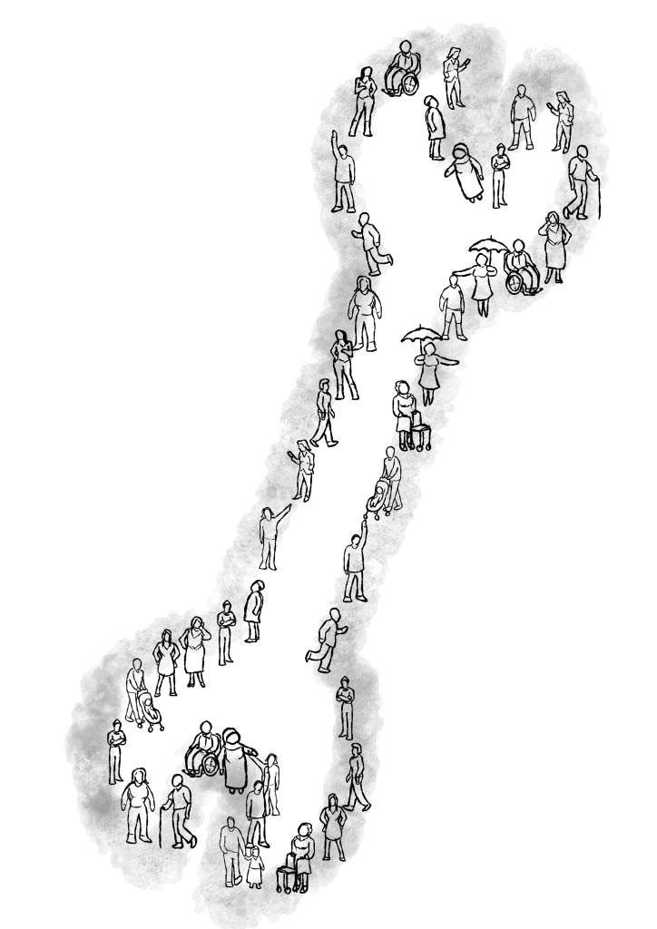
Democracy is a way to surface new ideas
In praise of democracy
Democracy is a way to get things done
Democracy is a way to bring people together

Slide 7
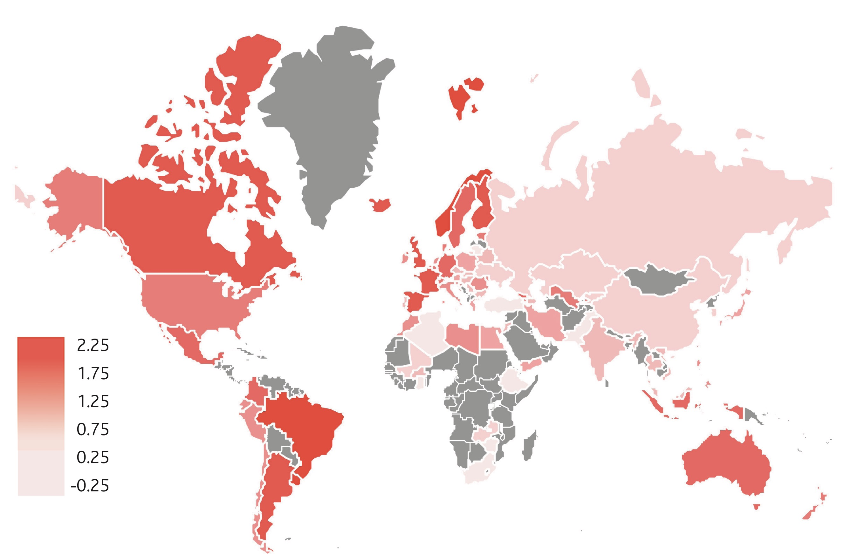

Slide 10
The Co-operative Bank is supporting business support progamme, The Hive
The Co-op College is launching the Future Pioneers Fund
A new network, CoTech aims to create 100,000 jobs by 2030
Unicorn Grocery is piloting a new Replication Lab
Notes:
There are some incredible initiatives bubbling up already, and the strategy is an invitation for you and your co-op to find ways to help us deliver the strategy that best fit

Slide 11
The power of co-operation
Ed Mayo @edmayo1 #coops

