Slide 1



BUILDING HOPE & COOPERATION!

Slide 2

Helping to promote & grow
Co-op Alternatives through:
Digitally –monthly website updates
MailChimp email marketing
Social platforms
Communications – PR – media releases
Design – updating generic A5 flyer
new A6 postcards

Slide 3


Slide 4
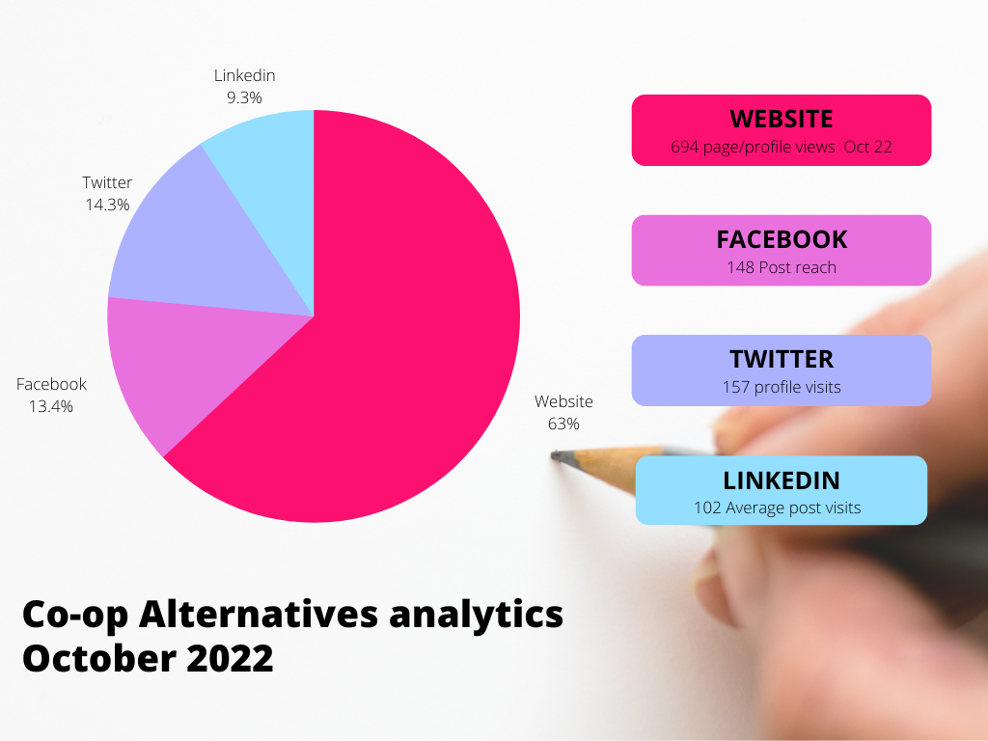

Slide 5
Supporting Co-ops
Edenderry Village Energy
new logo

Slide 6

Supporting Co-ops
Building on shared construction approach
Northern Construction Co-op logo

Slide 7





Supporting Co-ops
Logo, flyer, short social media video, PR – Cultivating Community Farming

Slide 8
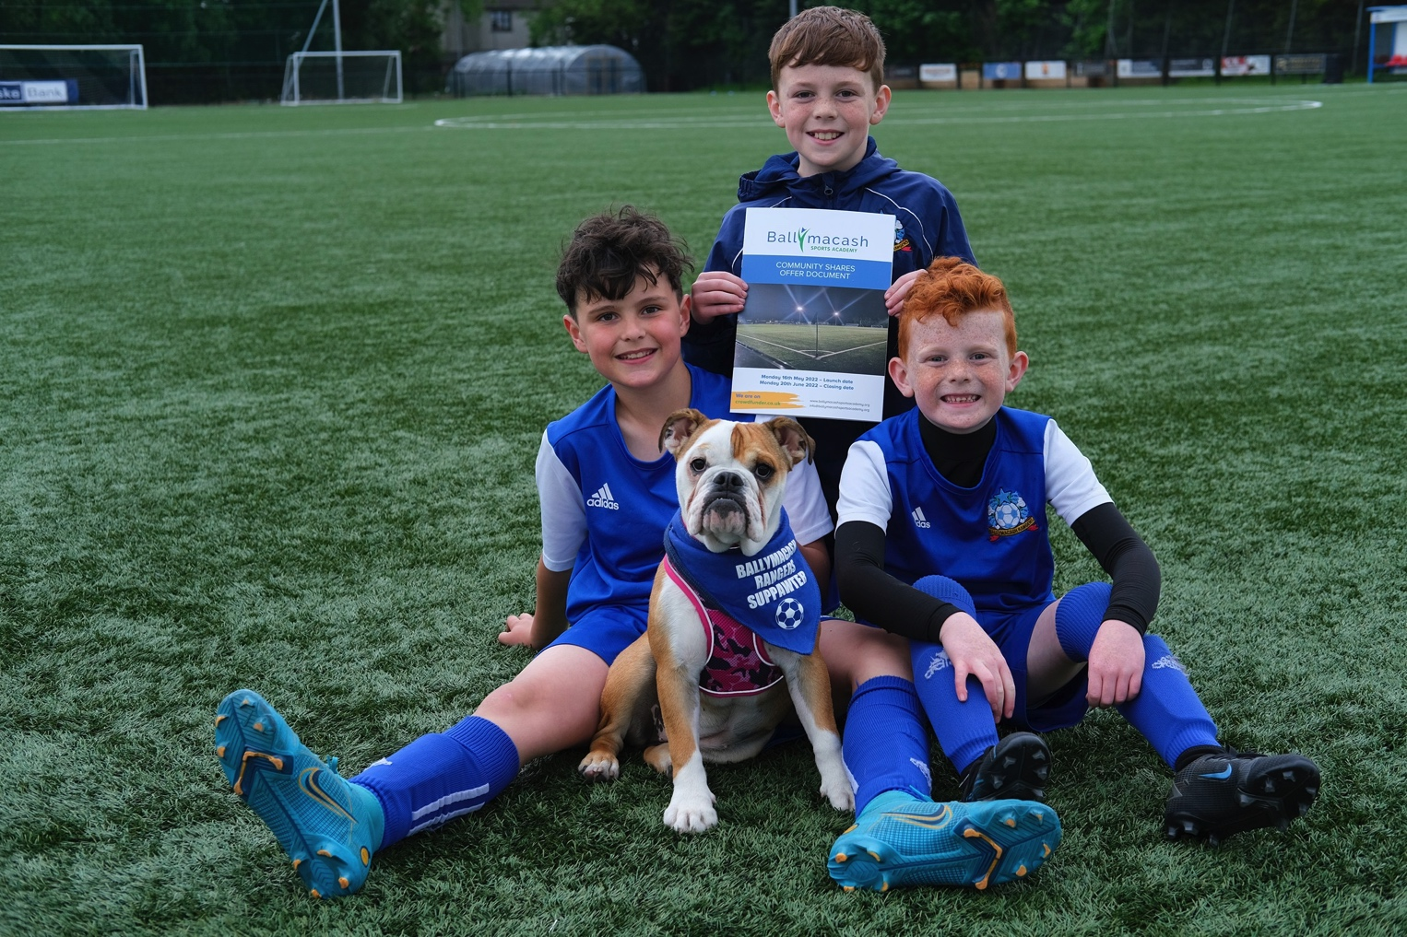
Supporting Co-ops
Sports for all!
Ballymacash Sports Academy - PR
Top media Tweet earned 76 impressions
Be part of Ballymacash Sports Academy share offer! Closes Mon 20 June 2022 ‪crowdfunder.co.uk/p/community-hu…
or visit ‪ballymacashsportsacademy.org
‪#Coopalts ‪@bcashsports ‪pic.twitter.com/drckNf29ds

Slide 9

Carbon-free Christmas wishes!

Slide 10


Co-operatives –all about community
Inclusive, Active & Forward-Moving
Here’s to more of the same in 2023 . . .
Co-op Alternatives A6 postcard

Slide 11

Celebrating Co-op Fortnight with the Big Reveal!
Daily 30’ video posts presented by Co-op Alternatives Norbert penguin showcasing just some of Northern Ireland’s Co-ops
Today meet Drumlin Wind Power – https://youtu.be/89FiBWJwpOs

