Slide 1

Co-operative Alternatives
9th Annual General Meeting
11/11/2022
Report to the Members
Tiziana O’Hara

Slide 2
What did we do in 2021
4 New registered co-ops
Over 200 hours of Mentoring and Coaching to emerging co-ops
10 Webinars (6 training + 4 awareness raising)
1 community share offer: Ballymacash Sports Academy
Start working with 10 community farming projects
Continued working on community energy: webinars and funding bids

Slide 3
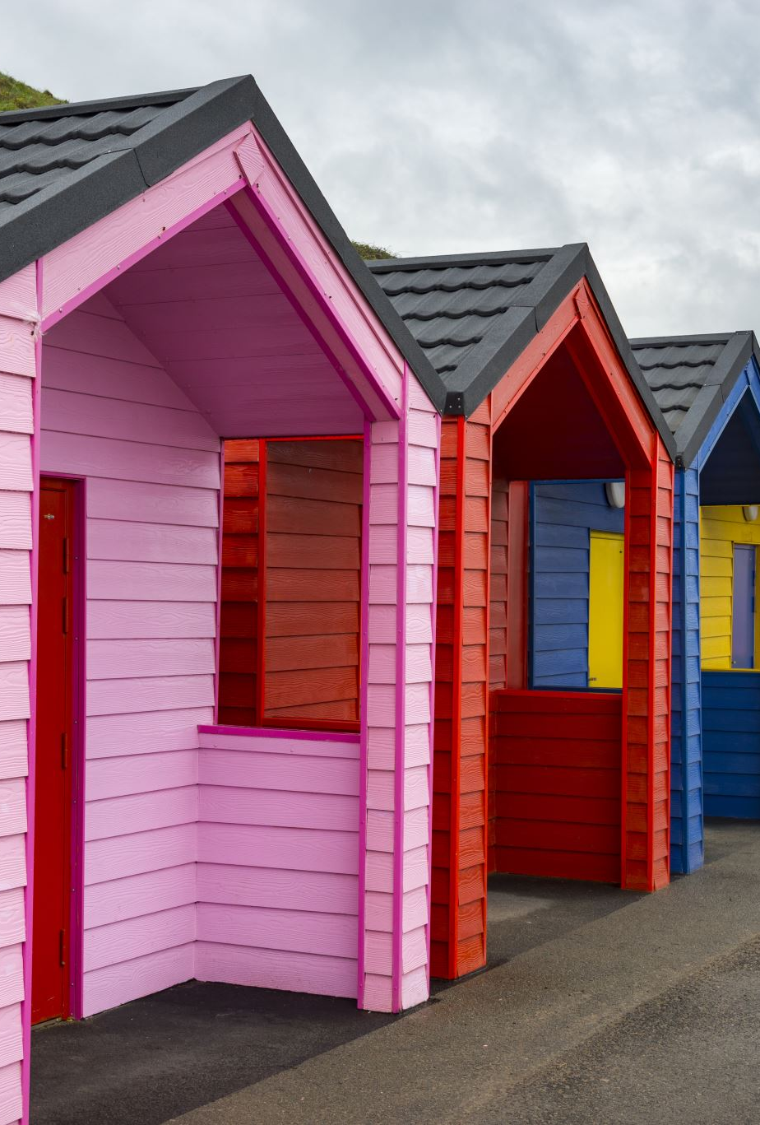
New co-ops
2021 – 2022
  Rabble Co-op (reg 9/07/2021)
  Edenderry Village Energy (reg 15/09/2021)
  Azora Community Benefit Society (reg 6/10/2021)
  Belfast Co-Housing Mutual Home Ownership (reg 22/09/2021)

Slide 4







Our support programmes

Slide 5






Who we co-operate with in 2021

Slide 6

Our Associates
Gill McNeill (Joined Dec 2020)
Our Directors
Tony McQuillan
Robert Heslip
Tiziana O’Hara

Slide 7
THANK YOU!

