Slide 1

Co-operative Alternatives
8th Annual General Meeting
5/10/2021
Report to the Members
Tiziana O’Hara

Slide 2
What did we do in 2020
4 New registered co-ops
175 hours of Mentoring and Coaching to 8 co-ops
9 Webinars with
1 Podcast with Combination NI
3 Outreach events

Slide 3




New co-ops

Slide 4







Our support programmes

Slide 5
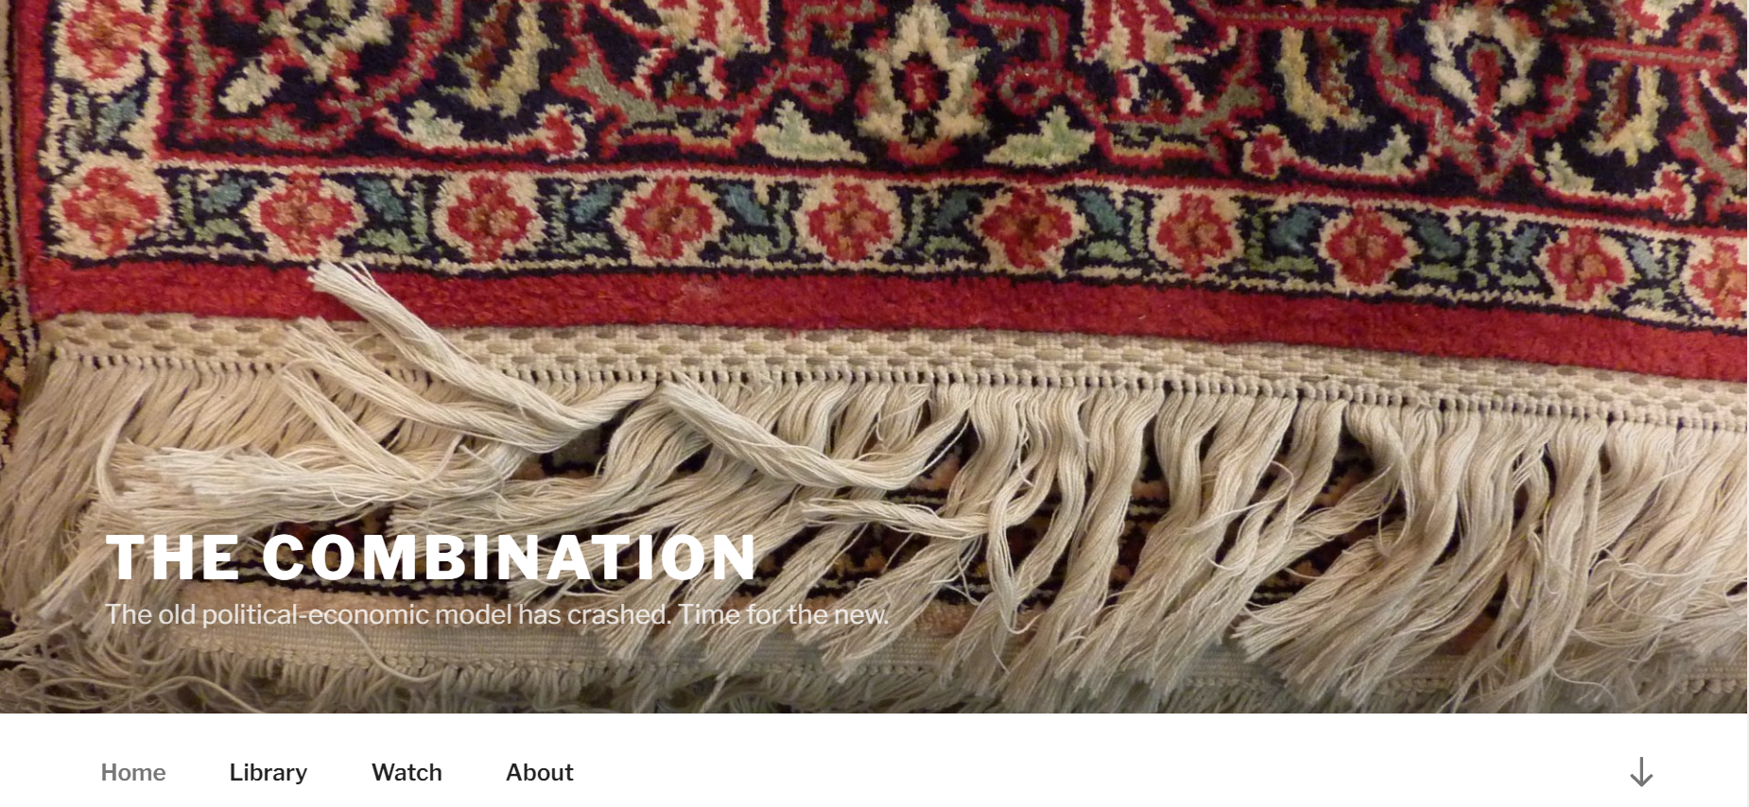





Who we co-operate with in 2020

Slide 6
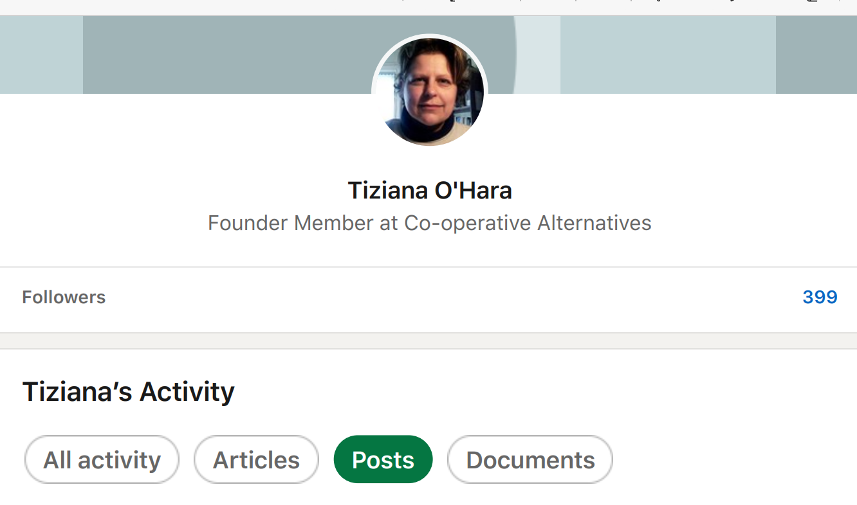

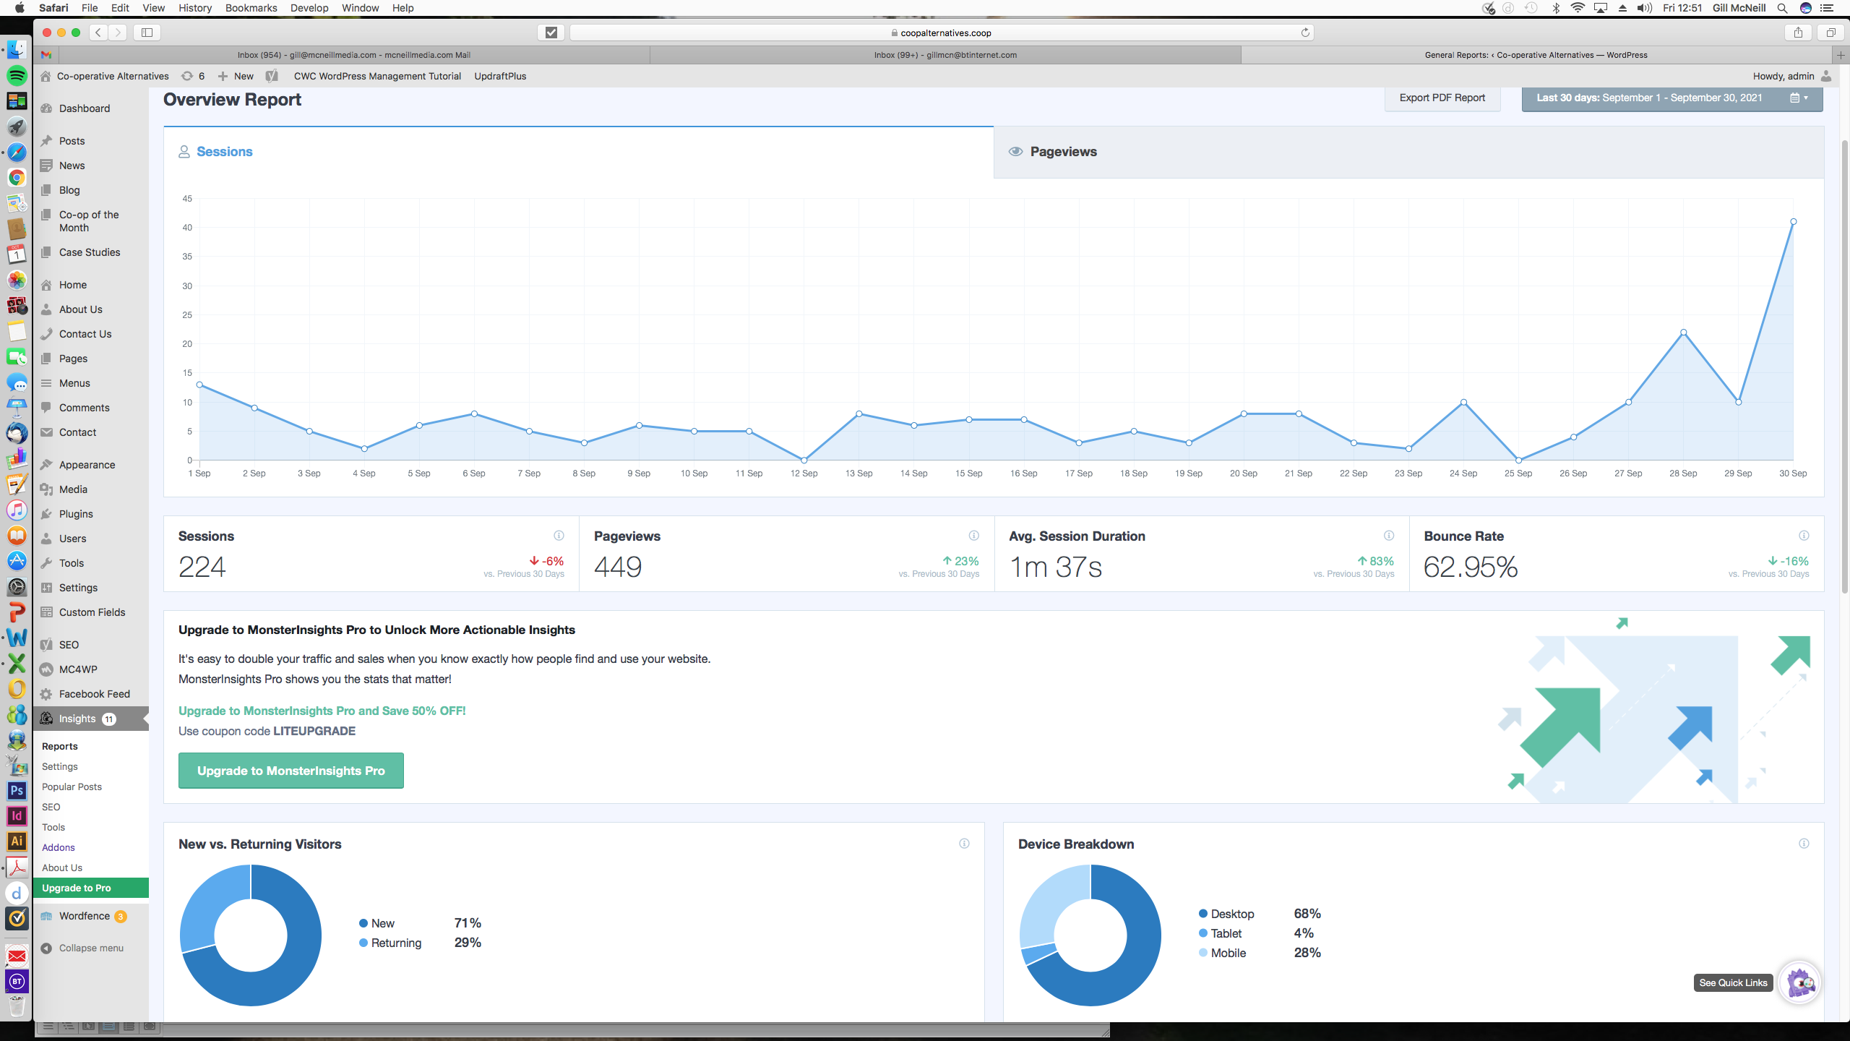
Impacts
Social media added Linkedin
Website added Researches, Case studies etc.
E-news from Sept 2020

Slide 7
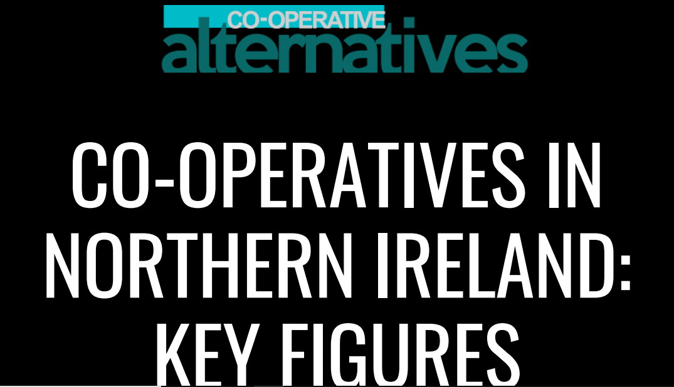
Policy and Research
2 policy briefings :
  Belfast Inclusive Growth Strategy: a Co-operative Perspective
  Co-operative-Led Solutions to addressing The Climate Emergency
1 research of the sector
  214 Co-ops
    145 credit unions
    69 societies
    766,847 members
    1bn turnover
    Over 3000 employees
Convenor of the Drumlin and Nice Joint Committee on community energy

Slide 8

Our Associates
Ellie Perrin (Joined Aug 2020)
Gill McNeill (Joined Dec 2020)
Mary McManus (Joined Mar 2021)

Slide 9
Our Directors
Tony McQuillan
Robert Heslip
Tiziana O’Hara

Slide 10
THANK YOU!

