Slide 1
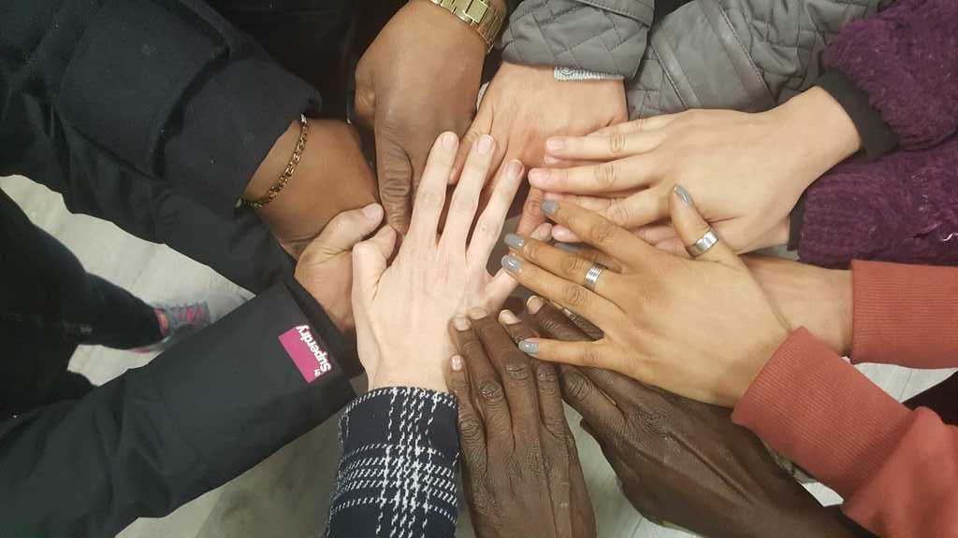
Ireland’s first Migrant-Led Care Workers Cooperative
Notes:
The Great Care Coop is funded under the ESF women’s entrepreneurship stream – MRCI applied for a funding to tackle labour market disadvantage experienced by Migrant own in care .
We knew we had the skills, analysis and expertise to design a better model, that wasw grounded in human rights and Equality framework.
WE set up a working group of 8 skilled women with MRCI and began the process of developing the worker owned social enterprise.
New departure for MRCI – no experience, coming from community development background, but armed with commitment and determination and a strong ivison for a worker owned model.
“ decades of leadership and campaigning work, the working group had capacity to deliver, powersharing process.
Buurtzorg + Home Care Worker Assosication Bronx.

Slide 2
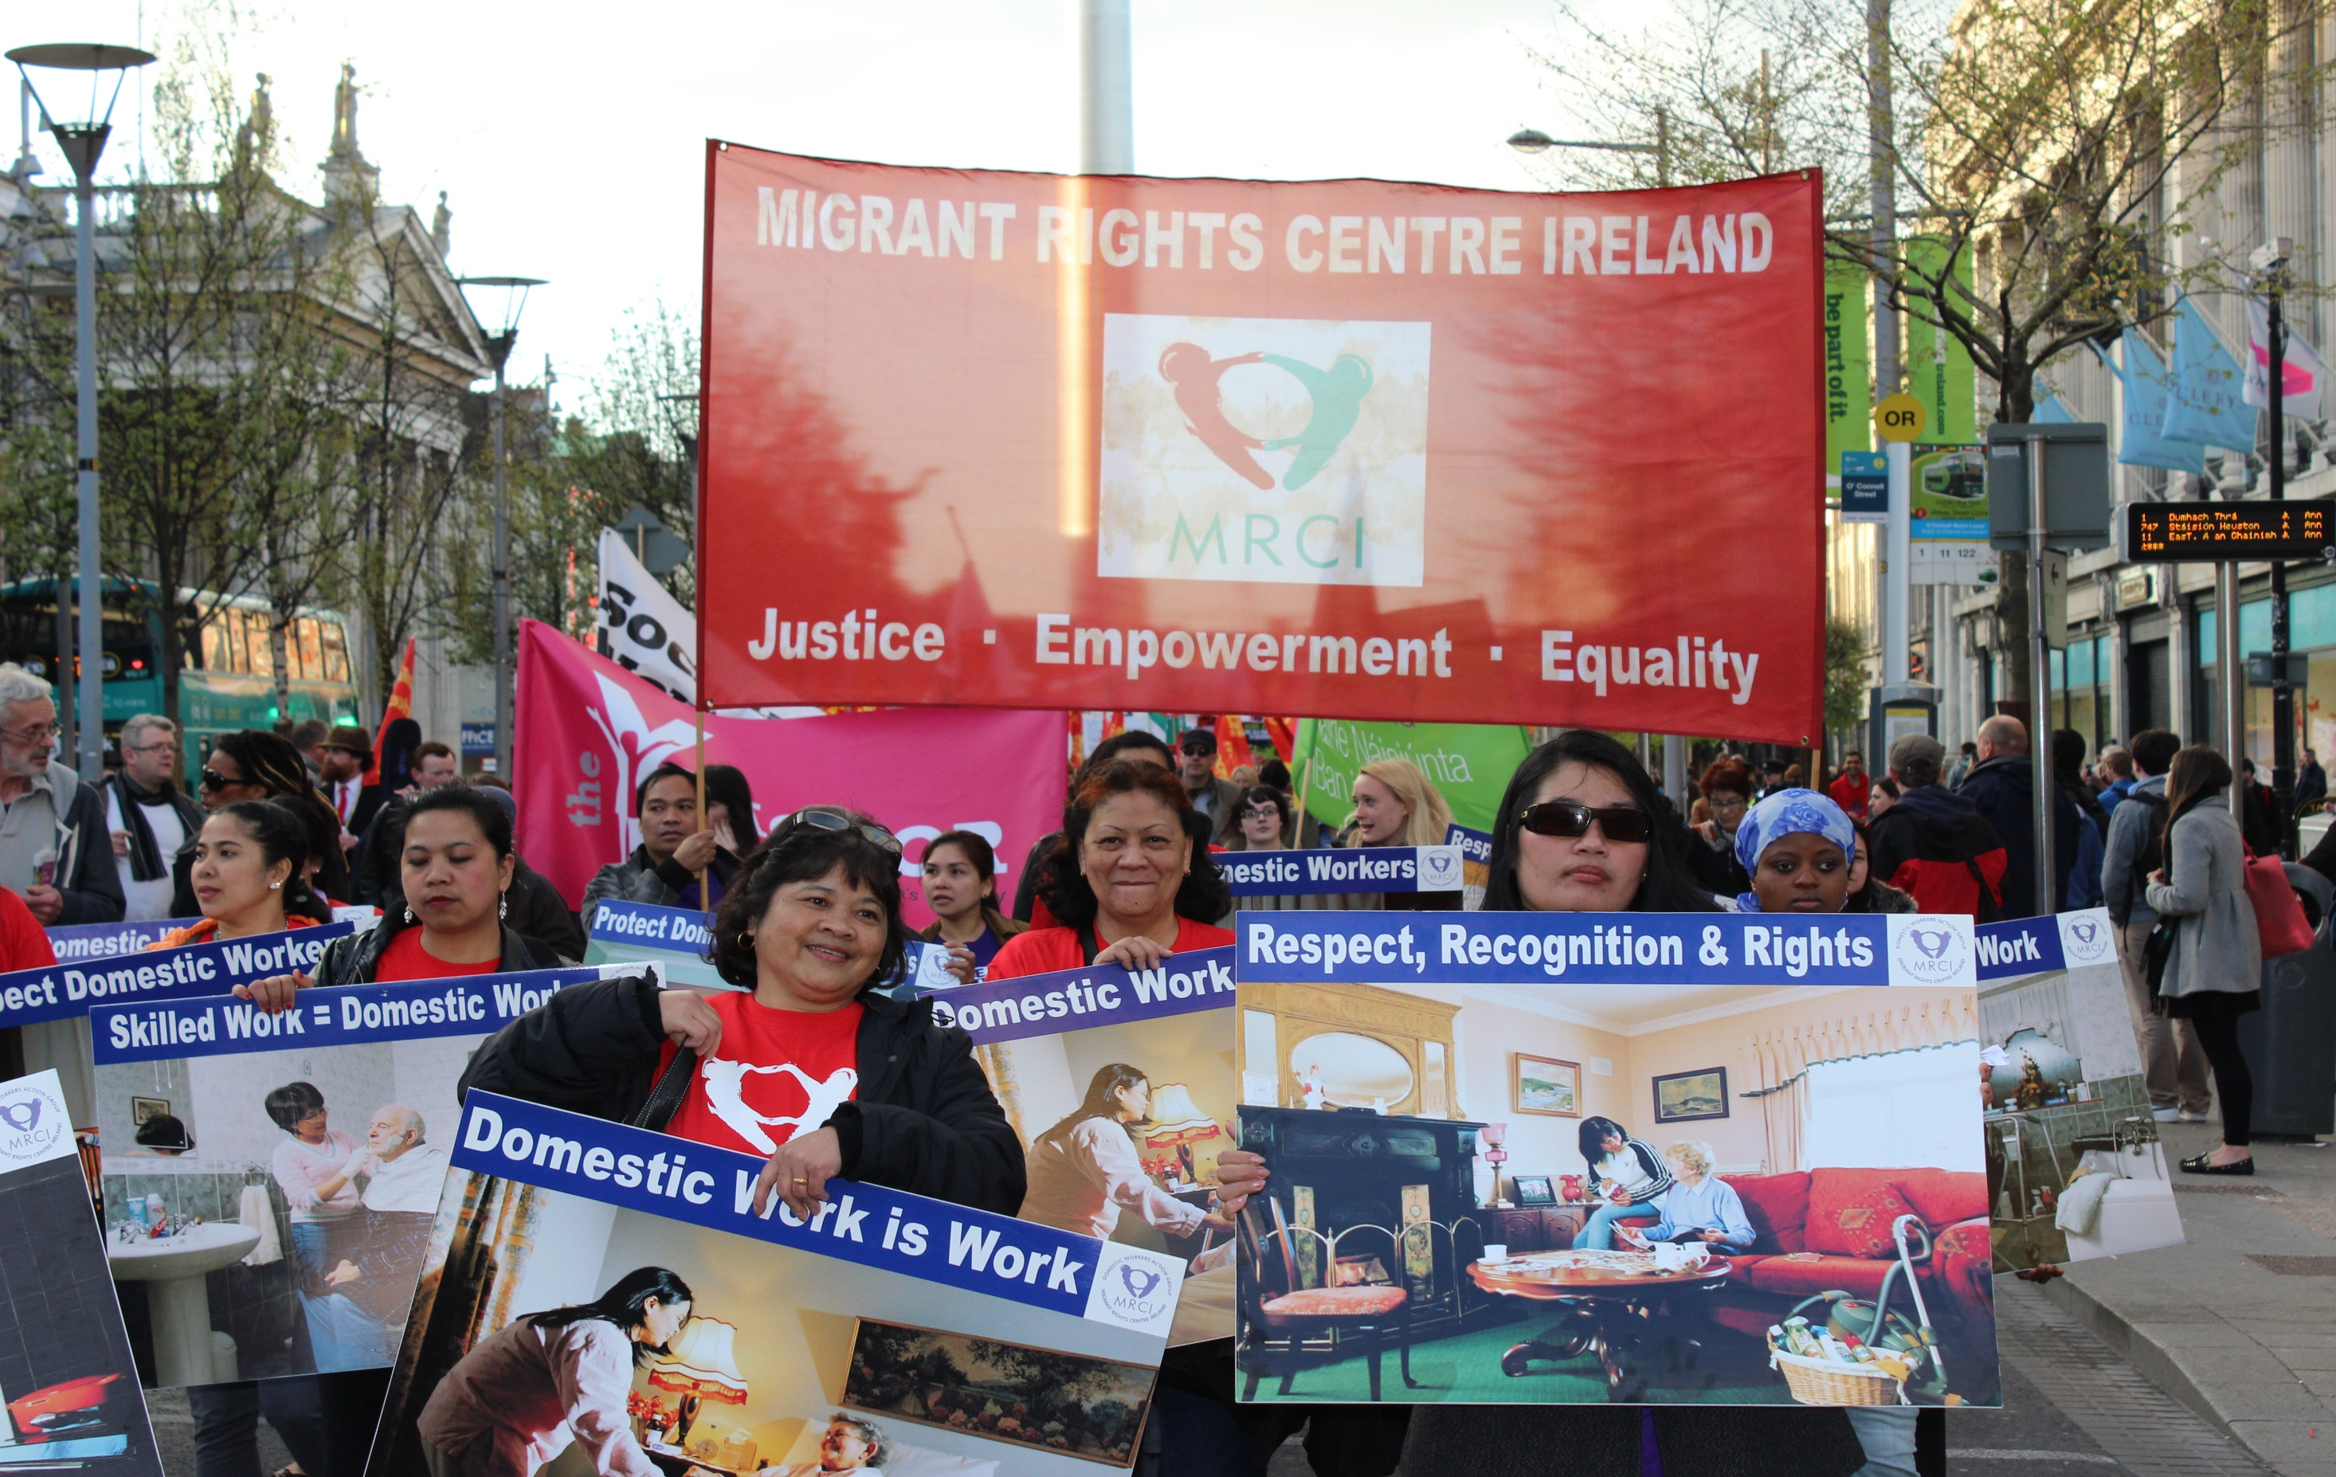
Notes:
First of its Kind
Underpinned by Community Development model, empowerment, participation, collective action
Walking the walk with Carers 18 years
Advocacy + Equitable Business Model = Real Impact

Slide 3
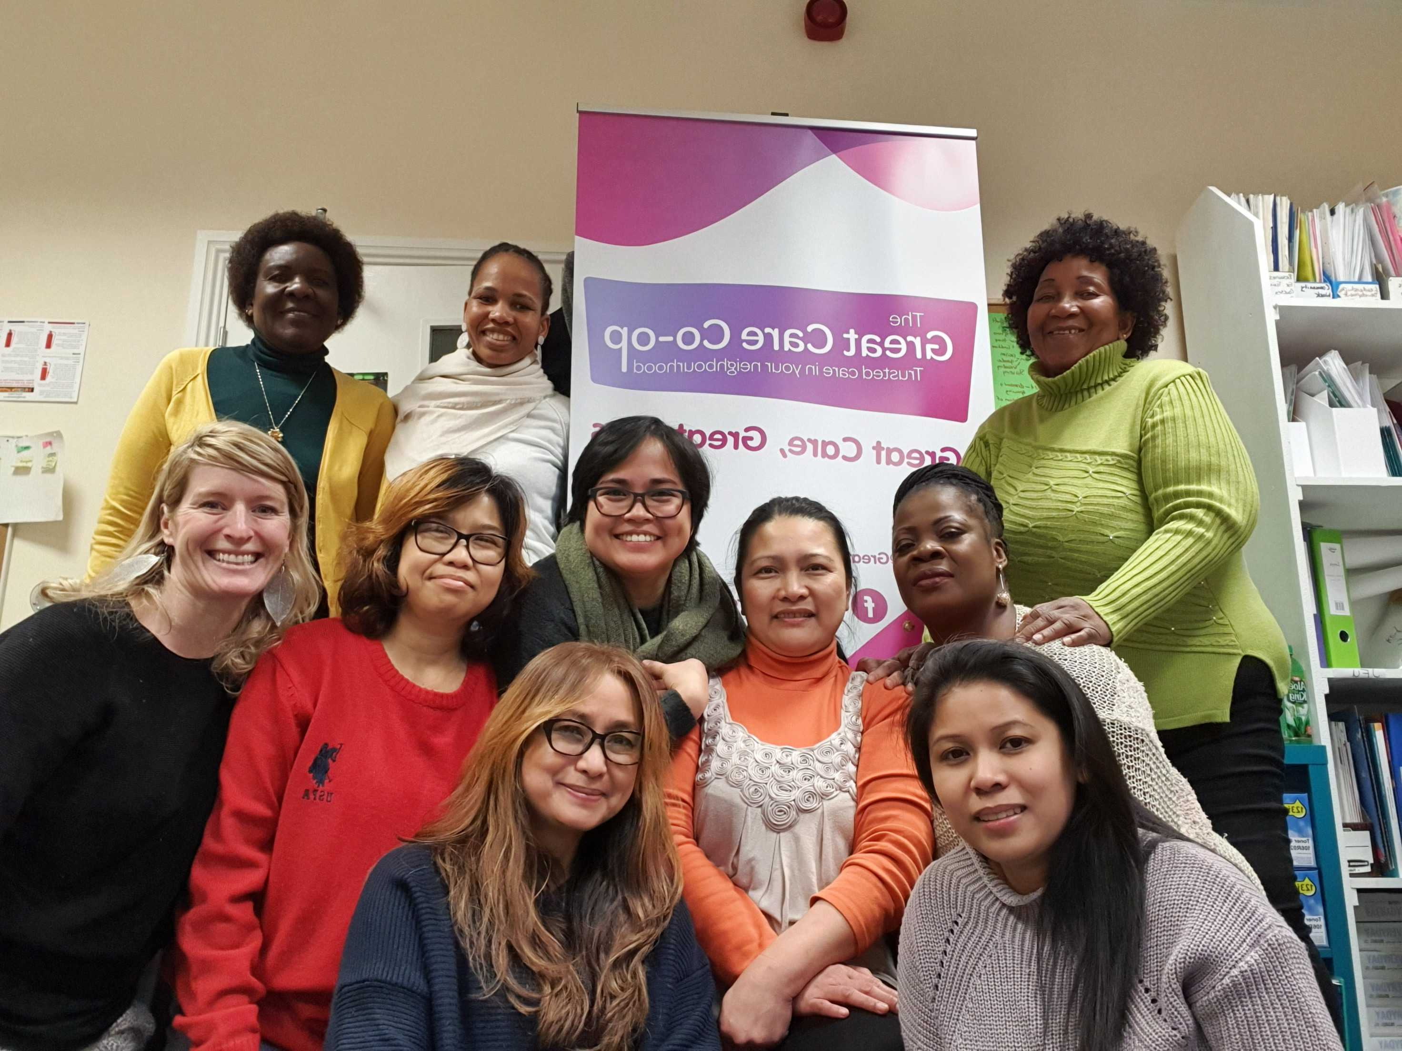

Slide 4
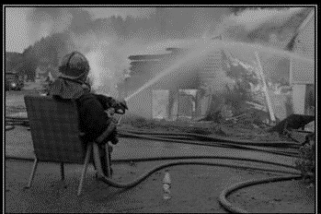
Notes:
Aoife: this is the state of play in home care today – It is a growth sector with large profits, but the system is broken and failing clients, families and carers, there are over 8000 on HSE waiting lists, and there is growing unmet need in the community and carers are burning out fast.

Slide 5
HIERARCHICAL
WORKER OWNED
PROFIT DRIVEN
NOT FOR PROFIT
TASK FOCUS CARE
SELF MANAGED TEAMS
LOW SALARIES
GREAT JOBS
ISOLATED CARERS
MIGRANTS RIGHTS
CURRENT CARE MODEL
NEW CARE MODEL
Notes:
A paradigm shift

Slide 6
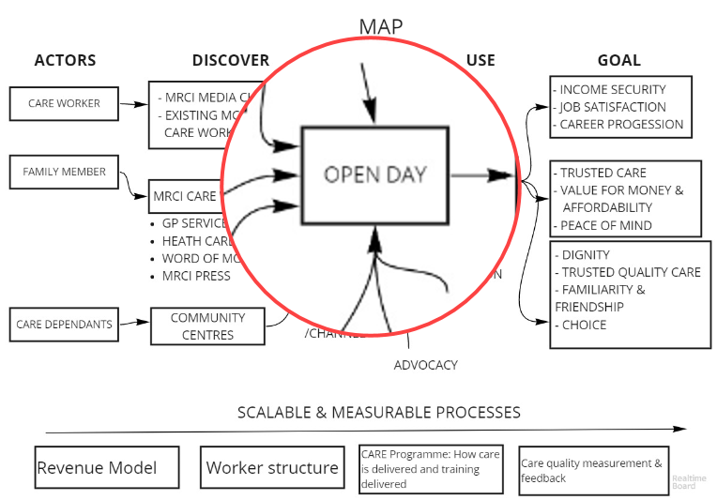
Understand
The Target
Sprint Question: Test whether the attributes of a worker-owned social enterprise would influence family and care dependants in
making decisions about care. In other words are those attributes
a solid value proposition?
About: The target is what we test and how.
The target is determined from the sprint question and where on the map the question belongs.
It is agreed with the group and the decider.
Target: Test the sprint question through an organised open day that simulates an actual carer meeting with a care dependant and families. The open day creates an ‘as-if’ environment, simulating the venture in the real.

Slide 7
High-Level Findings
The sprint determined that the attributes of ‘worker-owned’ value proposition* carried most risk and was the most important to test.
If the value proposition resonates, then everything else drives forward from this.
User testing clearly showed that the worker-owned value proposition and the model which it relies providing autonomy, flexibility and responsibility is a clear and positive differentiator when presented.
It’s recommended that MRCI pilot the model and accelerate their plans for local launch in order to learn to execute at scale.
*A value proposition tells people why doing business with you is better than going anywhere else

Slide 8
How are we Different to the other companies?
Notes:
GCC is a paradigm shift. It is pro workers, pro migrant, pro migrant and pro care. It flips the current model of care on its head to provide a new model af employment and care provision that is grounded in a human rights and equality framework.

Slide 10
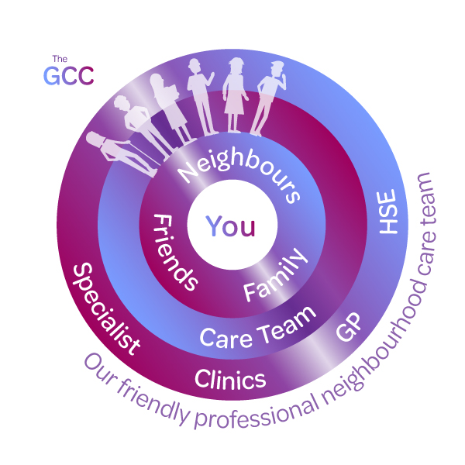
Our Model:

Slide 11
Benefits
Carers own the co-op, get a vote in business-related decisions, have better pay, conditions and benefits, making happy carers.
The team all live and work locally. We know the community and services to help keep clients connected.
Clients have direct lines of communication with us. When our clients voice concern or feedback to us, that feedback can have immediate impact on how we operate and grow.
Our clients make up a lot of the culture and heart of our cooperative in the same way as the caregivers.
We firmly believe that the people who own and control care organisations should be the people who give care and use care.
We are a not for profit. All profit is reinvested into improving care, training and education.
What’s so great about a home care workers co-op?

Slide 12
More Freedom and Responsibility
Notes:
The nurses and care givers work to enable clients to look after themselves more effectivey. This helps to reduce dependency and build confidence, as well as areducing the number of hours of professional care required, which also reduces costs.
Buurtzorg nurses don’t do things for people if they can help them to do those things for themselves. But they do things for their clients if necessary and to create better conditions for them to care for themselves.
So, for example, spending an hour helping a client learn how to administer his own insulin is an hour very well spent because it means many quarters of an hour will be saved later and the client is then more empowered.

Slide 13
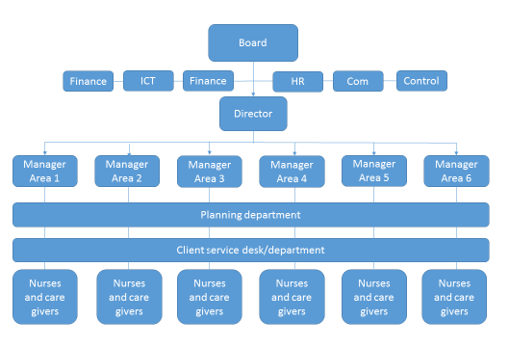
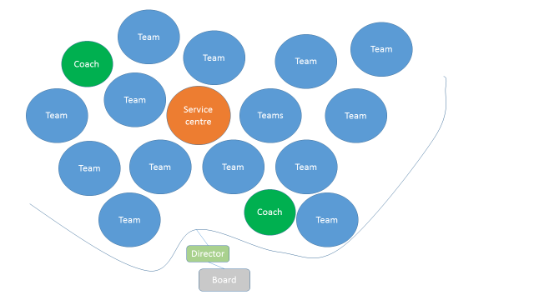
The Networked Organisation

Slide 14
This is how we do it….

Slide 16
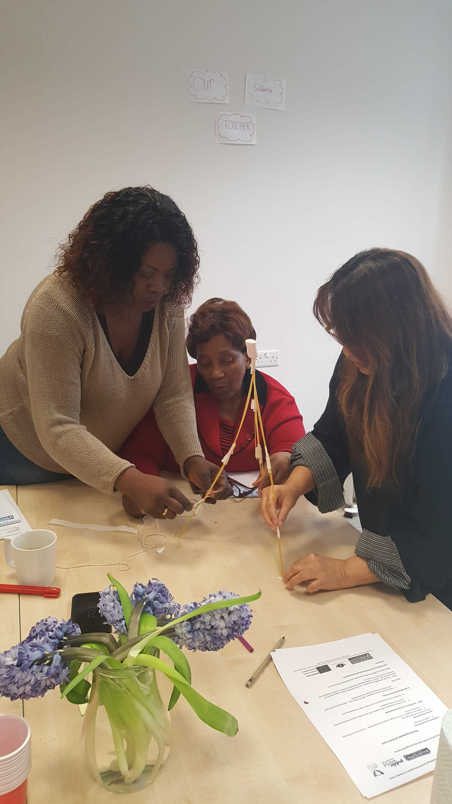
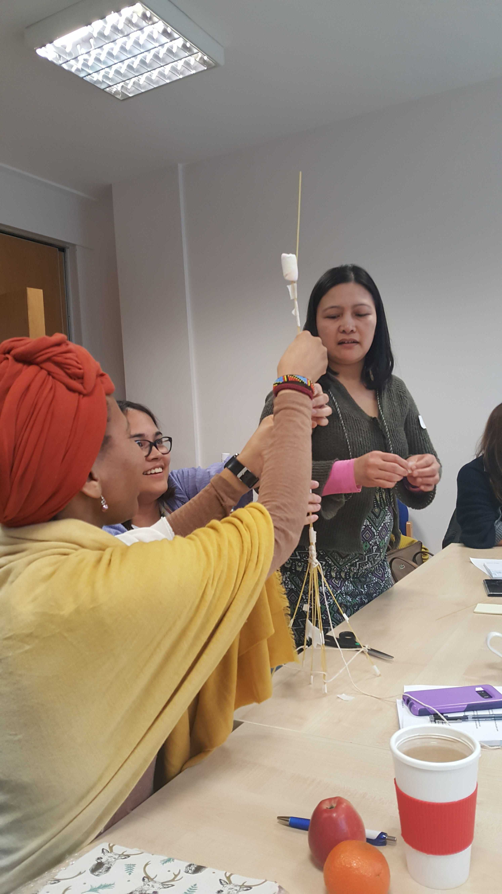

Slide 17
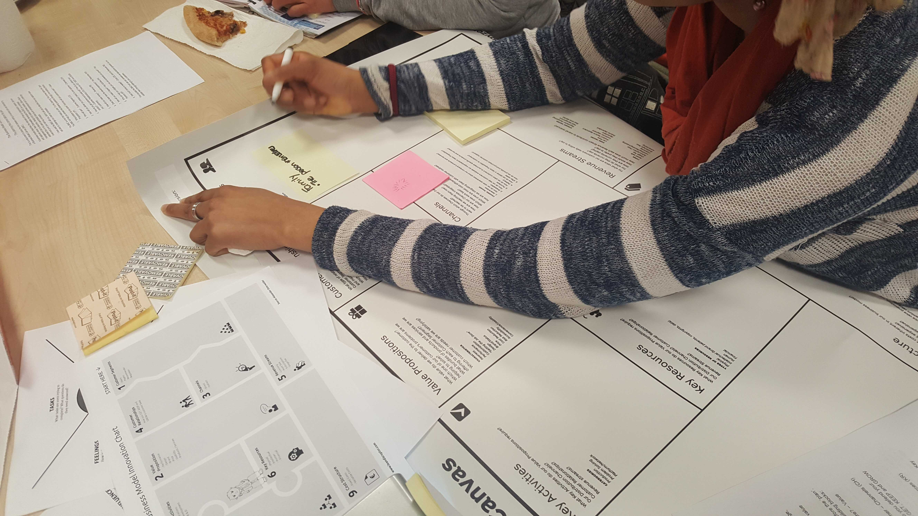

Slide 19
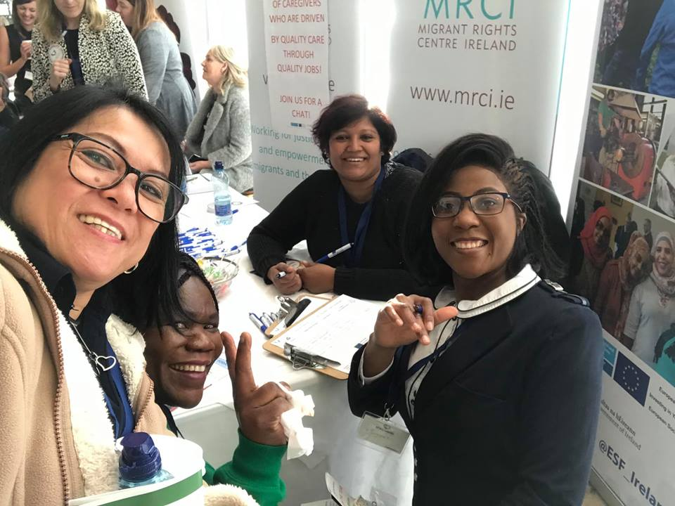

Slide 20
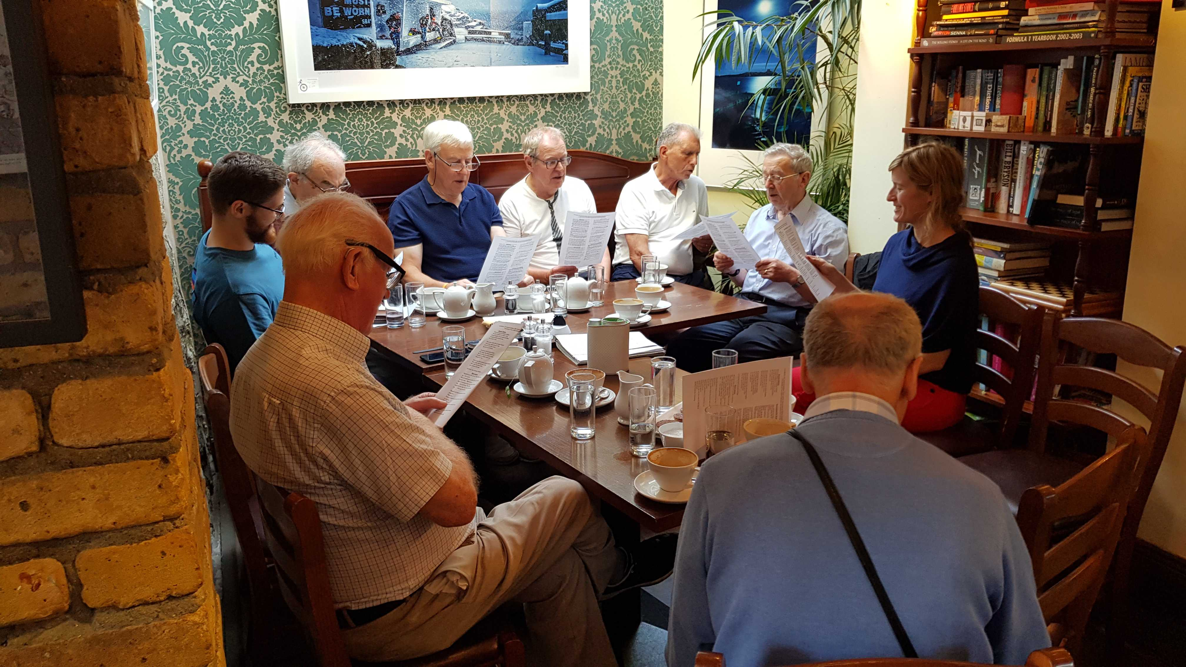

Slide 23
#CarersTogether
www.tgcc.ie
info@tgcc.ie
@GreatCareCoop
@GreatCare
info@tgcc.ie

