Slide 1
The TRANSFORMATIVE POWER OF
Co-opERATIVES
Co-operatives and the local economy - Ellie Perrin

Slide 2
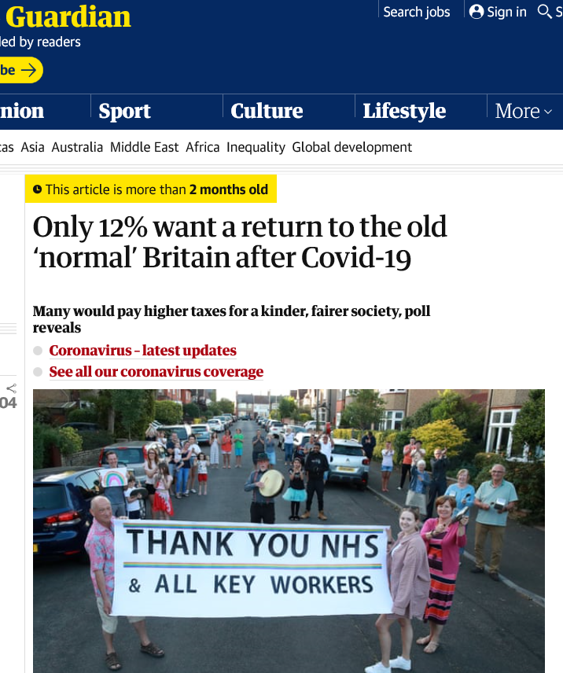
BUSINESS AS USUAL or BUILDING BACK BETTER?
In the wake of Covid-19, is the local economic policy fit for purpose?
Can we embed environmental and social concerns into economic recovery programmes?
Do we want business as usual or do we want to build back better?
  What are the implications of business as usual:
    Temperature increase of 3°C
    Placing the cost of the pandemic on workers and communities

Slide 3
Tackling socio-economic inequalities: 56,000 residents in poverty, 7,322 people in housing stress…
Climate emergency declared by Belfast in 2019.
Inclusivity and resilience: what role for co-operatives?

Slide 4
Co-operatives
Co-operative principles:
  Voluntary and Open Membership
  Democratic Member Control
  Member Economic Participation
  Autonomy and Independence
  Education, Training and Information
  Co-operation among Co-operatives
  Concern for Community

Slide 5
Economic and social performance long evidenced
  More resilient: survival rate in the first years of business is at least twice that of traditional firms ;
  Worker co-operatives contribute for every £1 to 35% more employment than any other business. (Co-operatives UK , 2020)
  More profitable, higher levels of happiness, trust and cohesion (NEF, 2018)

Slide 7
How can we best unleash co-operatives’ social and environmental value?
Areas for development:
      Green infrastructure projects (retrofitting houses, expanding green spaces, restoring wetlands and natural areas).
      Local regeneration through co-operatives and community land trust
      Development of co-operatives in renewable energy . Ex: NICE
      Promoting worker buyouts
            IMF predicting contraction of the Irish and British economies
            120,000 family business facing succession challenges in the next few years.

Slide 8
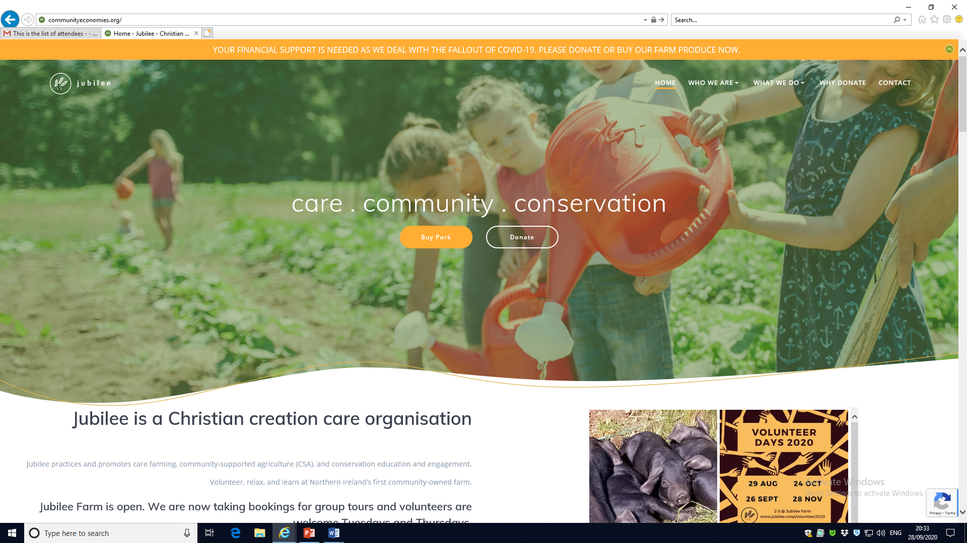

CO-operative farming and ethical consumption
Belfast Food Co-op
affordable, low waste, ethically sourced, eco-friendly, organic products
Jubilee Farm
– first community agriculture co-operative in NI

Slide 9
DEVELOPING A LOCAL Co-operative ECONOMY: our RECOMMENDATIONS
A level playing field for co-operatives
Raising the profile of co-operatives as real businesses
Tailored support through a Co-operative Development Agency
Financial Assistance and public investment
Deploying a community wealth building approach

Slide 10
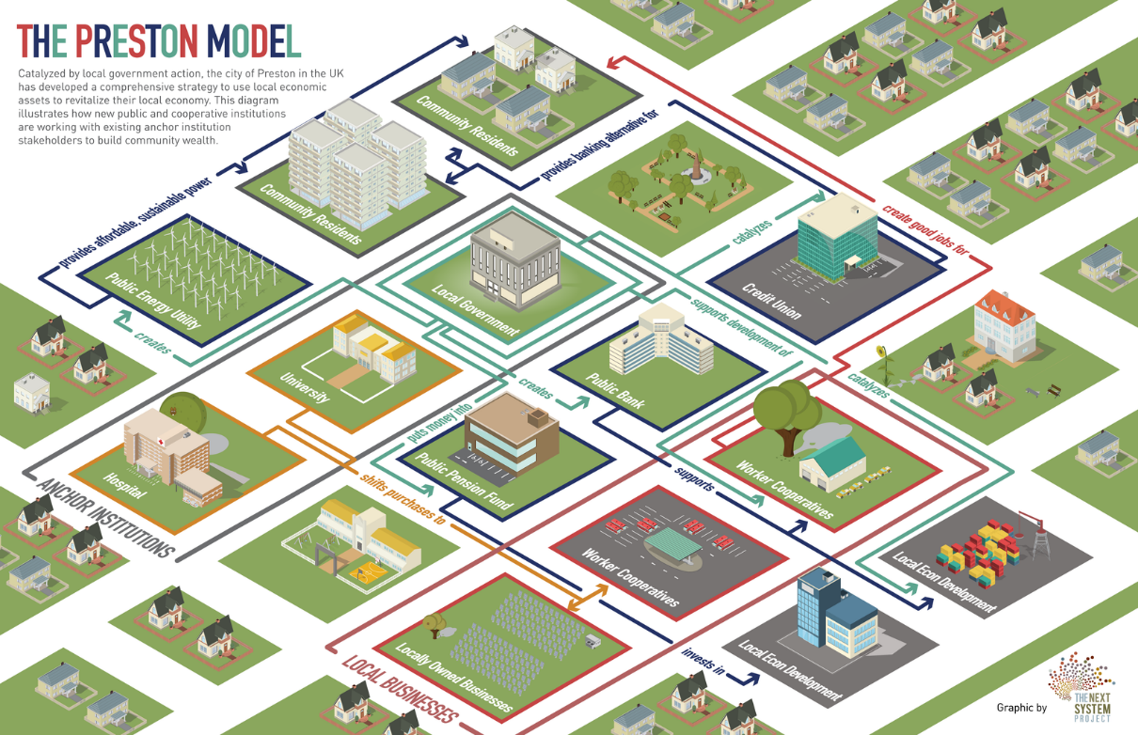
COMMUNITY WEALTH BUILDING
5 pillars of community wealth building
Progressive procurement of goods and services
Fair employment and just labour markets
Plural ownership of the economy
Socially productive use of land and property
Making financial power work for local places
The case of Preston:
A reduction of the money spent by local institutions leaving the Lancashire area from 61% to 21%.

Slide 11
Questions? ….

Slide 12
References:
Belfast City Council, Our Commitment to Inclusive Growth, November 2019 https://yoursay.belfastcity.gov.uk/chief-executives/inclusive-growth-strategy/user_uploads/446---inclusive-growth-nov2019-web-final--2.pdf
Belfast City Council, The Belfast Agenda: Your future city Belfast’s Community Plan, November 2017 https://www.belfastcity.gov.uk/council/Communityplanning/BelfastAgenda.aspx
Belfast City Council, Future Proofed City, Belfast Resilience Strategy: Draft strategy for consultation, 2020
Department for the Economy (2017), Economy 2030: A consultation on an Industrial Strategy for Northern Ireland, p44. See also Invest NI (2017), Business Strategy 2017-2021.
International Co-operative Alliance, What is a co-operative?, https://www.ica.coop/en/cooperatives/what-is-a-cooperative
New Economics Foundation (NEF), Co-operatives Unleashed: Doubling the size of the UK's co-operative sector, 2018
Co-operatives UK, Co-op Economy 2020, 2020
Co-operatives UK, We are the rebuilders: Four co-operative offers for building back better from Covid-19, June 2020;
Virginie Perotin, What do we really know about worker co-operatives?, 2015
Co-operative Councils Innovation Network (CCIN), Co-operatives Unleashed from the grassroots, July 2020
Nolan, Perrin Massebiaux, Gorman, “Saving jobs, promoting democracy: worker co-operatives”, Irish Journal of Sociology, 2013(21), p103-115
Peter Gowan (The Next System Project), Right to Own: A Policy Framework to Catalyze Worker Ownership Transitions, April 2019
Zevi, Zanotti, Soulage & Zelaia, Beyond the crisis: Cooperatives, work, finance, CECOP Publications, 2011
ICTU, No Going Back, A New Deal Towards a Safe and Secure Future for All, May 2020
CLES (Centre for Local Economic Strategies), Owning the Future: After Covid-19, a new era of community wealth building, April 2020. All CLES publications are accessible here: https://cles.org.uk/publications/
CLES, Community wealth building 2019: Theory, practice and next steps, September 2019
CLES, The Manifesto for Local Economies, November 2019
CLES, An economy for all: the role of community power, February 2020
CLES and Preston City Council, How we built community wealth in Preston: Achievements and lessons, May 2019
Hepburn, C., O’Callaghan, B., Stern, N., Stiglitz, J., and Zenghelis, D. (2020), ‘Will COVID-19 fiscal recovery packages accelerate or retard progress on climate change?’, Smith School Working Paper 20-02.
The RSA Food, Farming and Countryside Commission (2019), Field Guide to the Future. Available at: https://www.thersa.org/
The RSA Food, Farming and Countryside Commission (2019), Our Future in the Land.
The RSA Food, Farming and Countryside Commission (2019), Lay of the Land: Report of the Northern Ireland Inquiry.
https://www.buildbackbetteruk.org/
http://www.nicommunityenergy.org/
https://www.jubilee.coop/jubileefarm/
https://openfoodnetwork.org.uk/belfast-food-co-op/shop#/producers

