Slide 2
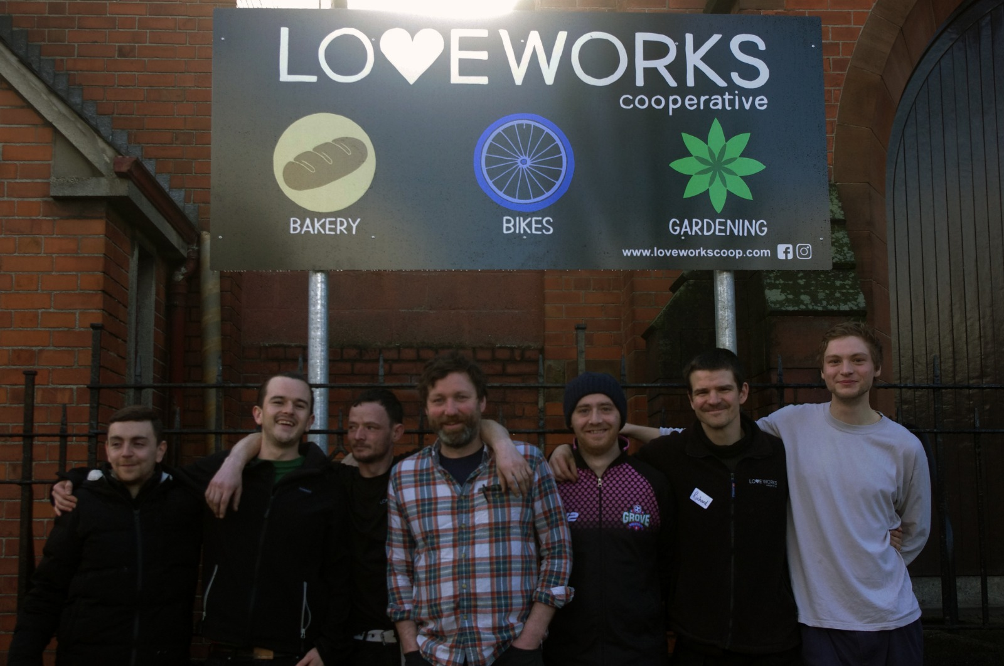
Our Vision
To generate dignity and wellbeing in people

Slide 3
Our Mission
By creating a Worker-owned Cooperative, we sustain ourselves through operating refurbished bike sales and bike repairs, domestic gardening & landscaping, and an artisan bakery.

Slide 4
Operations: Bakery

Slide 5
Operations: Bike Repair

Slide 6
Operations: Gardening

Slide 7
Conceptual frameworks
Blessing
Faith-based: Blessing & Reconciliation
Restorative Justice
Cooperative

Slide 8
History
A seed
A promise to be fulfilled
A potential to be discovered
A truth to be told
A wonder to unfold

Slide 9
Values
Relationship
Reparation
Reintegration
Root Causes
Voluntariness
Inclusivity
Victims Needs
Accountability

Slide 10
Initial Projects
Fortwilliam & Macrory Presbyterian Church Garden
Duncairn Community Garden
Bike Repair & Maintenance Course

Slide 11
Vision
The Community Garden was visioned as a living metaphor of personal and relational development, creating space for recreation, reflection, relationship building, reparation, and reintegration.

Slide 12
Vision
Similarly, the Bike Repair Course, in partnership with the local bike shop, (Full Cycle) was a new space for enabling young men the possibility of restoring a sense of dignity and self-worth.

Slide 13
Dilemma
Continue small grant-funded projects, recruiting new cohorts of participants
OR
Continue to cultivate the growth started by those who have completed the projects and want to commit longer-term.

Slide 14
Workers Cooperative Principles
Voluntary Membership
Democratic Member Control
Member Economic Participation
Autonomy & Independence
Education & Training
Cooperation
Concern for the Community

Slide 15
Economic Democracy

Slide 16
Economic Democracy
Membership/directorship
Wage equality
Member responsibility: “economic member participation”
Autonomy: agree affordable wages, surplus investments

Slide 17
Economic Growth 2016-20
YEAR | 2016-17 | 2017-18 | 2018-19 | 2019-20
TURNOVER | 20,563 | 27,250 | 93,661 | 176,337
AV. WAGE RATE | £1.44 | £4.64 | £6.72 | £8.84
NO. OF MEMBERS | 8 | 9 | 9 | 11
SELF-EMPLOYED | 1 | 5 | 8 | 11
BENEFITS ONLY | 7 | 4 | 1 | 0
GRANT SUPPORT | 19.80% | 19.90% | 8.40% | 7%

Slide 18
Challenges
Work load management
Team dynamics
Policy & Communication
Covid-19

Slide 19
Strengths
Harnessing the power of team: Together Everyone Achieves More
Generating dignity & wellbeing: Another Day Another Dream
Sustaining income and relationships: Work is Family

