Slide 1

Drumlin Wind Energy Co-op
Community Owned Renewable Energy Co-op
www.drumlin.coop
Anne Ford, Chair

Slide 2
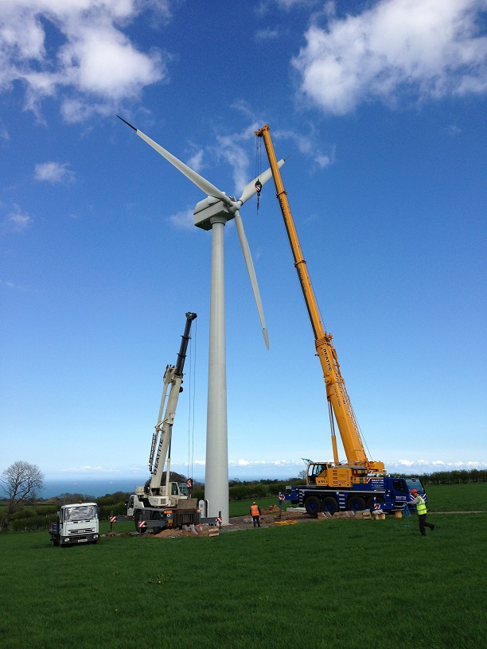
Outcomes for
Drumlin Co-op Members
interest & SEIS tax relief
Turbine Site Owners
% revenue
Local Communities
Community Fund
Environment
reduced carbon emissions
Economy
jobs, farm diversification
and meeting targets

Slide 3
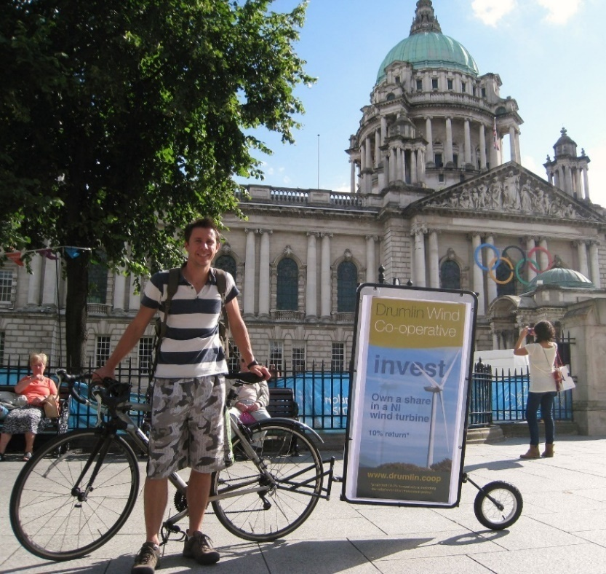
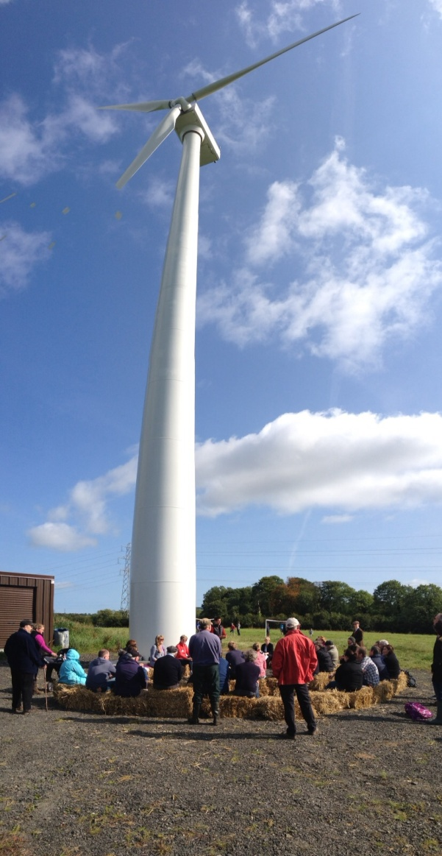
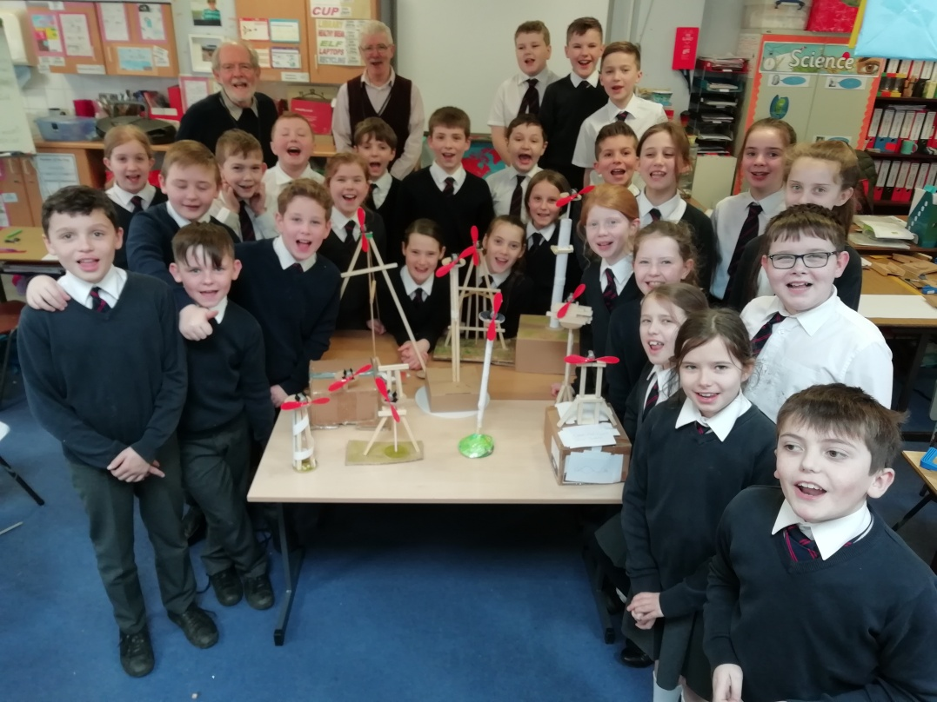
The Vision and Community Engagement

Slide 4
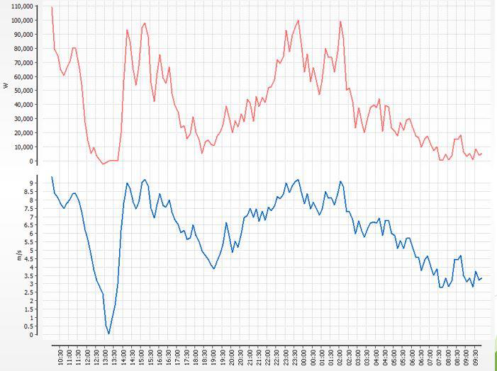
Relationship between wind speed (red)
and electricity generation (blue) over 24 hours

Slide 5
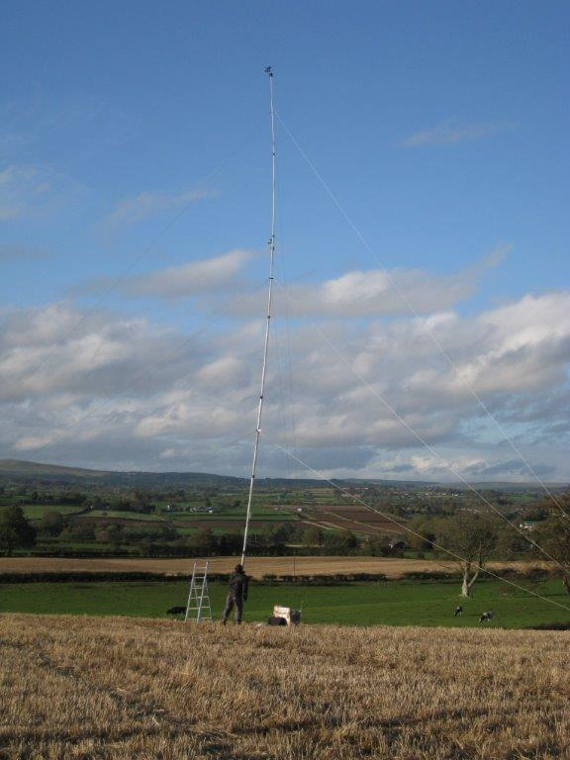
Site Search
Site Selection
Planning
Grid Connection
Legal
Share Offers
Construction
Management
Administration
Challenges Faced

Slide 6
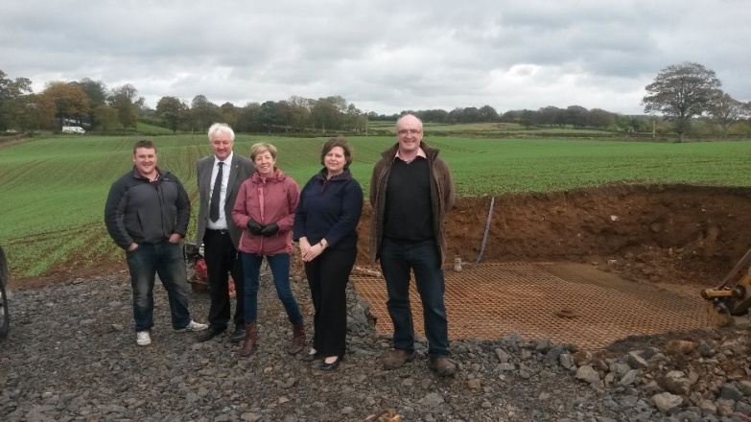

Resources
NRG Solutions
Energy4All
UCIT
ROCs
WEP/WTN/RES
Board of Directors
Volunteer members

Slide 7
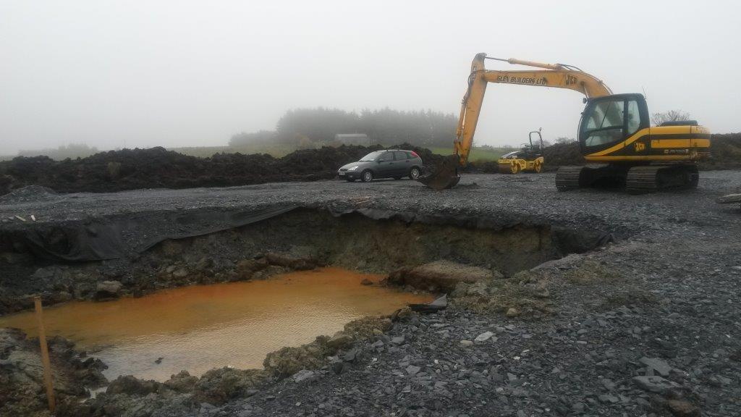
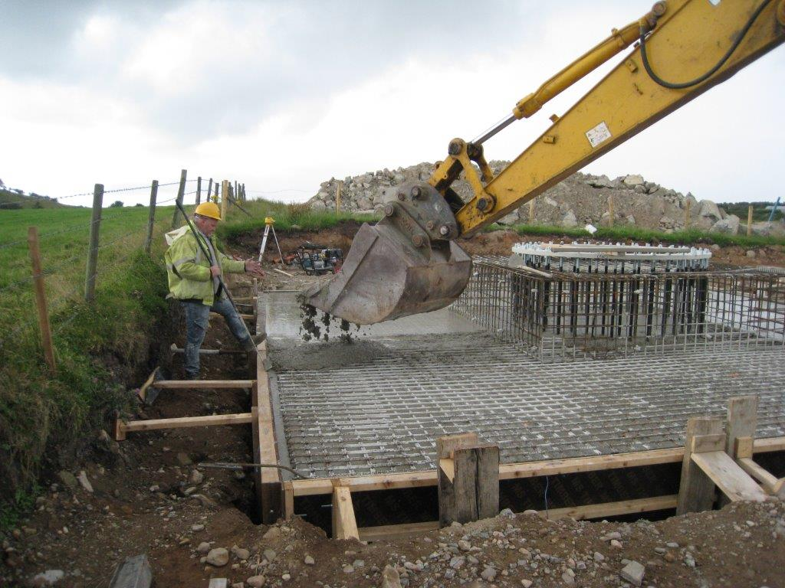
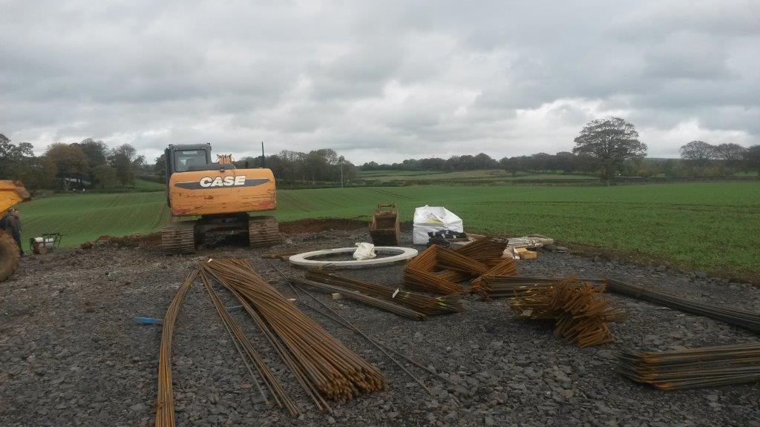
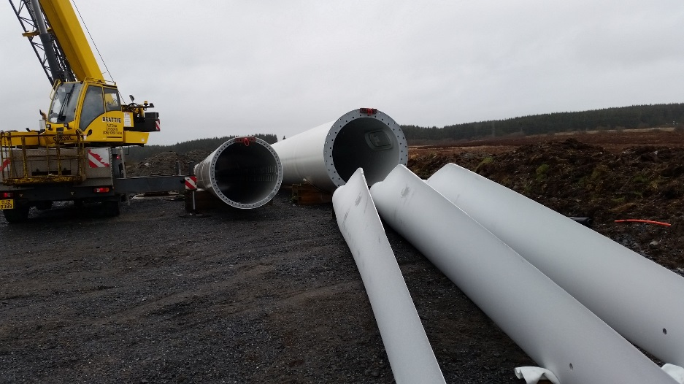
Construction Phase

Slide 8
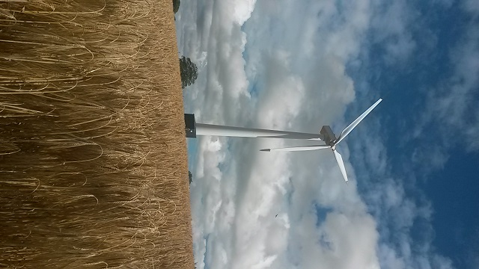
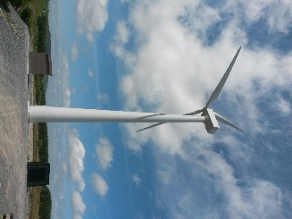
Ballyrobert
Cavanakill

Slide 9
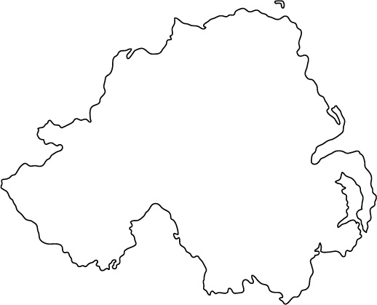
Total 6 turbines in Northern Ireland
x Ballyboley
Parkgate x
x Ballyrobert
x Aghafad &
x Cavanoneill
x Cavanakill

Slide 10
2012 to Fully Operational
Drumlin 1 Drumlin 2
Share Offer with help of Energy for All
Raised £2.7 million
4 turbines built
First at Cavanoneill, Pomeroy, Co Tyrone
Operational January 2014
Second Share Offer
Raised £1.2 million
Two turbines built
Last one at Ballyrobert, Co Antrim
Operational September 2015

Slide 11
Five Years On
Monitoring operations
Maintenance
Administration
Policies
Community Fund Development
Performance improvement
Future Strategies

Slide 12
Annual Output

Slide 13
Annual Output

Slide 14
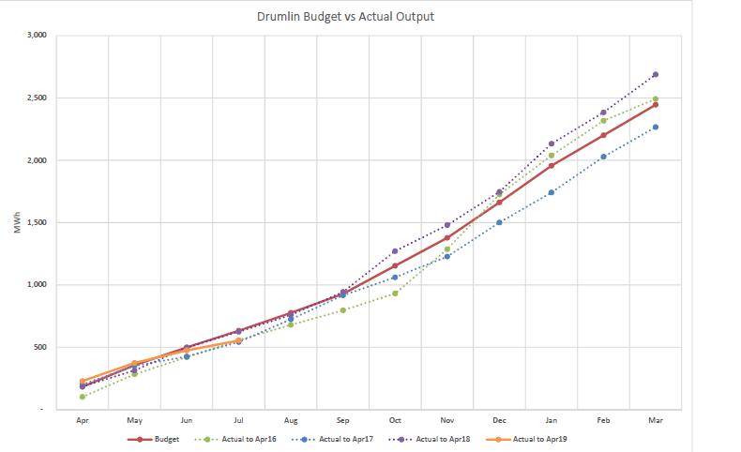

Slide 15
Community Fund
BREESI educational programme in Primary Schools
Forest Schools funding
Turbine Visits and Talks
Educational Resources
Energy initiatives
Support for other Co-ops

Slide 16
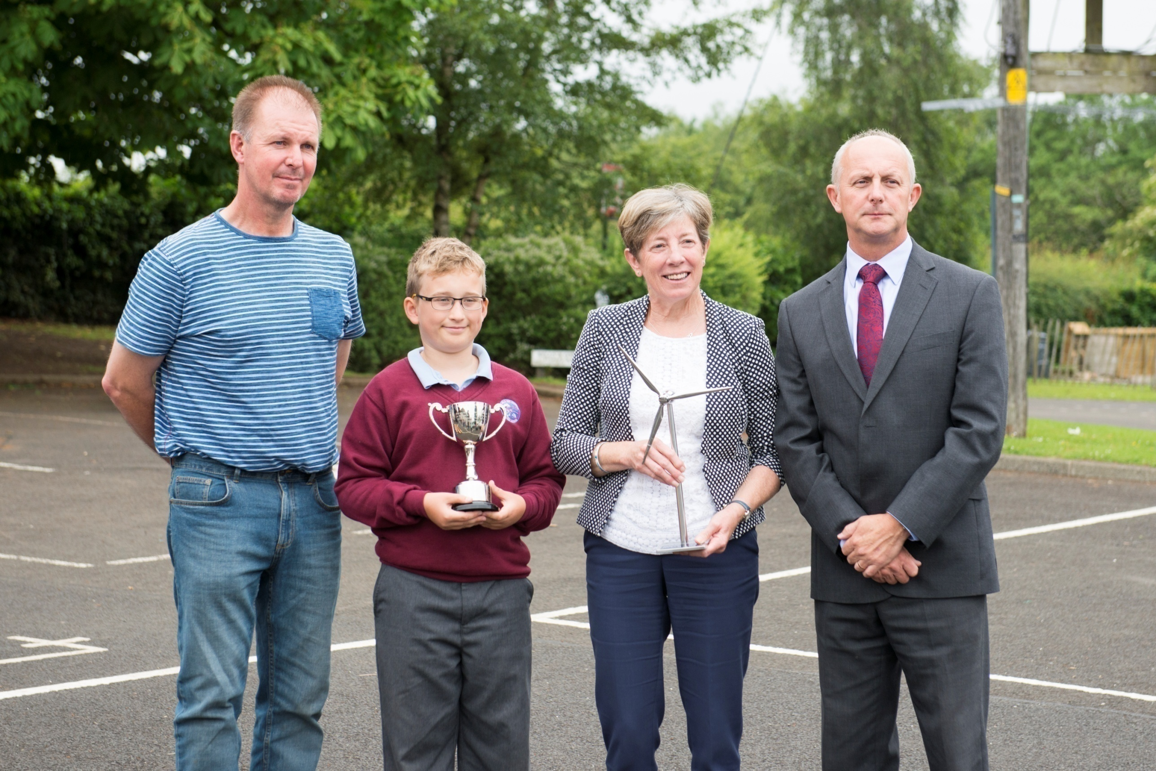

Slide 17
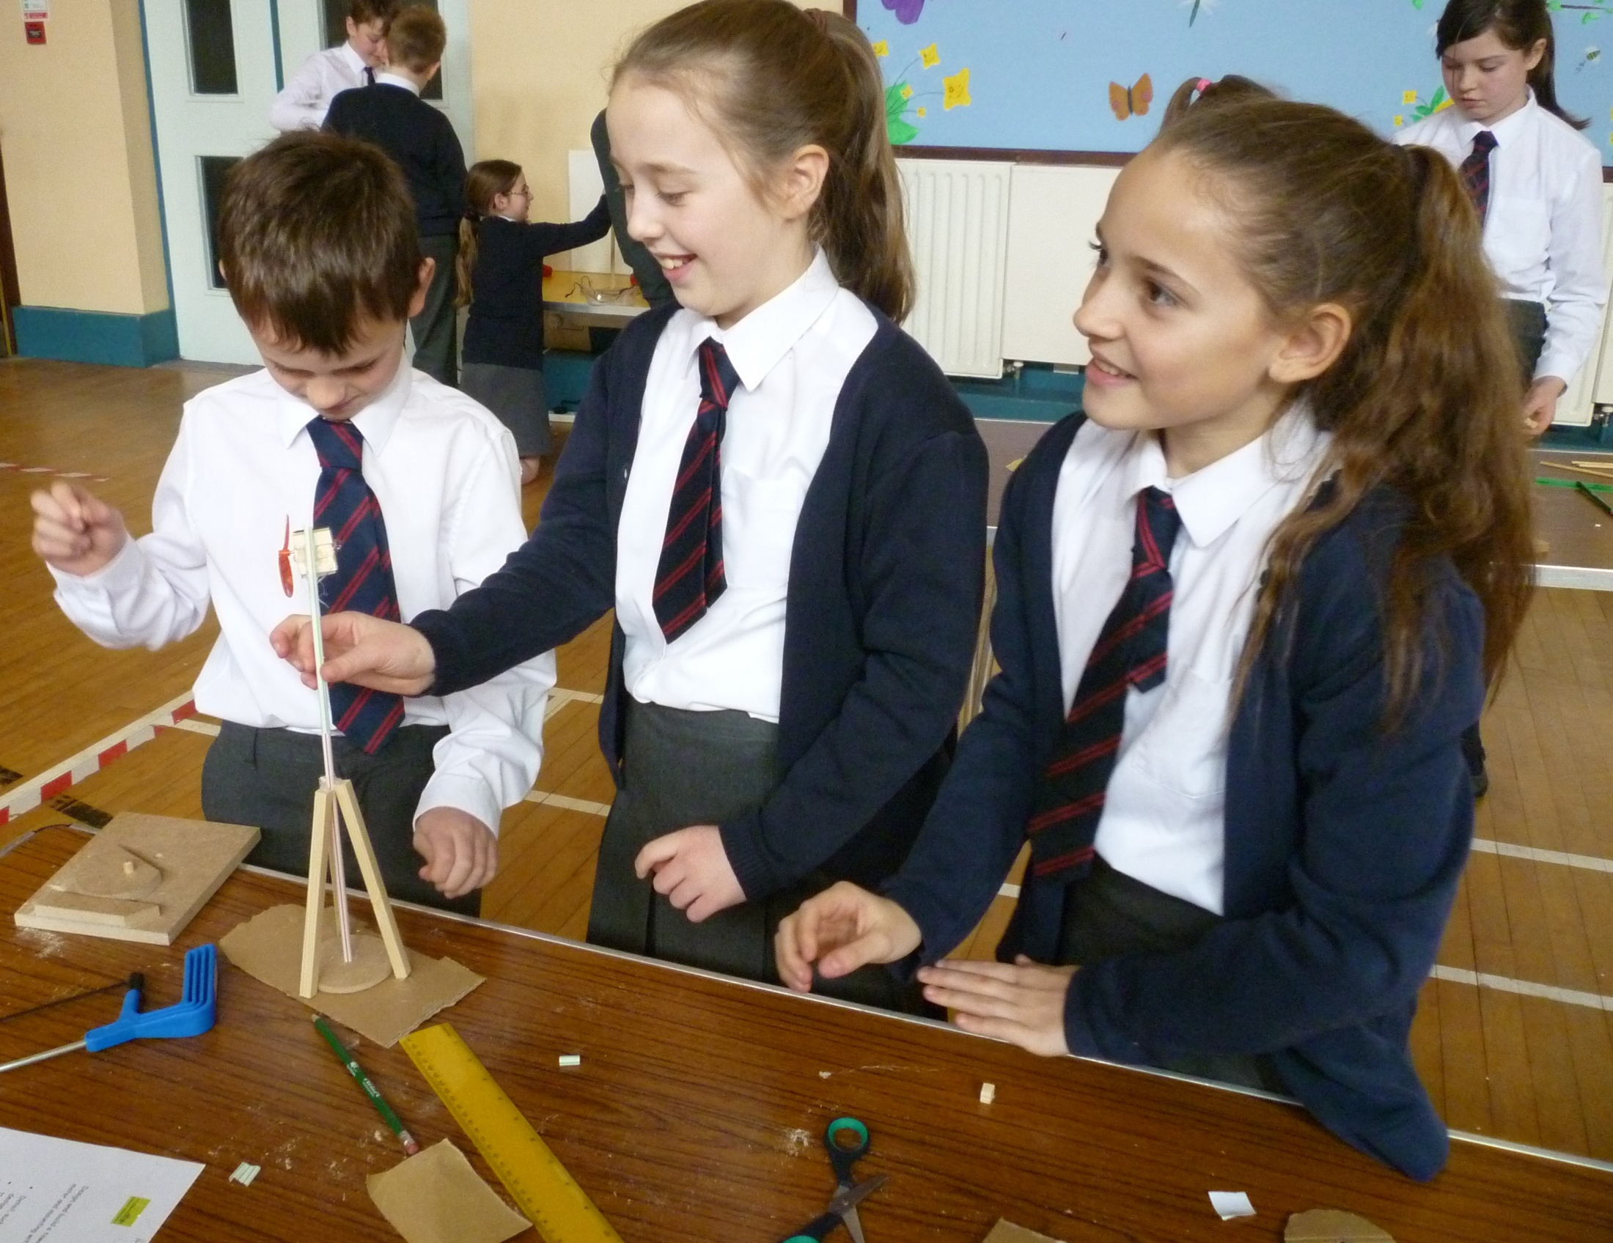

Slide 18

Challenges –
Wind Resource
Fluctuating Electricity Prices
Power Purchase Agreements
ROC Values
Grid Quality
Brexit ............
£ € £
€ £ €

Slide 19
Advantages of being a Co-op
Identity
Empowerment
Funding
Skills base
Volunteering
Community Links
Opportunities
More Initiatives
Benefit environment
Benefit community
Education
Influence energy policy Promotion of Community ownership and renewables

Slide 20
The Future for Renewables in Northern Ireland
Energy Policy
Targets
Incentives
Grid
Storage
Initiatives
Community Energy
Social Enterprise
?

Slide 21
Thank You
Anne Ford
Chair, Drumlin Wind Energy Co-op
drumlin.coop
eanneford@hotmail.co.uk

