Slide 1


PRESENTATION
29th September 2020

Slide 2


The story so far….
Ballymacash Rangers Football club has served the community of Ballymacash and local young people for over 30 years.
The football club had the foresight and community support to replace a Bonfire Site to a place where young people could play football.
Through the club, thousands of young people have been engaged in football over the years and our teams have played football at Mid-Ulster Intermediate A-level for over 15 years.
In 2016 we established Ballymacash Rangers Youth and have grown from 7 children on a cold November morning to almost 200 currently, and still growing.
Everyone is proud of what we have achieved so far because it came from the passion, support and hard work of our players, their families and the wider local community.
At the beginning of 2017, we embraced the fact that developing sports in the community meant developing stronger communities.
We began to work in partnership with other local organisations and plan for better facilities, more sports activities and become a truly accessible Sports Academy on that very ground where we started.
Ballymacash Sports Academy was born from Ballymacash Rangers Football Club in 2017.

Slide 3
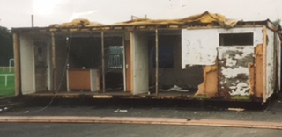
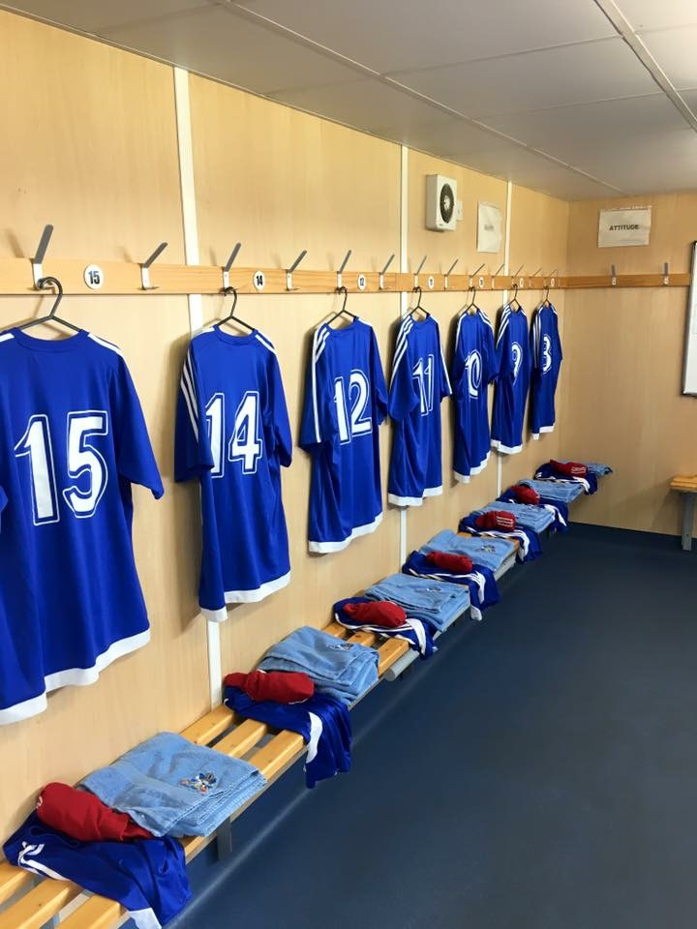
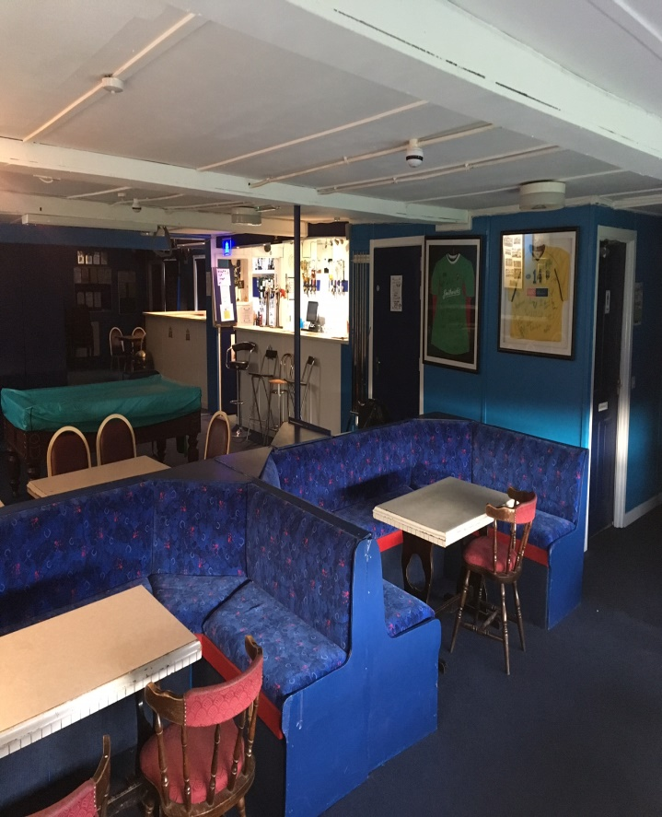
BEFORE
AFTER
PREFAB’s ON ARRIVAL TO BRFC
HARD WORK FROM MEMBERS AND SUPPORTERS

Slide 4






Community Ownership Models
FC United of Manchester
Wrexham AFC
Chelmsford City FC
Lewes FC
In Spain 99% of Clubs 3rd Tier and below are fan owned
Ballymacash Sports Academy is the 1st Community Owned Sporting Facility in Northern Ireland

Slide 5


  OUR LEGAL ENTITY
  We are a Community Benefit Society (a type of co-operative) under the Industrial and Provident Societies (Northern Ireland) Act 1969 . Registered with the Department for the Economy in Northern Ireland and also with the NI Charity Commission.
  OUR AIMS
  1) Provide or assisting in the provision of facilities and services primarily for the benefit of the community of Ballymacash and surrounding areas for recreational, sporting and other leisure use
  2) Provide facilities for persons who by reason of their youth, age, infirmity or disability, poverty or social or economic circumstances may have need of special facilities and services
  3) Maintain facilities for the home ground of Ballymacash Rangers Football Club as the pre-eminent enterprise in the amateur football community of Lisburn.

Slide 6
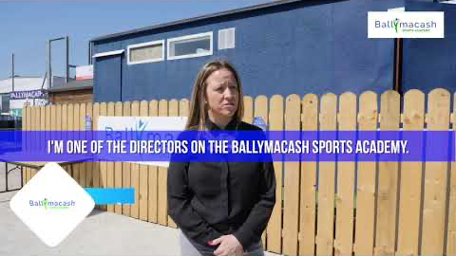
COMMUNITY SHARE OFFER OPENED IN JUNE/JULY 2018
297 INDIVUALS INVESTED INTO THE SOCIETY
32 BUSINESSES/SCHOOLS INVESTED
TOTAL OF £112,540 RAISED THROUGH THE OFFER
PHASE 1 SHARE OFFER

Slide 7








GRANT FUNDING
Co Op Foundation
£25,000
The Alpha Programme
£50,000
Army Covenant Fund
£20,000
Dept for Communities
£113,000
Ulster Community
Investment Trust
£100,000 Loan

Slide 8
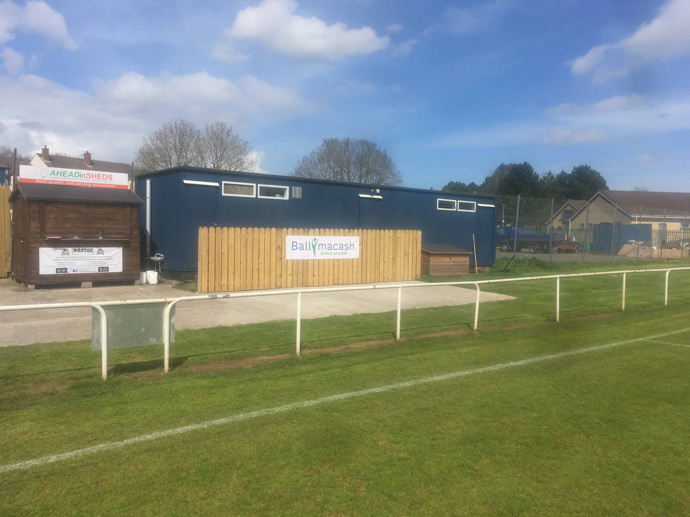
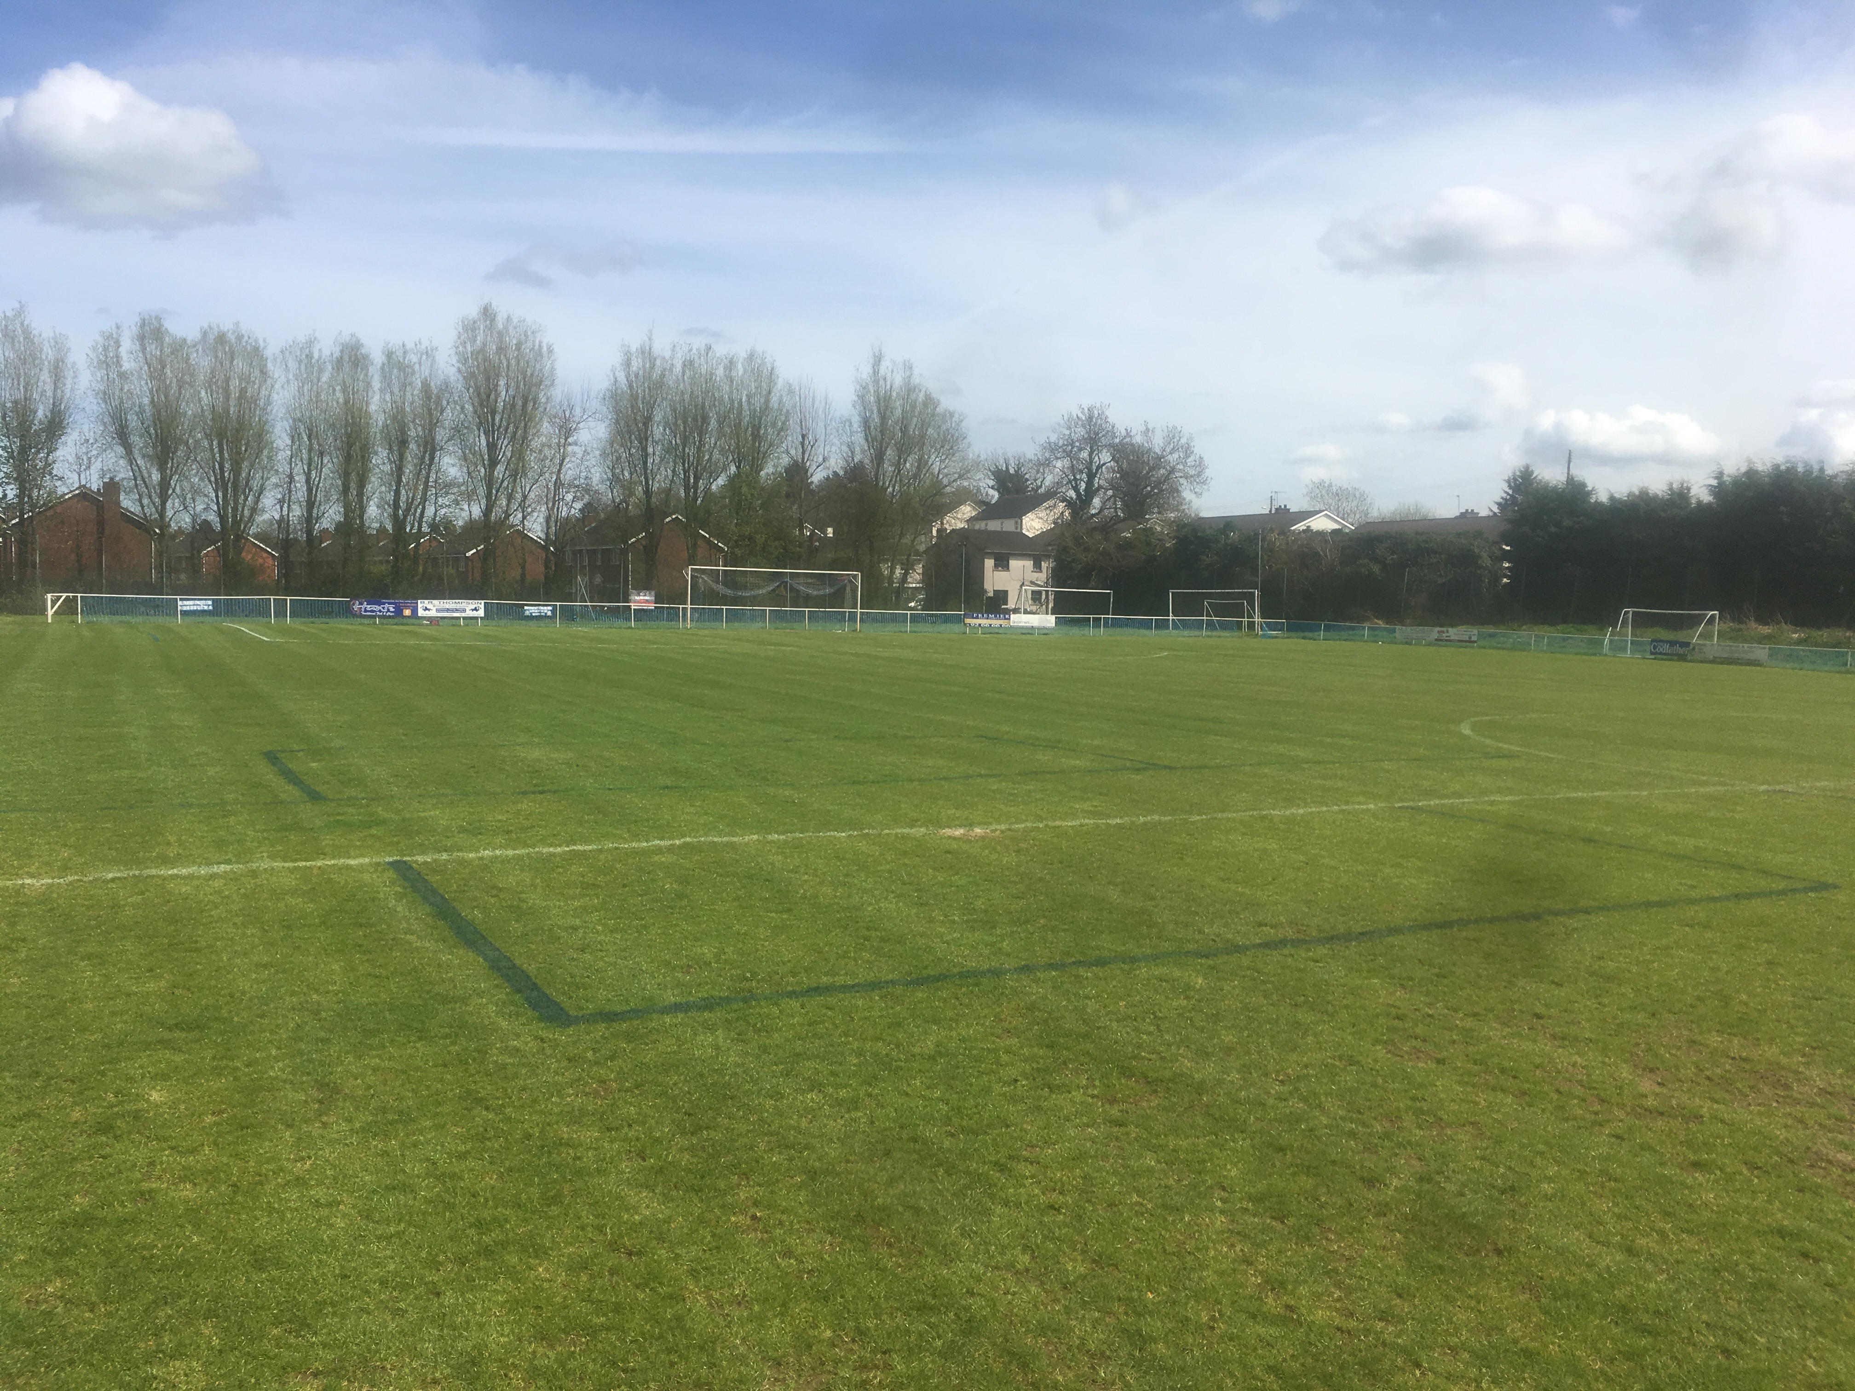
FROM THIS

Slide 9
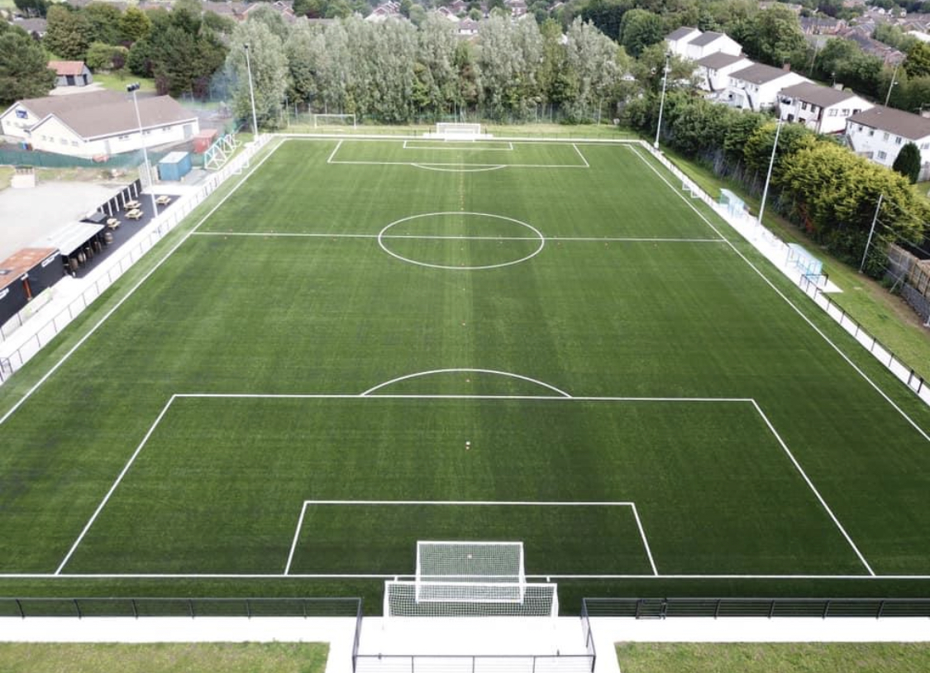
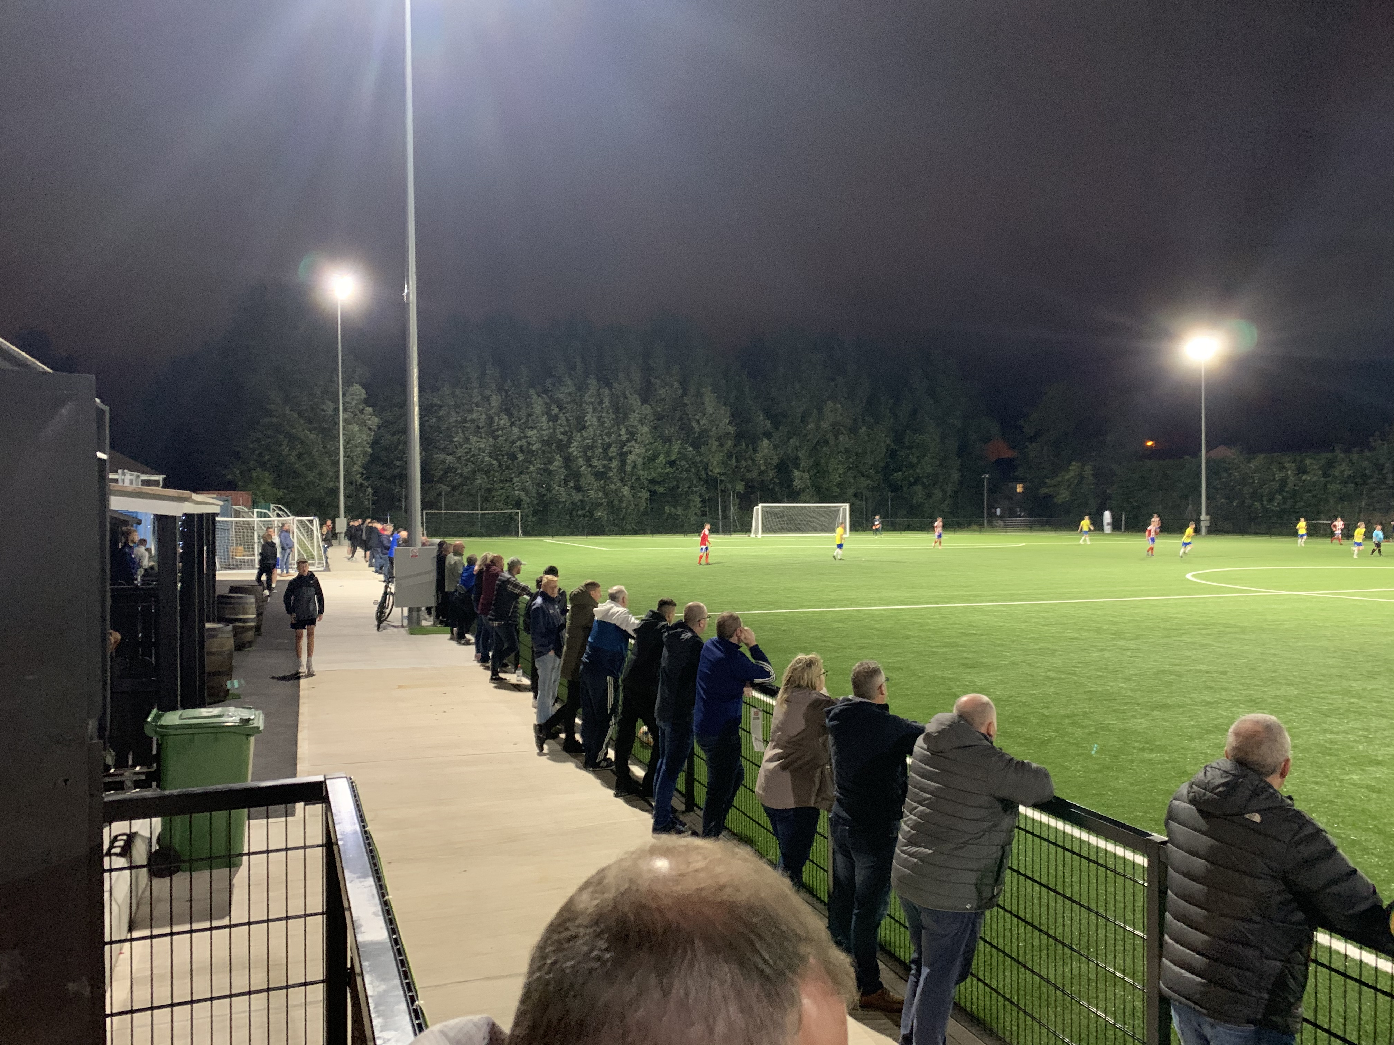
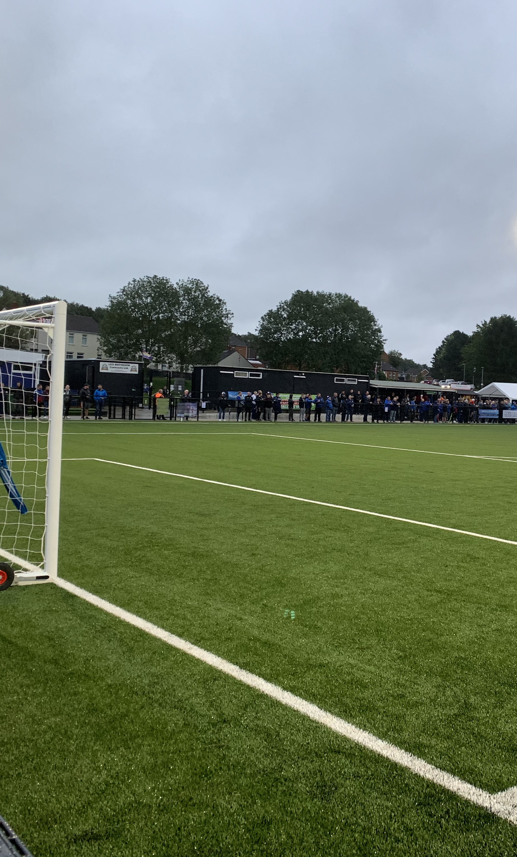
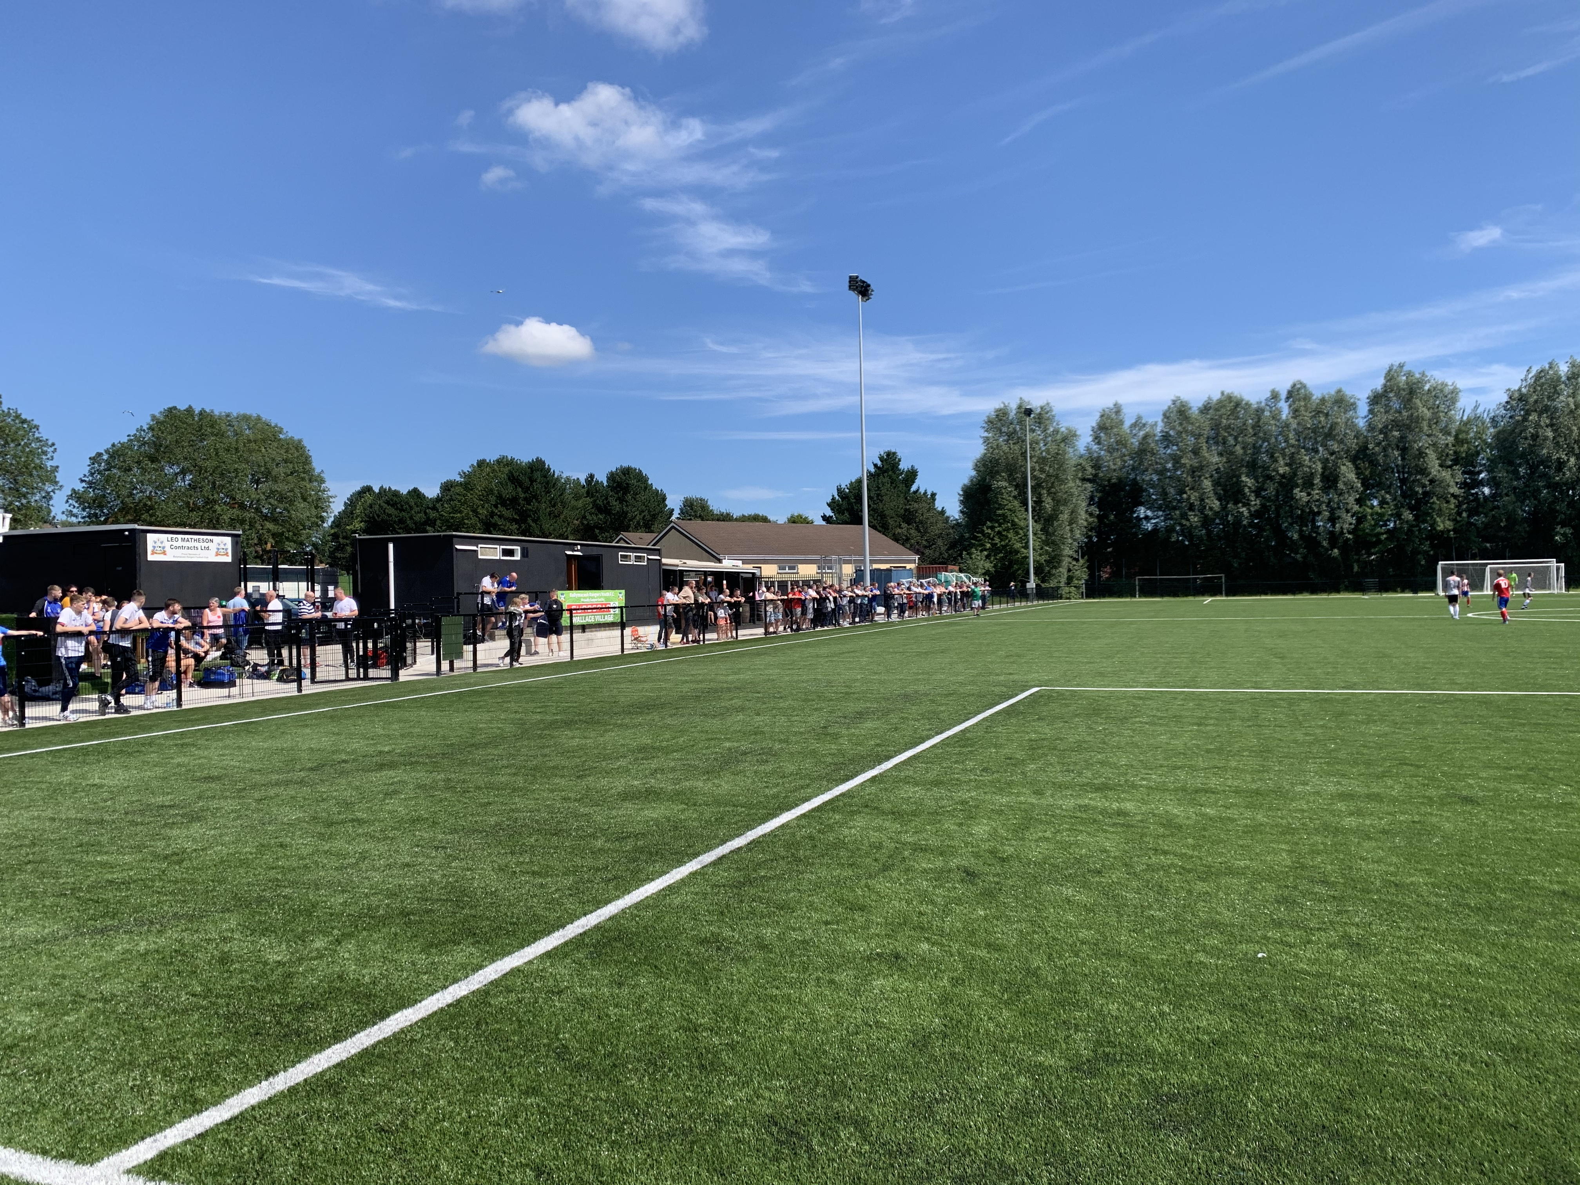
TO THIS

Slide 10
SPORTS ACADEMY LATEST
EMPLOYMENT
P/T CARETAKER
F/T ACADEMY MANAGER
BOOKINGS
MON-FRI FROM 6PM FULLY BOOKED
RANGERS FC SOCCER ACADEMY
PORTADOWN FC
UEFA U19 EURO FINALS TRAINING VENUE
TURNOVER
SEPTEMBER £6000
OCTOBER £7500 ESTIMATED

