Slide 1
SEMINAR
Thursday 23rd November 2017
Girdwood Community Hub, Belfast
TIME | SESSION
10:30 | Registration opens
11:00 | Opening Welcome Karen Arbuckle, Co-operative Alternatives Chair.
11:10 | Who is in the room? What do we appreciate about Co-operatives? Davie Philips, Facilitator.
11:20 | “The Power of Co-operation” Ed Mayo, General Secretary, Co-operatives UK.
11:40 | “Economic Growth for Common Good” Diarmuid McLean, Director Strategic Policy, Department for the Economy.
11:55 | “Promoting Co-operatives at a local level. Go Social, Go Co-Operatives.” Leah Thompson, Economic Development Officer, Belfast City Council.
12:10 | Insights, clarifications and questions
12:50 | “Co-operative Stories” Tasha Bevan, Frontline Team, Plunkett Foundation.
13:00 | A Networking Co-operative LUNCH Lunch is provided by Lunasa Workers Co-operative complimented by tasters of Lough Neagh Eels and award winning craft beer from the Lacada brewery.
Unit 140 North City Business Centre 2 Duncairn Gardens,
Belfast BT15 2GG
Phone No: 028 90 736 075
www.coopalternatives.coop

Slide 2
TIME | SESSION:
14:00 | “Community Shares, a funder perspective” Nigel McKinney, Director of Operations, Building Change Trust.
14:15 | Co-operative Stories Drumlin Wind Energy Co-operative – Anne Ford, Chair Creative Workers Co-operative - Clem Bradely, Founder Member N.I. Co-Housing - Joanna McMinn, Founder Member Loveworks Workers Co-operative - Richard Higginson, Founder Member Raglan Community Development Renovation Society - William Millar, Secretary.
14:50 | Co-operative Conversations Roundtable discussions.
15:30 | Plenary harvest discussion
16:00 | Co-operative Alternatives N.I. Co-op Survey Tiziana O’Hara, Co-operative Alternatives, Director and Project Manager
16:15 | Reflections by Key Listeners
16:25 | Closing Remarks Tiziana O’Hara, Co-operative Alternatives
16:30 | CLOSE
This event was organised by Co-operative Alternatives
This event was sponsored by the Building Change Trust.
Co-operative Alternatives aims to develop and support a strong co-op movement connected across the island of Ireland and doing business in a fair, just and ethical way. We are Northern Ireland’s leading co-operative development agency offering high quality support and expert knowledge to existing and emerging co-operatives.
The Community Shares, Ready! programme was commissioned by the Building Change Trust and delivered by Co-operative Alternatives.

Slide 3
SPEAKERS
ED MAYO CO-OPERATIVES UK | Ed Mayo is Secretary General of Co-operatives UK, the network for the UK’s thousands of co-operative businesses. He is a long-term co-operator and has a track record of innovation and impact in his work to bring together economic life and social justice. Ed is Chair of the participation charity, Involve and Vice-President of Co-operatives Europe. He is editor of The Co-operative Advantage: innovation, co-operation and why sharing business ownership is good for Britain, published in 2015, and co-author of the book Consumer Kids. Ed Mayo was one of the team who founded the Fairtrade Mark, which sources products from co-operatives and small-scale producers in developing countries. He rose to prominence as director of the New Economics Foundation from 1992 to 2003. Ed is now a fellow of NEF. From 2003 – 2009, he was Chief Executive of the National Consumer Council. In 2007 he was awarded an honorary doctorate from the London Metropolitan University for his work to build an ethical economy.
DIARMUID MCLEAN DEPARTMENT FOR THE ECONOMY | Diarmuid took up post as Director Strategic Policy in the Department for the Economy on 1 September 2014. He has responsibility for development of Northern Ireland’s Economic Strategy. He also has responsibility for the Matrix science and technology panel, as well as Exports and Innovation Policy. He previously worked for 5 years in the Department of Education where he was responsible for the capital investment programme of £300m p.a. as well as developing area planning policy. Diarmuid’s experience includes 5 years as Chief Executive of Account NI where he led the development and introduction of the new accounting system across the NICS as well as spells as Director of Innovation, Research and Technology and Director of International Sales and Marketing in Invest NI.
LEAH THOMPSON BELFAST CITY COUNCIL | Leah is an Economic Development Officer, Belfast City Council. Go Social is a support programme which uses innovative approaches to find and explore new ideas that could support developing a new social enterprise or cooperative. Participants have access to social spark events, tailored workshops, one-to-one mentoring, showcasing opportunities, networking with like-minded people. The current Go Social programme is open for applications until 30th June 2019.
TASHA BEVAN PLUNKETT FOUNDATION | Tasha joined the Frontline Team in May 2016 to provide initial advice and legal guidance for groups who are looking to set up a Community Enterprise. Before working at Plunkett, Tasha spent ten years prior to that delivering Leadership and Business Skills training to managers across a wide range of sectors. Tasha has a BSc in Psychology and an MSc in Cognitive Science and is interested in what makes people tick.
FACILITATOR
DAVIE PHILIP CULTIVATE | Davie was a founding member of both the Foundation for the Economics of Sustainability (FEASTA) and Sustainable Projects Ireland Ltd the company behind the ecovillage project in Cloughjordan, Co. Tipperary where he now lives. In 2000 he set up the Sustainable Ireland Cooperative with Ben Whelan which trades as Cultivate. With Cultivate he organises networking and learning events including the annual Convergence Festival.

Slide 4
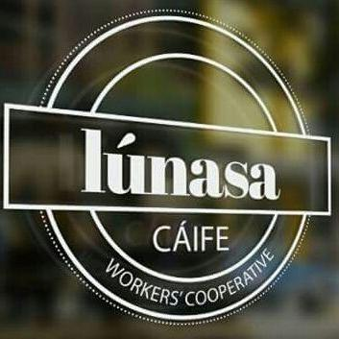
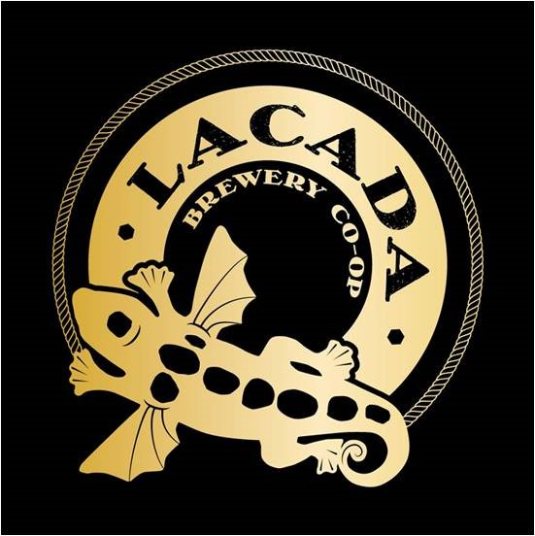
CO-OPERATIVE STORIES
 | Drumlin Wind Energy Co-operative is a community owned energy co-operative which owns and operates six 250kW wind turbines at locations spread across Northern Ireland. Drumlin has over 1000 members who have invested approximately £4 million, in amounts ranging from £250 to £20, 000, to fund turbine construction and who are committed to ongoing promotion of environmental awareness and support for communities local to their turbines.
 | Formed in November 2012 as a workers co-operative, the Creative Workers Co-operative is democratically owned and controlled by its workers. Our members have a diverse array of skills in design for print and web, film and photography, as well as a background in community and social activism. It is this mixture that drives us to work for positive social change. We are a worker owned co-operative. We are a multimedia service provider; producing graphic and website design, animation, short films and photography. We specialise in community based projects, grassroots activism and social justice campaigns. We aim to provide reasonably priced media packages to Community Groups, NGOs and Campaign Groups as well as to private businesses
 | Co-housing NI aims to building a community in the city or the countryside, with 10 - 20 affordable energy efficient homes - whether apartments or houses, rented or owner occupied - where residents have their own homes, yet also have use of extensive common facilities such as open space, courtyards, a playground and a common house. This is an initiative where residents actively cooperate in the planning, design and construction of the project and in maintaining its shared resources when up and running; and where residents have one goal in mind: to create and be part of a vibrant, diverse and intergenerational community living in a safe, and a mutually supportive environment.
 | Loveworks Co-operative was established in December 2015 to create work placement opportunities and training for disadvantaged young men, to help them gain employment and be better equipped to meet their needs. It operates a range of business ventures including: (a) bike repair and refurbished bike sales (b) organic micro-bakery, (c) garden maintenance & landscaping.
 | The Raglan Community Development & Renovation Society is a community co-operative of local people working for the regeneration of Harryville through the regeneration of the Raglan site. Our vision is “to create a vibrant community and business centre at the heart of Harryville providing a sustainable, secure, culturally diverse and accessible space, valued by the people of Harryville and beyond.”
LUNCH AND TASTERS
 | Lunasa is a worker co-op, a cáife in Belfast which serves freshly cooked meals in house on a daily basis and also offers private bookings or catering services for any event.
 | Lough Neagh Fishermen’s Co-operative Society Ltd. manages the eel fishing rights on Lough Neagh which is home to the largest wild eel fishery in Europe, marketing approximately 350 ton’s annually. Based on the north coast, Lacada Brewery Co-operative was set up by people who love a good beer and the place they live in. Our brilliant beers tell stories about the area we live in and we always aim to augment the visitor experience to the Causeway Coast and Glens.

