Slide 1

Economic Growth
for the Common Good
Keith Forster
Strategic Policy Division
Department for the Economy

Slide 2
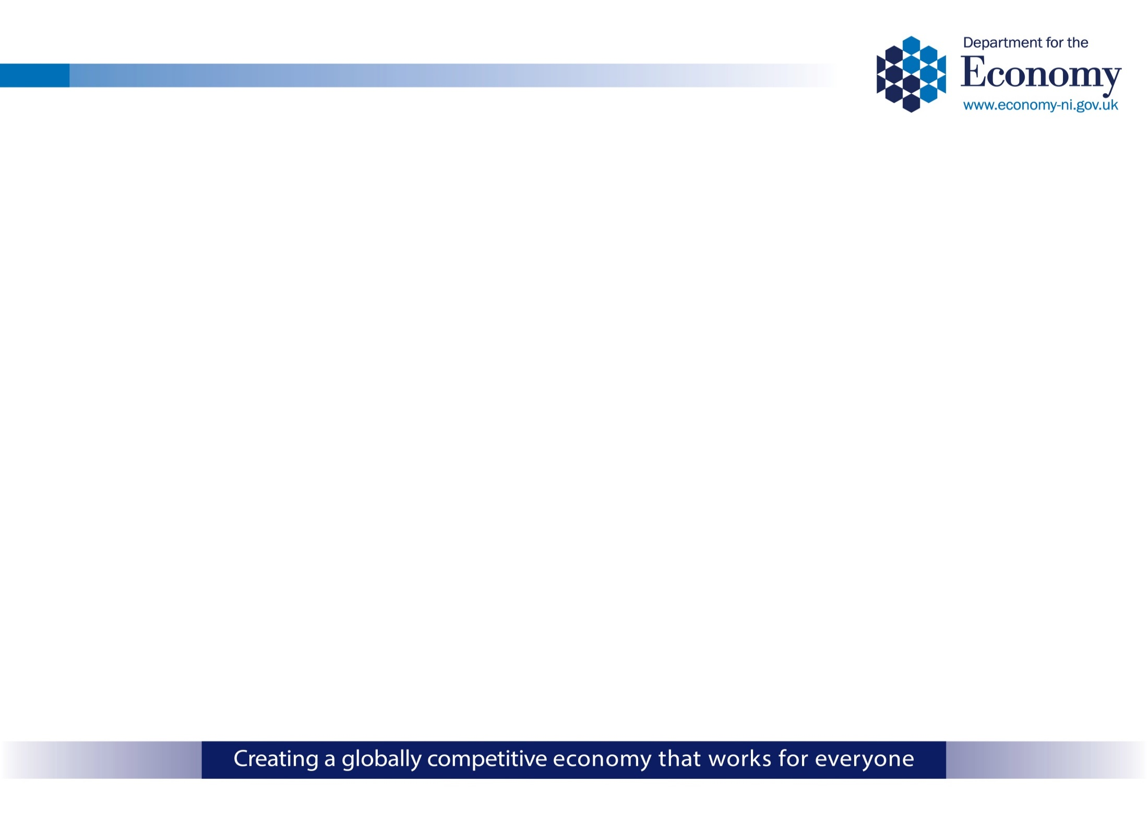
Draft Industrial Strategy
VISION FOR 2030
To be a globally competitive economy that works for everyone
Five Pillars for Growth
Accelerating Innovation and Research
Enhancing Education, Skills and Employability
Driving Inclusive, Sustainable
Growth
Succeeding in Global Markets
Building the Best Economic Infrastructure

Slide 3
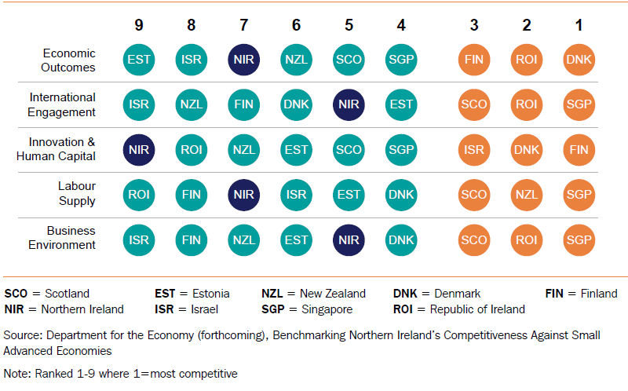
Competitiveness
Overarching aim of Industrial Strategy to increase our economic competitiveness.
Competitiveness remains the international benchmark against which advanced economies continue to be measured.
Increasing our competitiveness will result in increased productivity.
Key target is for Northern Ireland to become one of the three most competitive of the nine small advanced economies by 2030.
Current Position

Slide 4
Our Economy – Challenges Remain
In Northern Ireland growth has generally been on a much shallower path than that of the UK and Republic of Ireland
Source: NI Composite Economic index, NISRA

Slide 5
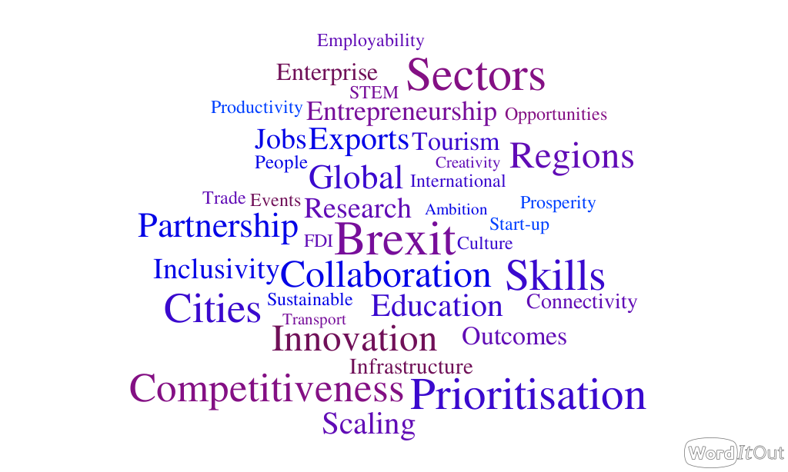

Slide 6
Supply gap – NQF Level
Annual average labour market supply gap (NQF L1 to L8)
High Level (L6+)
- Marginal under-supply
Mid Level (L3-5)
- Significant under-supply
Low Level (L2 and below)
- Over-supply
Source: UUEPC

Slide 7
Partnership Approach
New Programme for Government and Industrial Strategy recognise importance of partnership working.
Government cannot work in isolation, neither can we accurately predict economic conditions of 2030.
Government will work closely with Private Sector, Local Government, Voluntary & Community Sector and beyond to maximise collective achievement.
Co-operatives can play an important role in the collaborative process.

Slide 8


Thank you
Any questions?

