Slide 1


Slide 2
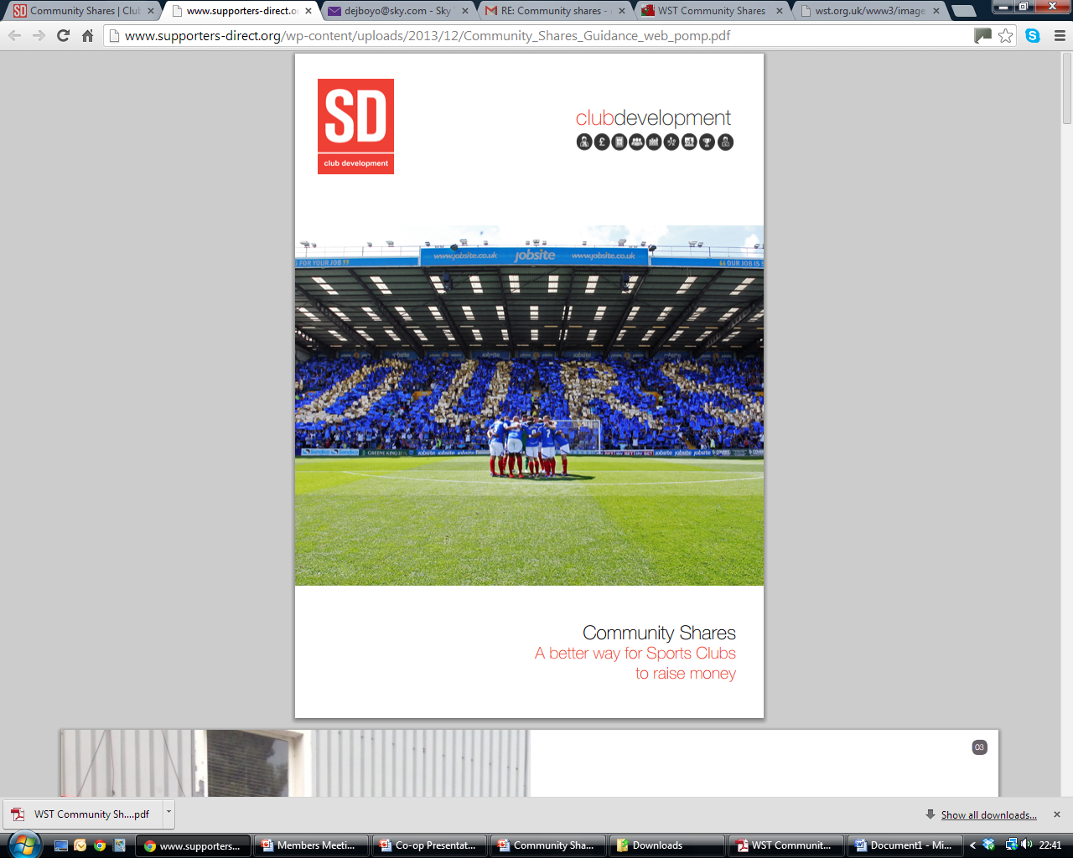
What are Community Shares ?
A means to raise finance by offering shares in a Community Benefit Society (CBS).
CBS shares don’t go up in value and are unlikely to go down,
One member, one vote.
Community shares can be withdrawn,
A CBS can pay interest to shareholders,
Maximum investment is £100,000
Without the regulatory burden and cost of a Limited Company share offer.

Slide 3


WST Community Share Offer
Red or Dead campaign launched to raise funds for WST to secure the acquisition of the club and provide working capital.
90 Subscribers paid £60k into an ESCROW account.
Full Share Offer launched in April 2012.
Short term aim to help the business offset forecasted losses.
Medium term aim to provide capital to improve the business infrastructure.
Offer not time-bound

Slide 4
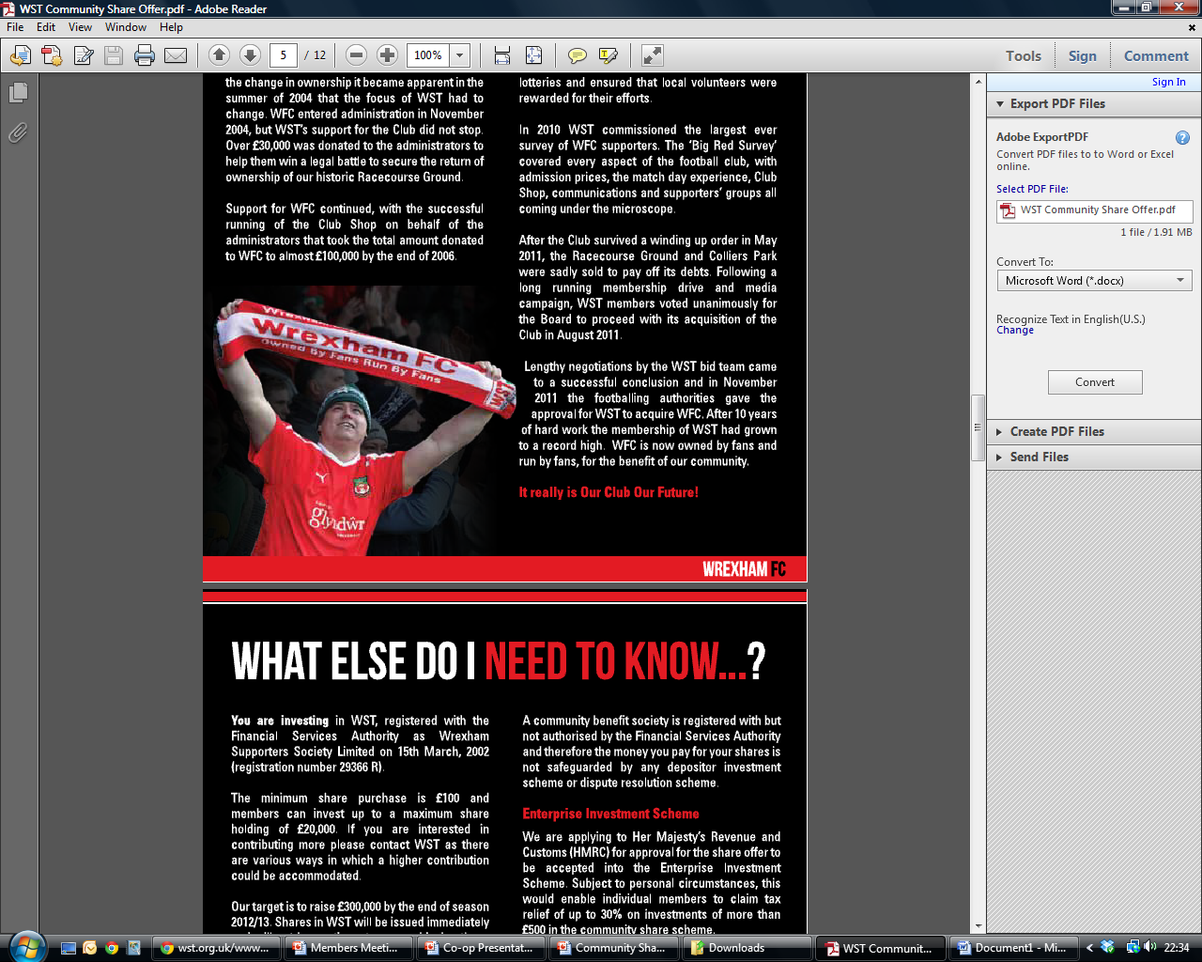
Benefits to Members
Receive a Share Certificate
Option to receive interest up to 2% above Bank of England Base Rate
Option to spread payments
Donate a ticket to WST’s chosen charities
Opportunity to receive tax relief through the Enterprise Investment Scheme
Lifetime membership of WST
Shares can be withdrawn (subject to
T’s & C’s)

Slide 5
Community Shares – Current Position
350 investors have invested over £150k
The funds raised are being ring fenced for infrastructure projects.
Process in place to authorise Community Share Spend
Approx £75k has been spent on Shop/Office development
Other Potential Projects:
  Upgrade of IT infrastructure
  Solar Energy Generation
£150,000
£100,000
£50,000
£0

Slide 6
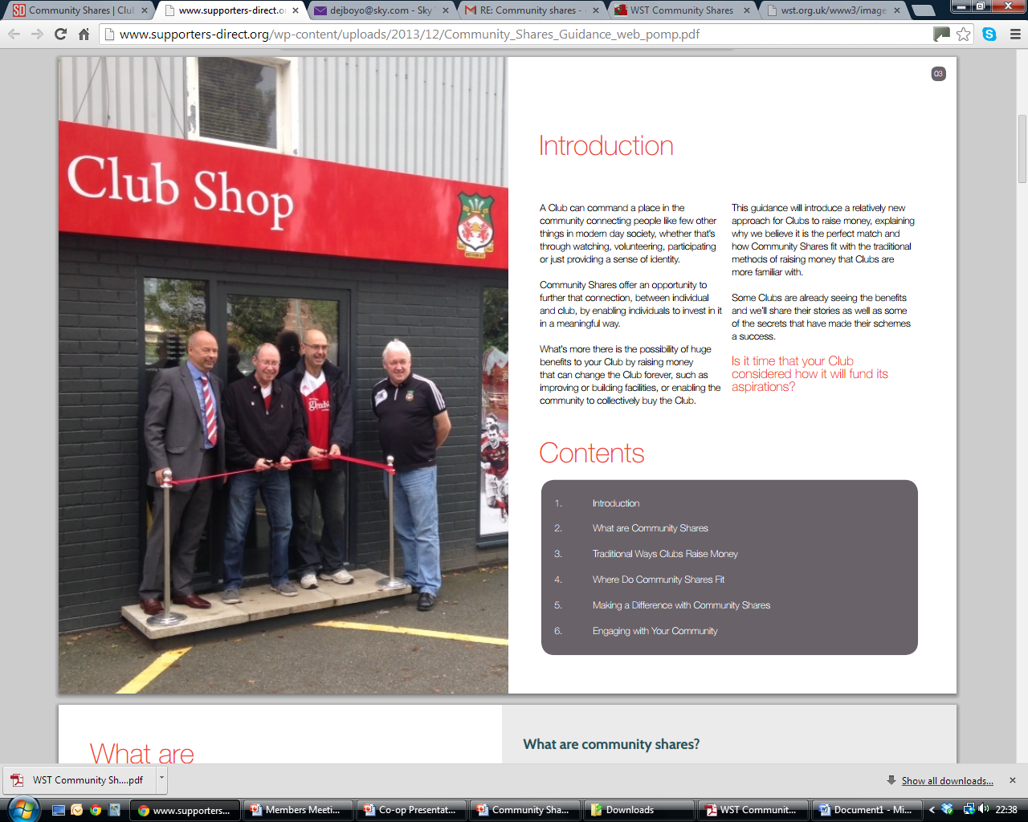
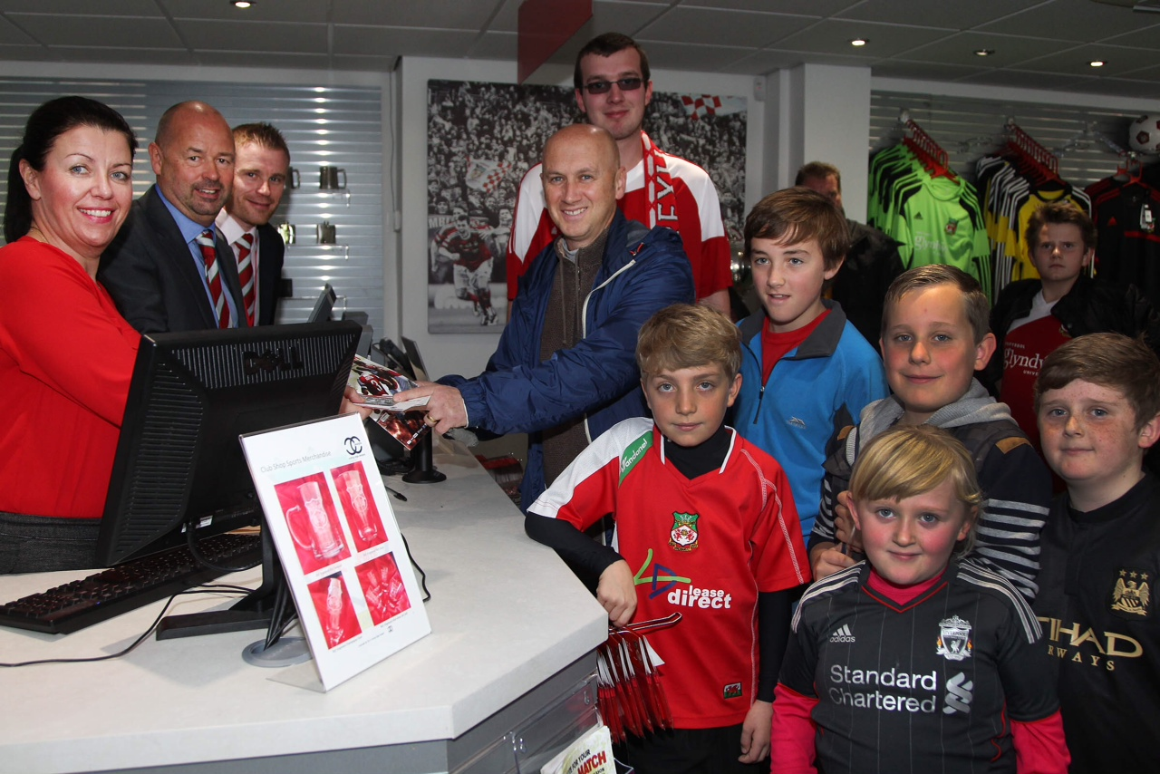
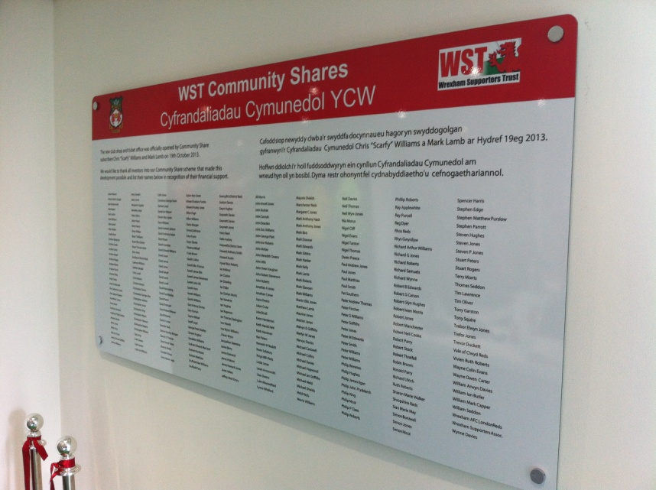
Ticket Office & Club Shop

Slide 7
Further Resources
Produced by Supporters Direct in partnership with the Community Shares Unit
www.supporters-direct.org/wp-content/uploads/2013/12/Community_Shares_Guidance_web_pomp.pdf
Animation - explains what community shares are in the context of sports clubs in 2 minutes
http://clubdevelopment.coop/homepage/about-us/research/community-shares/
Further information on WST’s Share Offer
http://wst.org.uk/www3/

