Slide 1
What is Incredible Edible Cloughmills?
Partnership
Respect
Engagement
Sustainability
Resilience
Making a difference

Slide 2
What is Incredible Edible Cloughmills?
Quality of life should never become a cliché
Maximise our own physical and human resources
Public and community sectors can only deliver positive change by working together
No room for ‘white horse syndrome’ in partnerships

Slide 4
The benefits
Enhanced emotional and physical well being = HAPPINESS
Dealing with ‘Nature Deficit Disorder’
Reconnecting people with each other, their community and the natural world
Taking control, making things happen
Meeting needs locally
Striving towards self sufficiency
Making a difference!

Slide 5
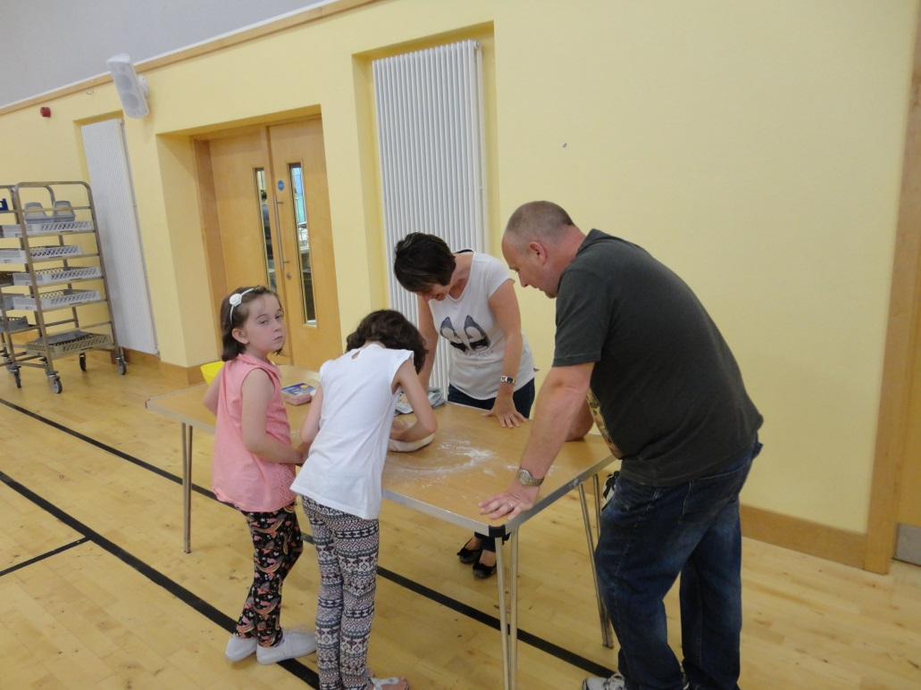
Tea time

Slide 6
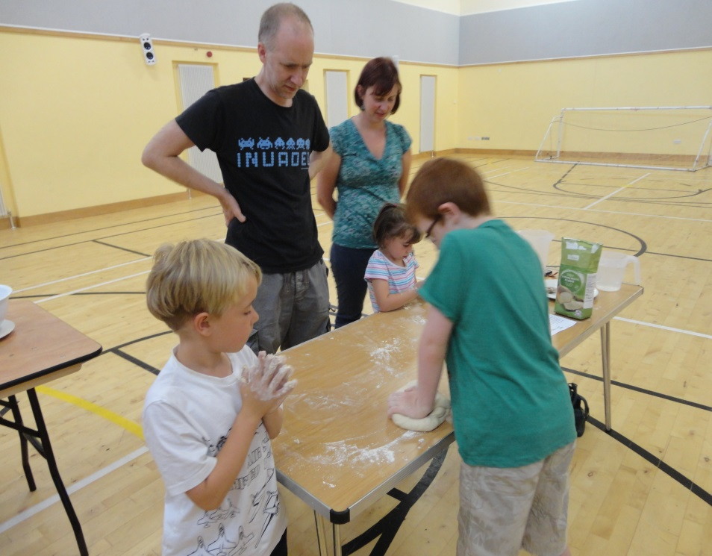
Tea time

Slide 7
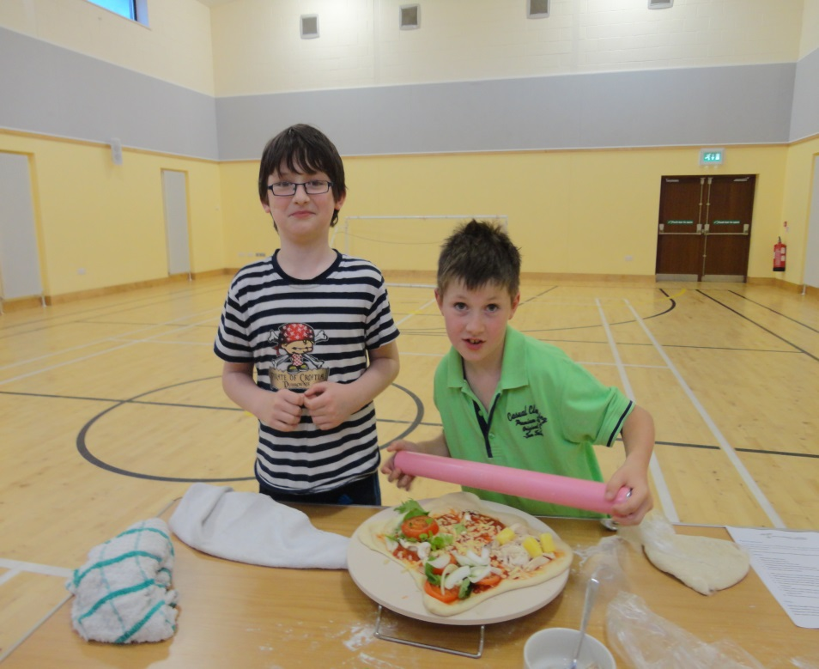
Tea time

Slide 8
Tea time

Slide 9
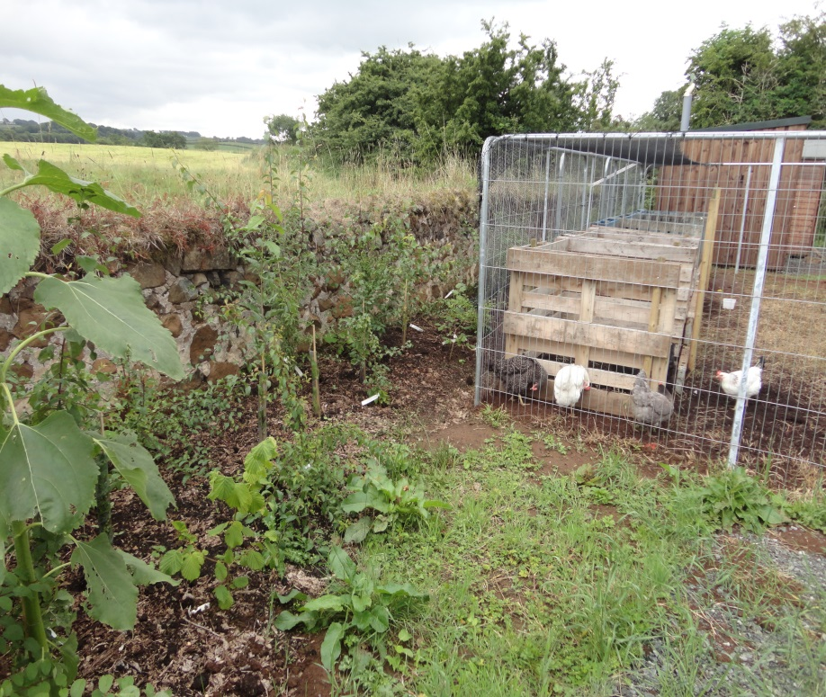
General pics

Slide 10
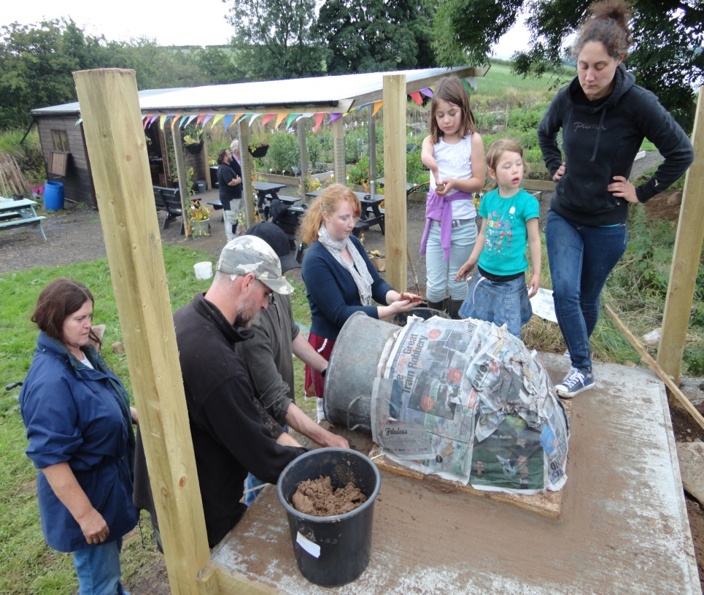
General pics

Slide 11
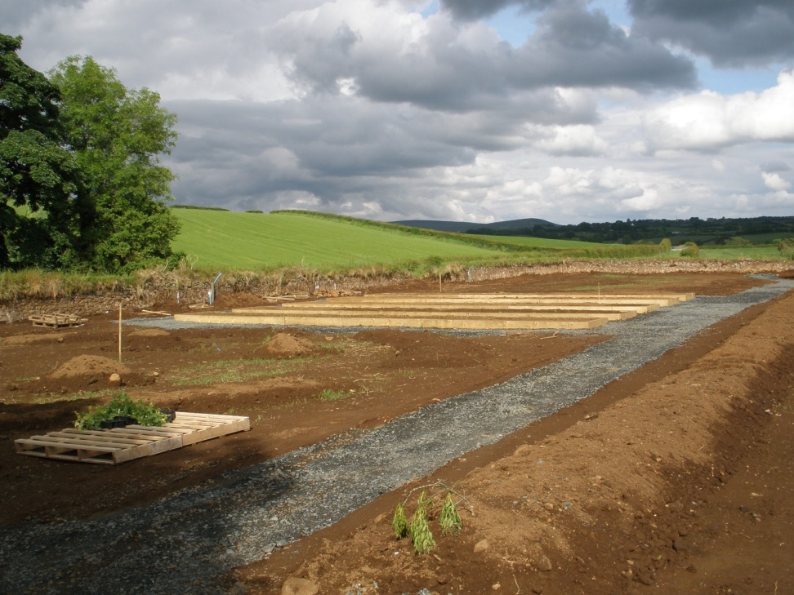
Never ending journey
June 2012
June 2013

