Slide 1
The Challenge
How to keep moving forward, building on our successes?

Slide 2
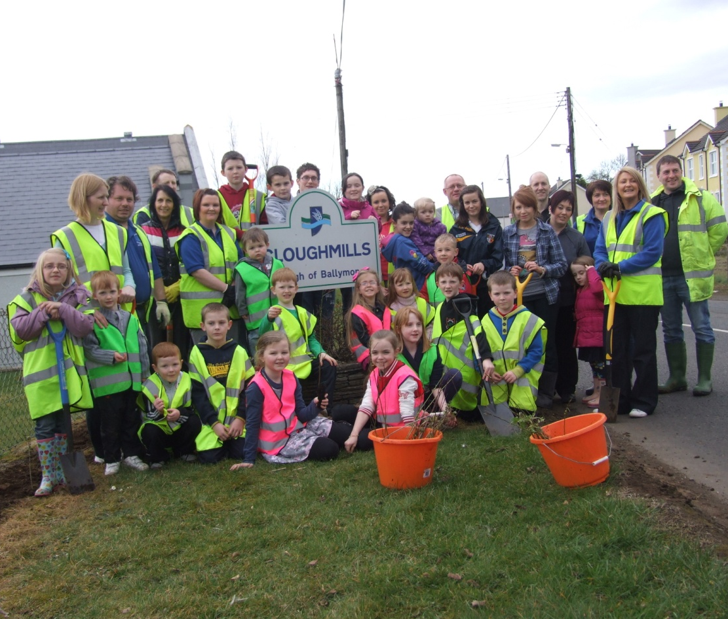
Cloughmills Community Orchard
26th March 2011, work begins on the village orchard

Slide 3
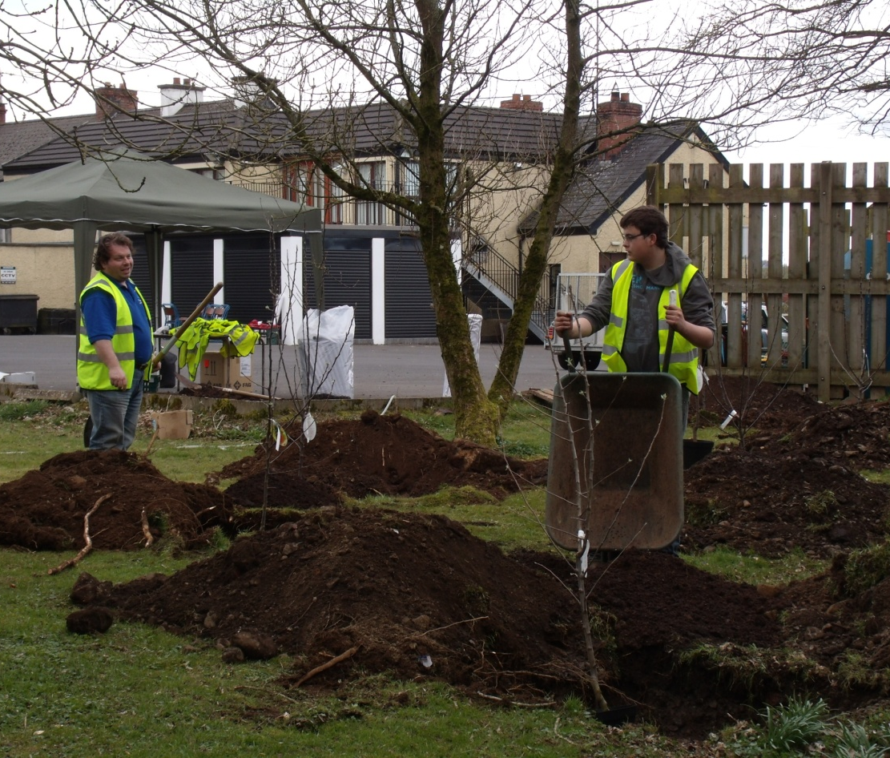
Community Orchard
Working on the main growing site, Patton’s Bar

Slide 4
Why an orchard?
Reconnecting people with fruit trees
Get young people ‘used’ to fruit, not stealing it!
Working with and sharing surplus fruit to make jams, tarts etc
Plans for food festivals etc

Slide 5
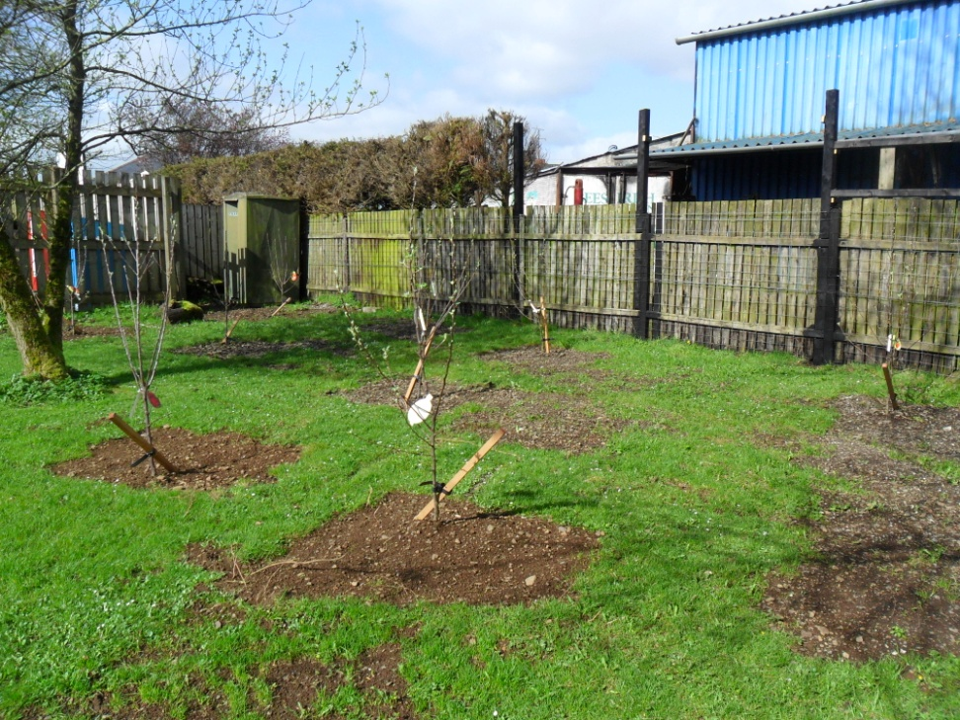
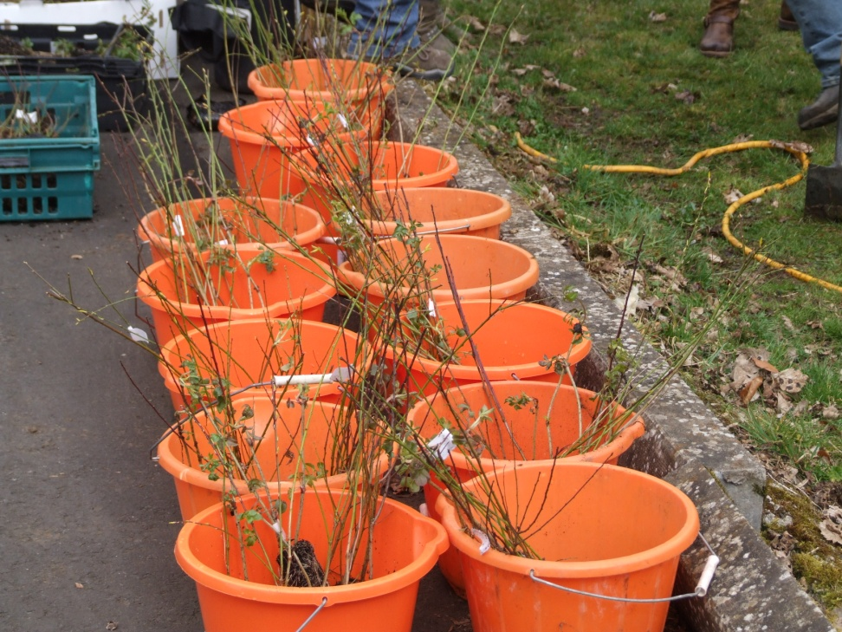
Village Orchard
Apples and plums at Patton’s
The fruiting hedge

Slide 6
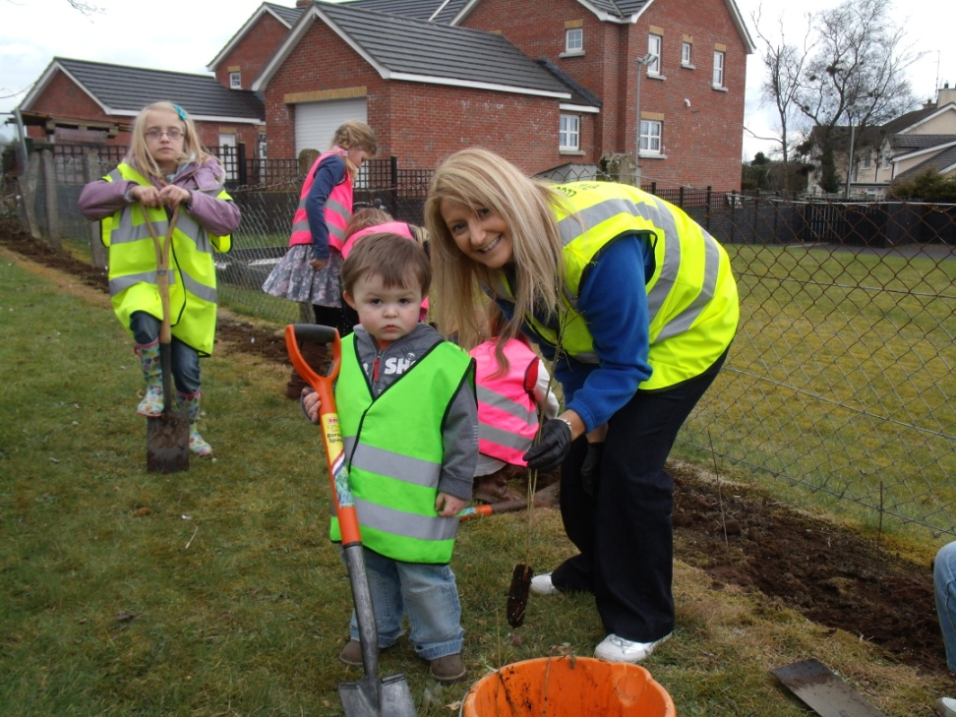
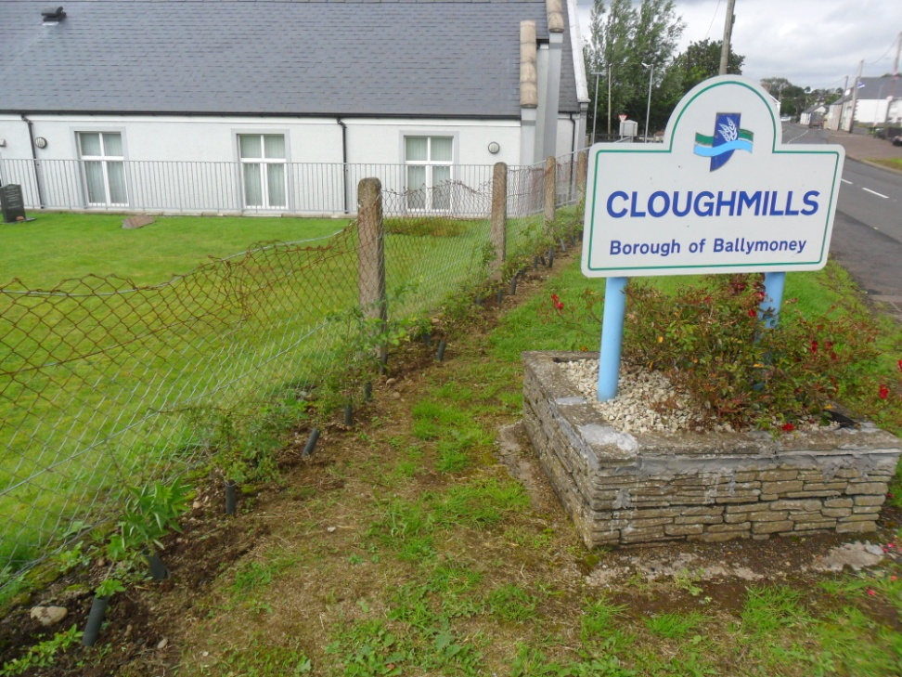
440 New Trees in Cloughmills
Reluctant digger
Edible Hedge

Slide 7
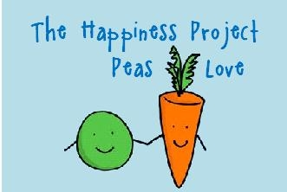
The Happiness Project

Slide 8
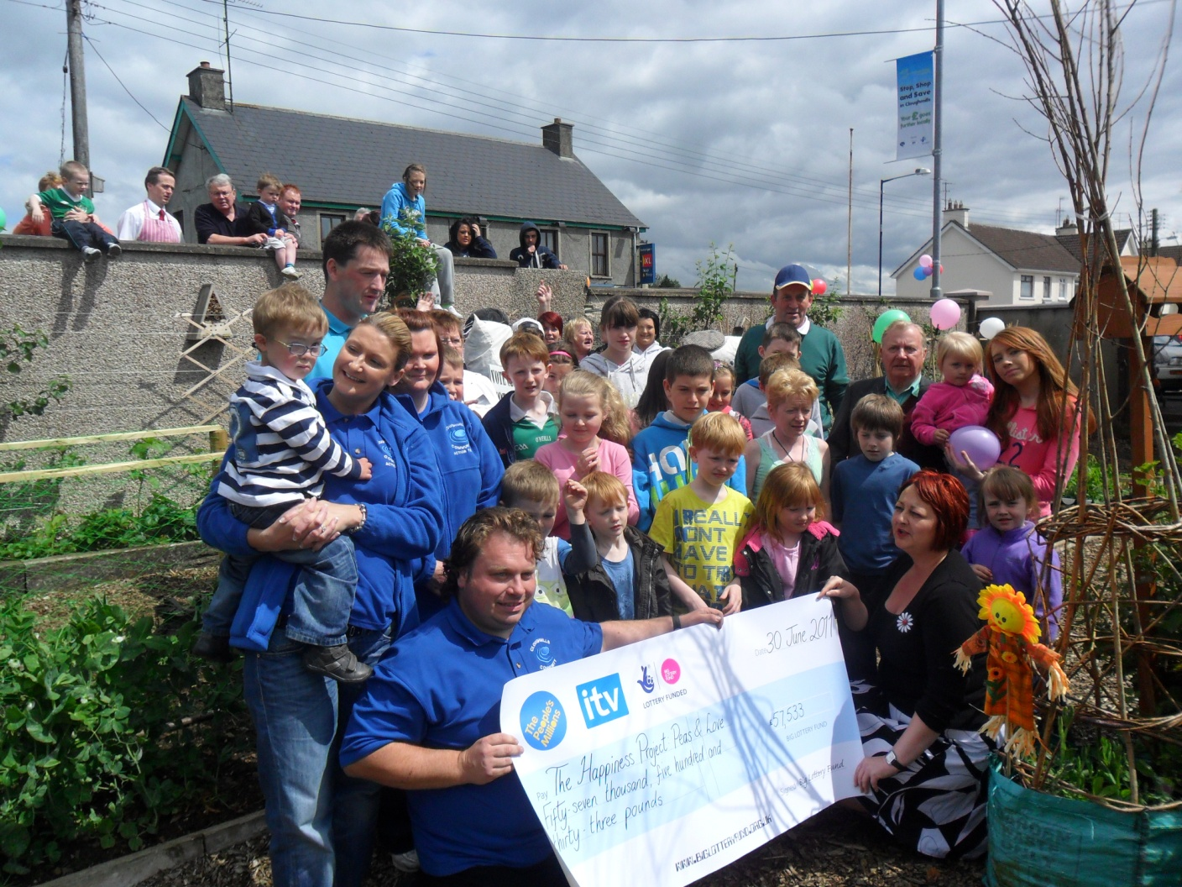
A Community ready to act…

Slide 9
The Happiness Project
A serious attempt to address issues which contribute to happiness:
  Connecting with people
  Being active
  Taking notice of the world around you
  Learning new skills/rediscovering old ones
  Giving time to yourself or others

Slide 10
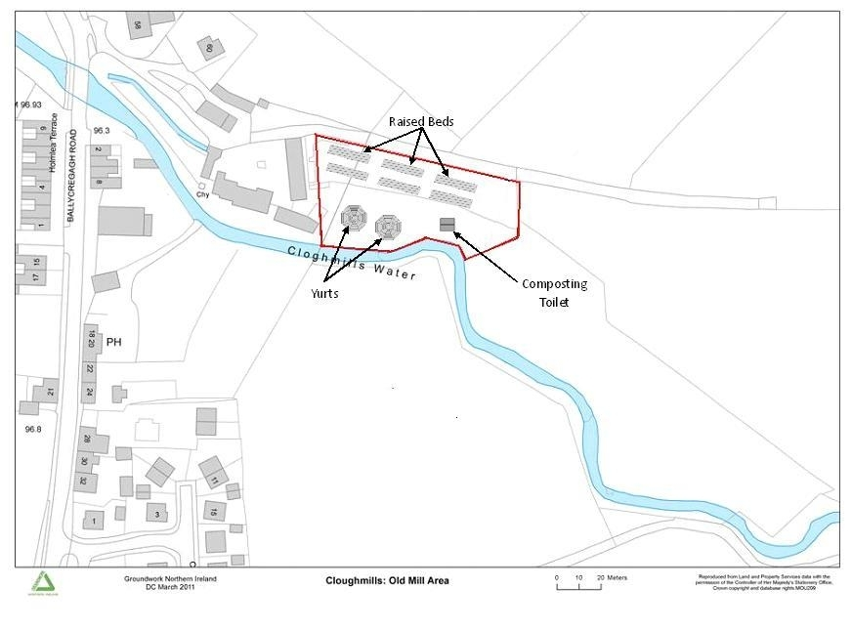
Old Mill Site

Slide 11
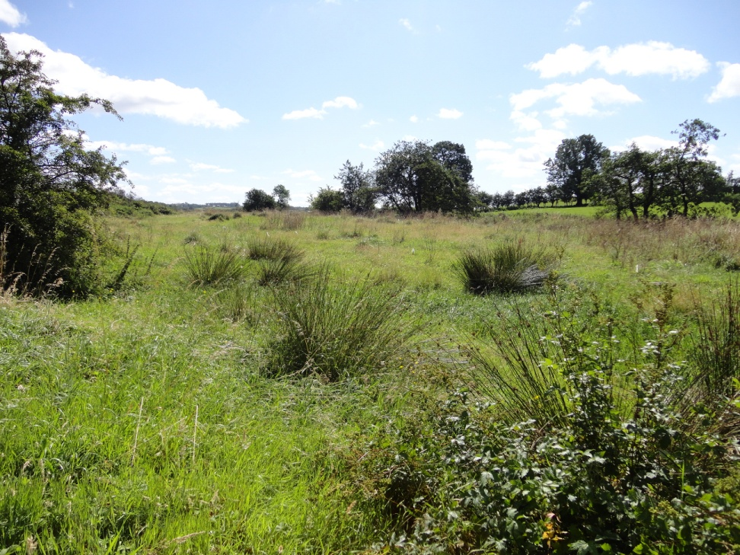
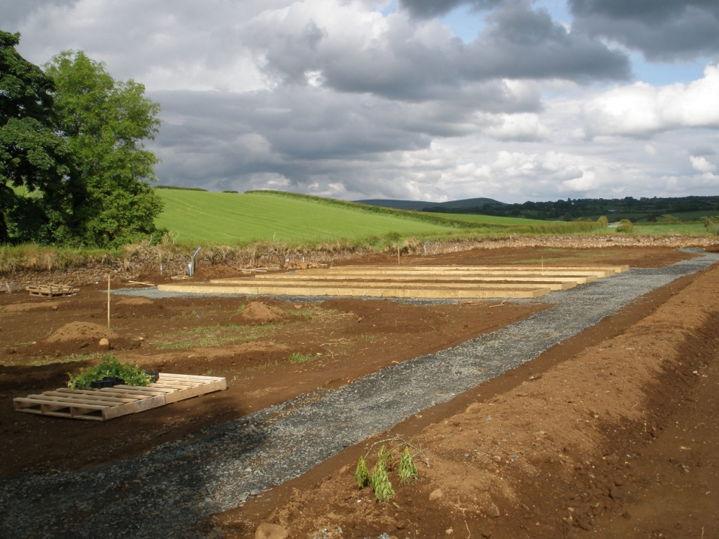
Another journey begins

Slide 12
Permaculture in action
Earth Care
People Care
Fair Shares

Slide 13
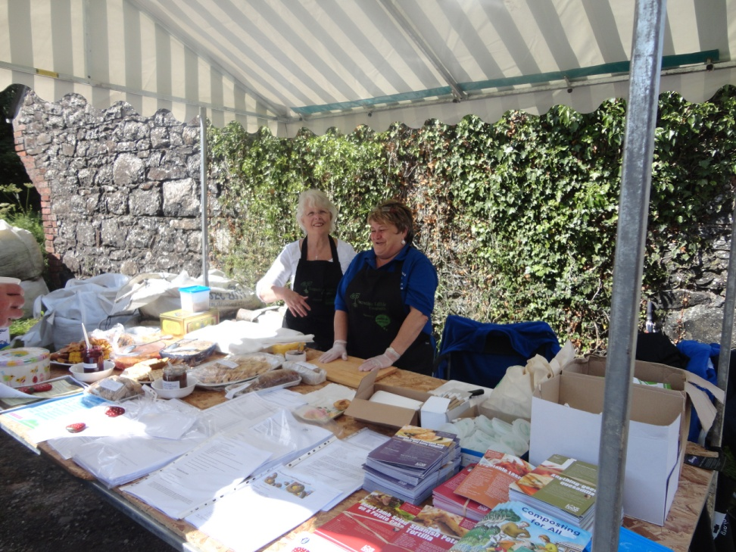
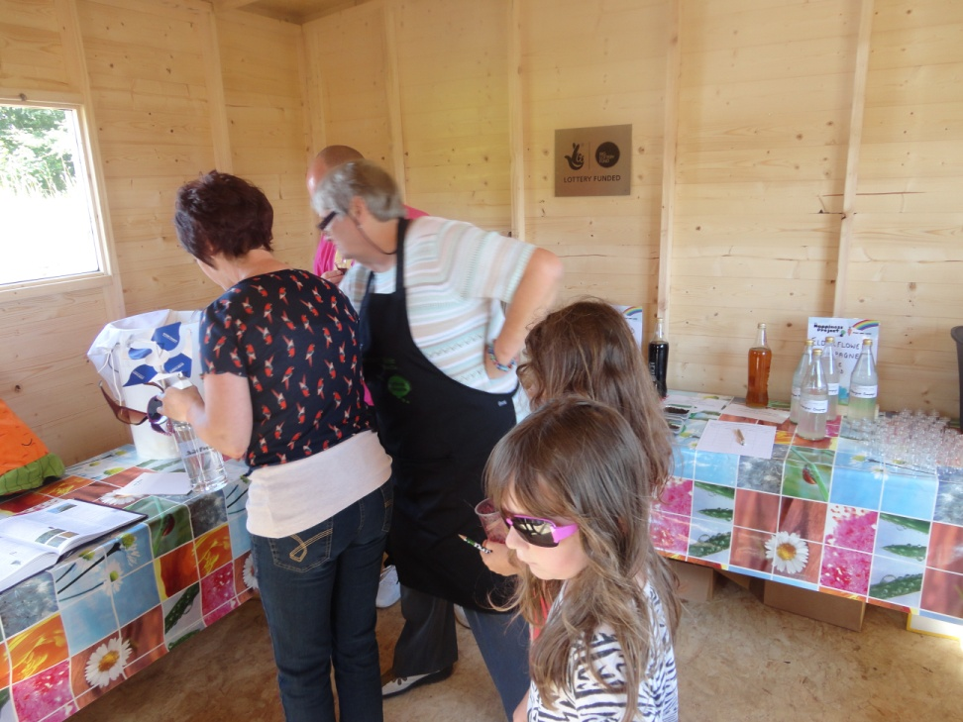
Getting people involved everyone has a role to play in ‘reskilling’ our communities

Slide 14
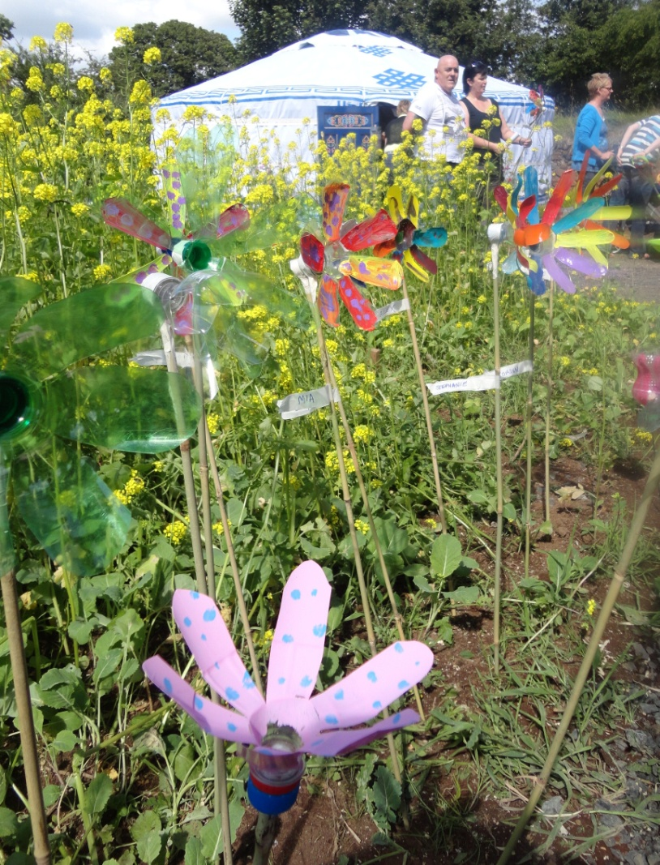
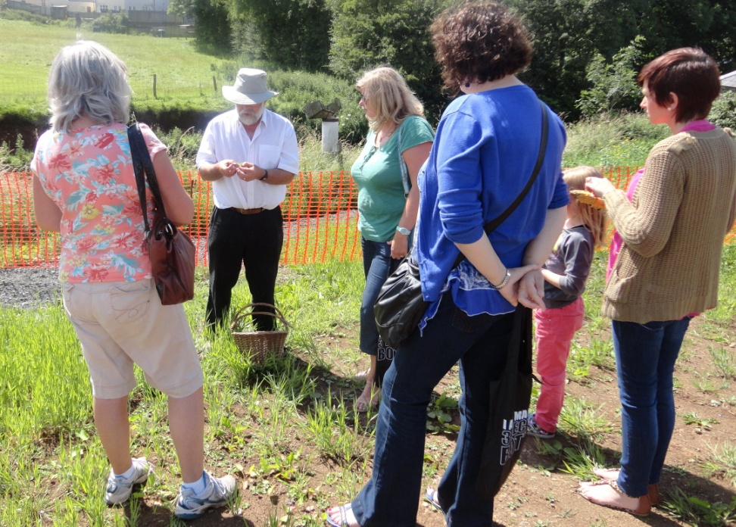
Reskilling Cloughmills

Slide 15
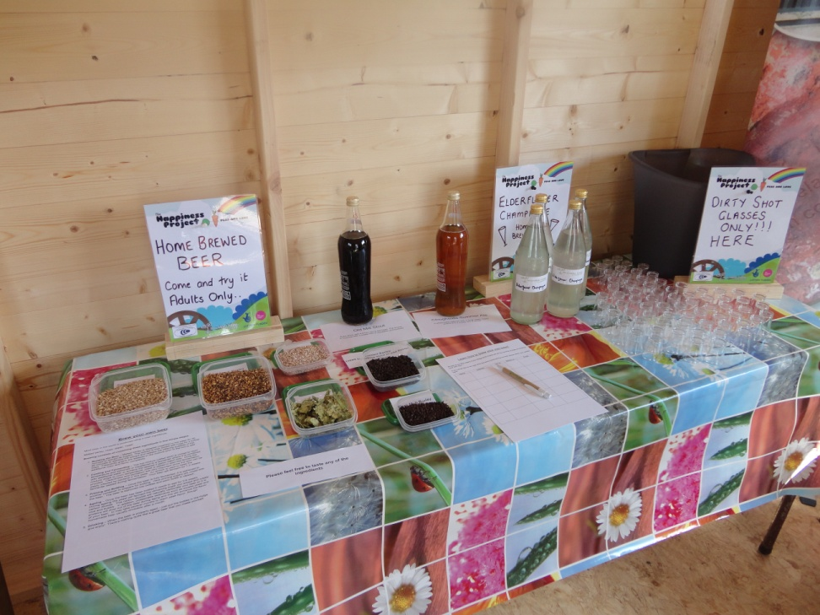
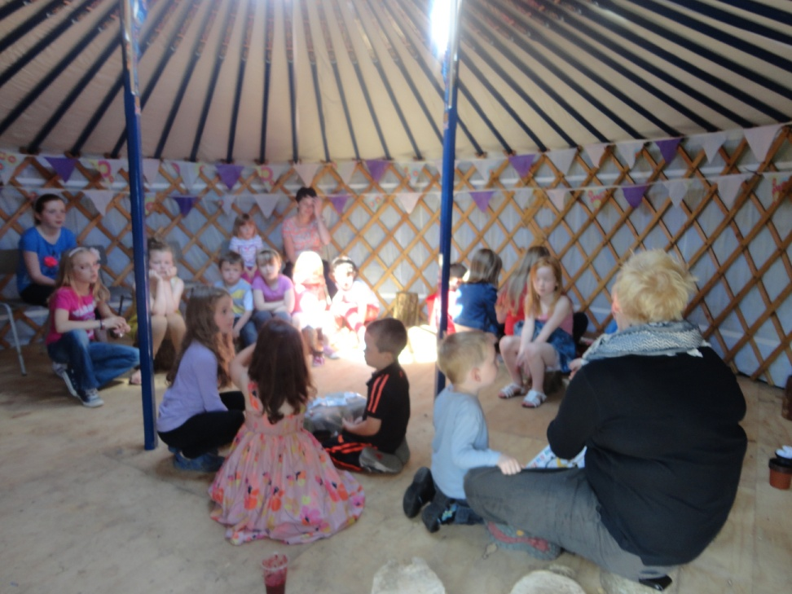
Reskilling Cloughmills

Slide 16
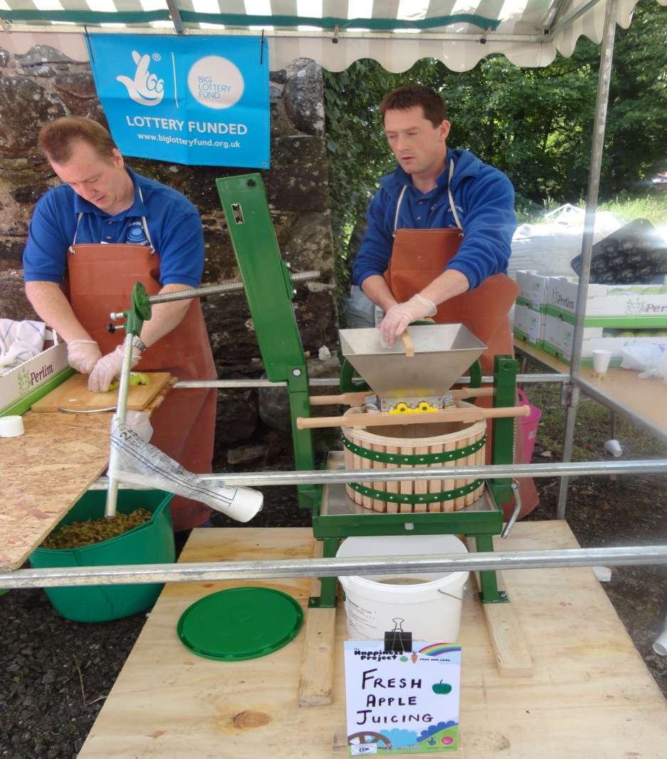
Reskilling Cloughmills

Slide 17
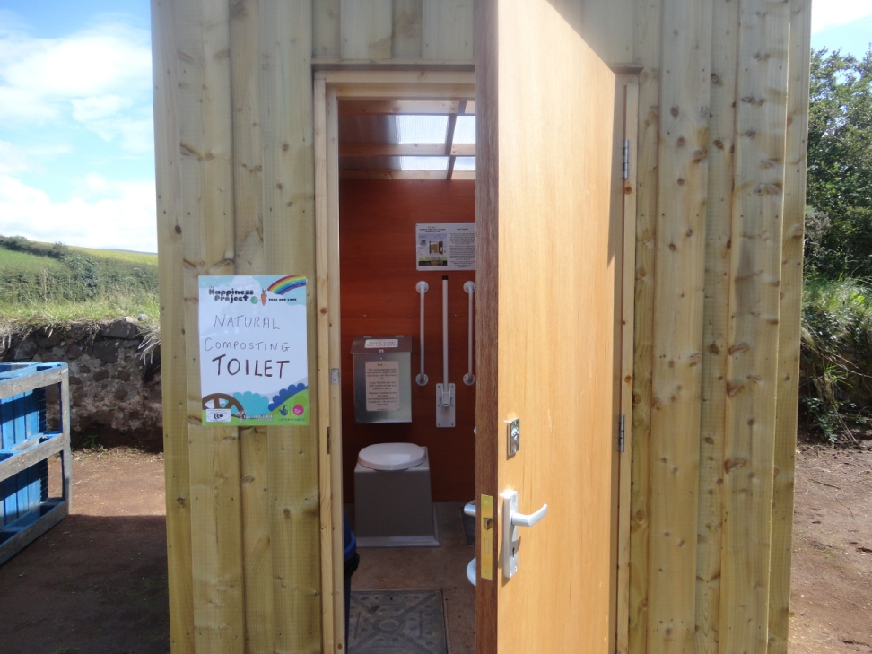
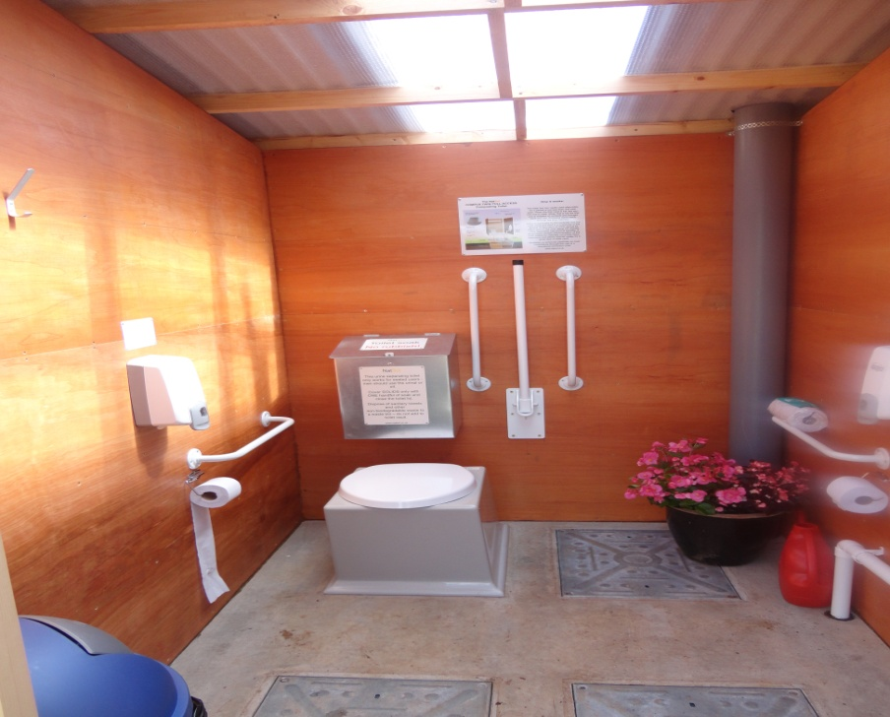
Every convenience provided!

Slide 18
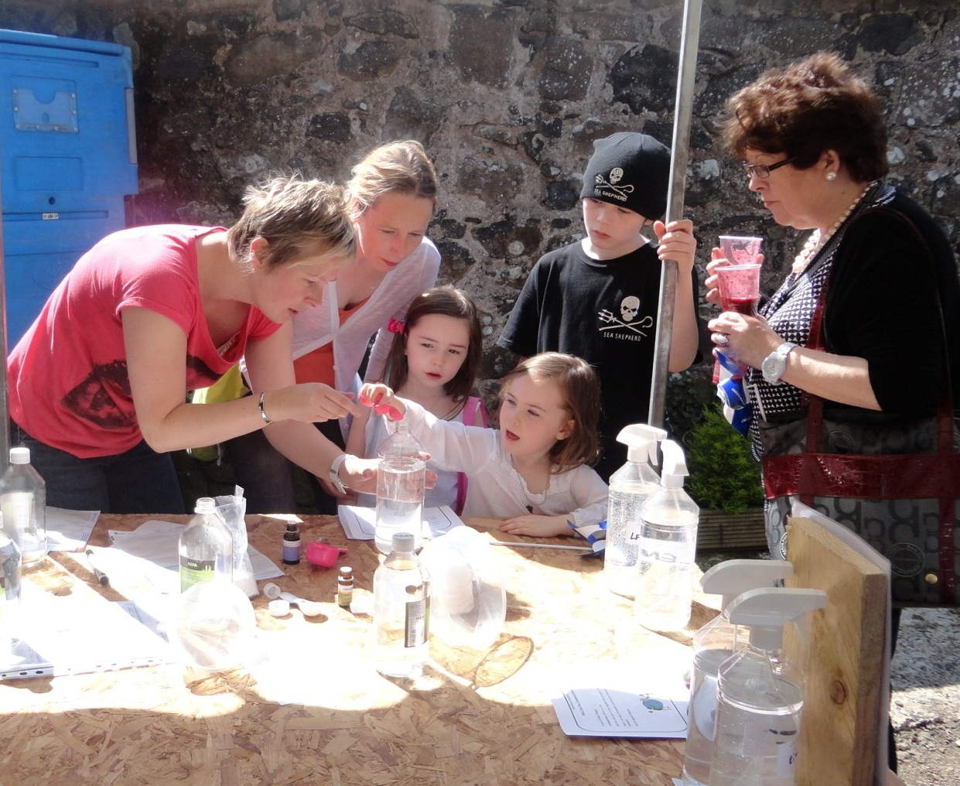
What is a resilient community
Takes control, making things happen not waiting for things to happen
Meets needs locally
People feel safe, valued and have a voice
People are connected to each other, their community and the natural environment

