Slide 1
Incredible Edible Cloughmills
Creating an alternative reality
Patrick Frew, Cloughmills Community Action Team
Declan Donnelly, Ballymoney Borough Council

Slide 2
Community of Cloughmills
650 houses including rural area
Approx 2,500 people
Largest village in Ballymoney Borough
1/3 of residents are under 16
Village has grown in last 15 years
Facilities and services haven’t grown

Slide 3
Community Action In Cloughmills
The Community Action Team was formed 15 years ago
Volunteers in action
Focus on social, economic and environmental projects
Involve everyone from toddlers to mature citizens
Still going after 15 years
Building relationships based on mutual respect

Slide 4
Incredible Edible Cloughmills
Reconnecting people with each other, their community and the natural environment using the language of food

Slide 5
Background
Began life as an idea in June 2009
Addressing anti social behaviour, apathy, gaps in services and building relationships in Cloughmills
Looking at different ways of doing this – our own physical and human resources
Building on the successes of the Community Action Team
Working with Community Safety & Environmental Services, Ballymoney Borough Council

Slide 6
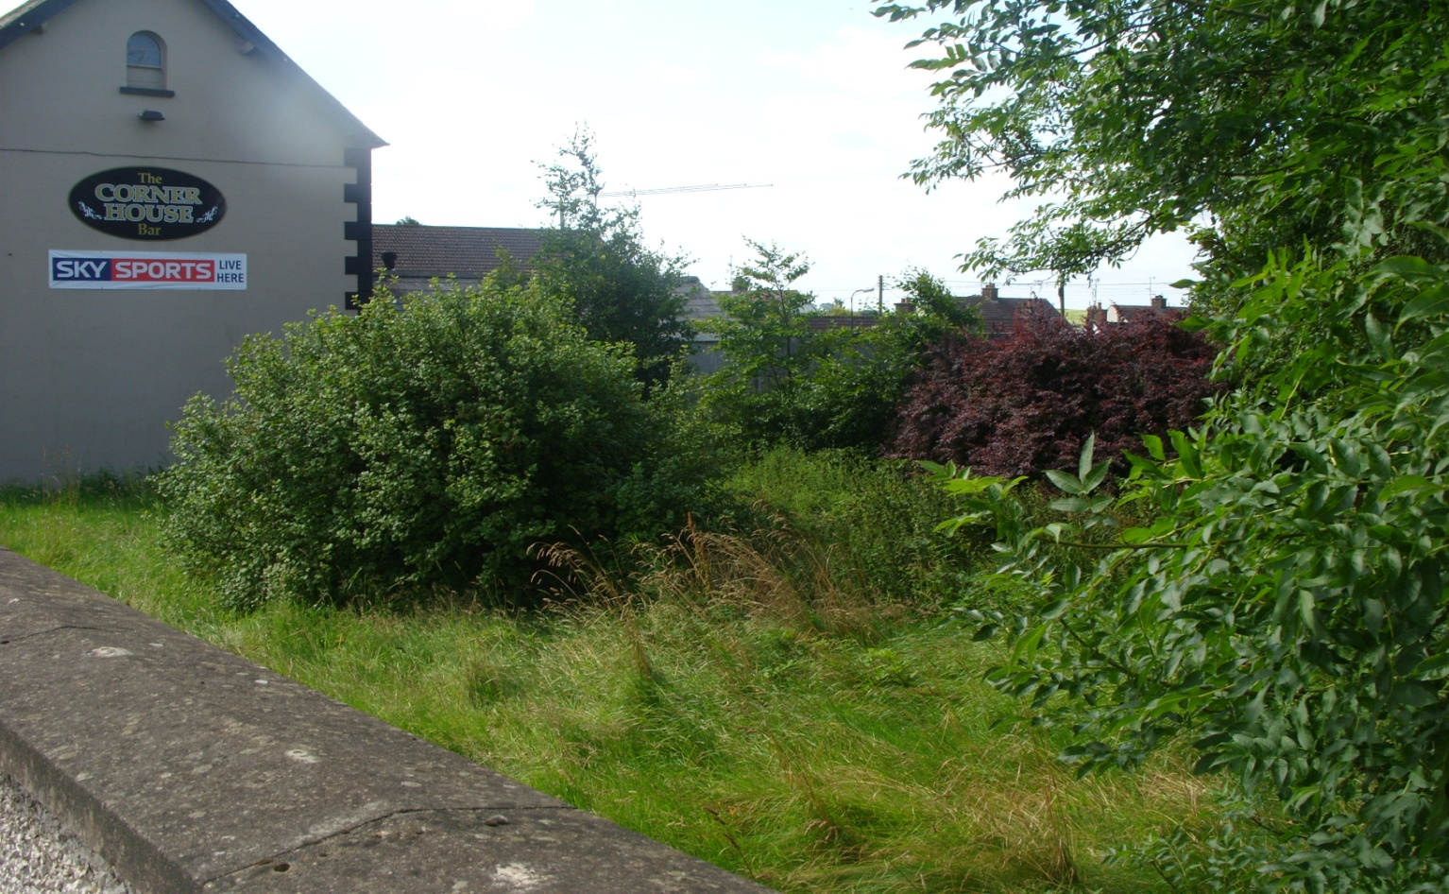
August 2009
‘Growing community’
Identify a main growing site
Partnership with the community
Working with Tony O’Hanlon, Cornerhouse Bar

Slide 7
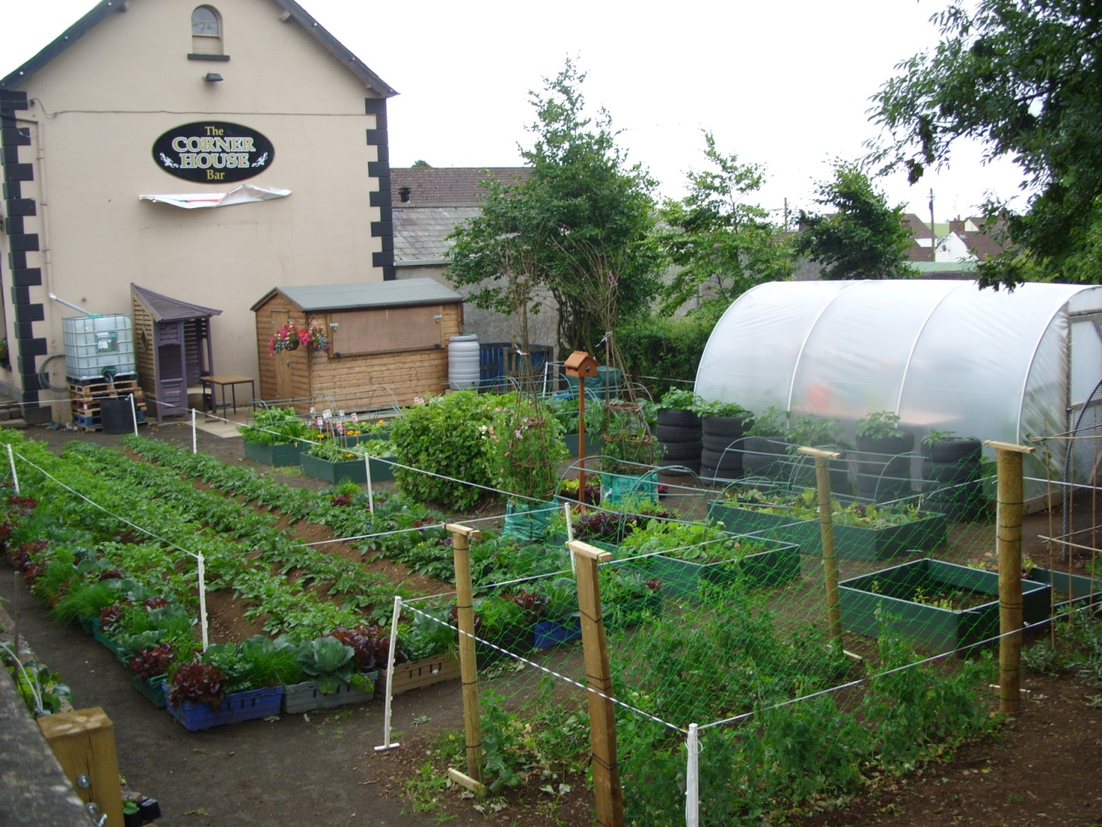
June 2010
What a difference a few months makes!
When people work together, anything is possible

Slide 8
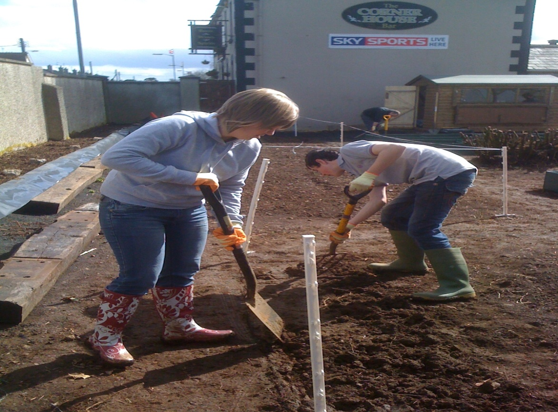
The Journey
Not all about money and not just a garden!

Slide 9
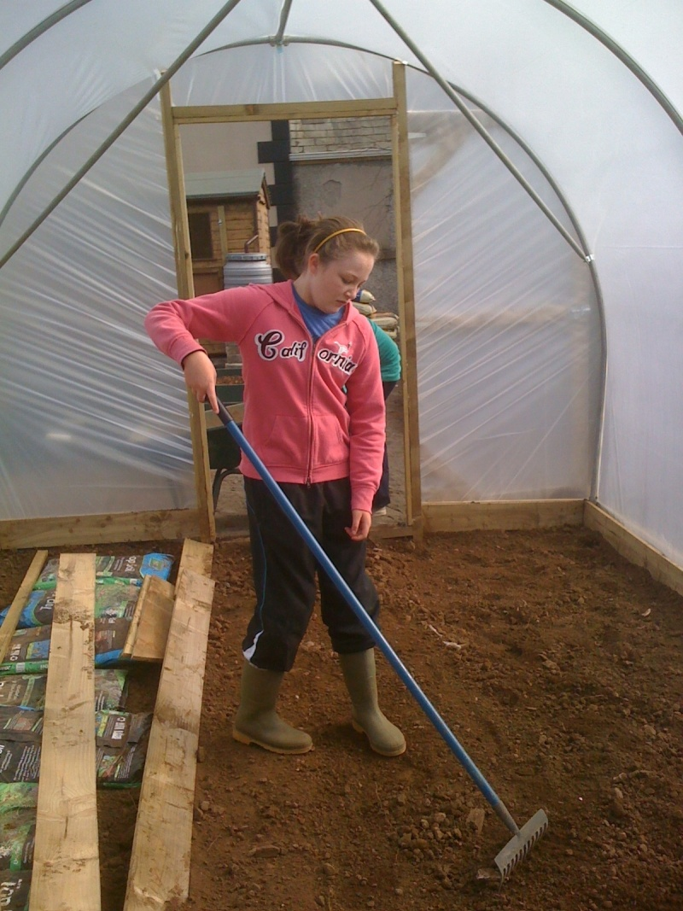
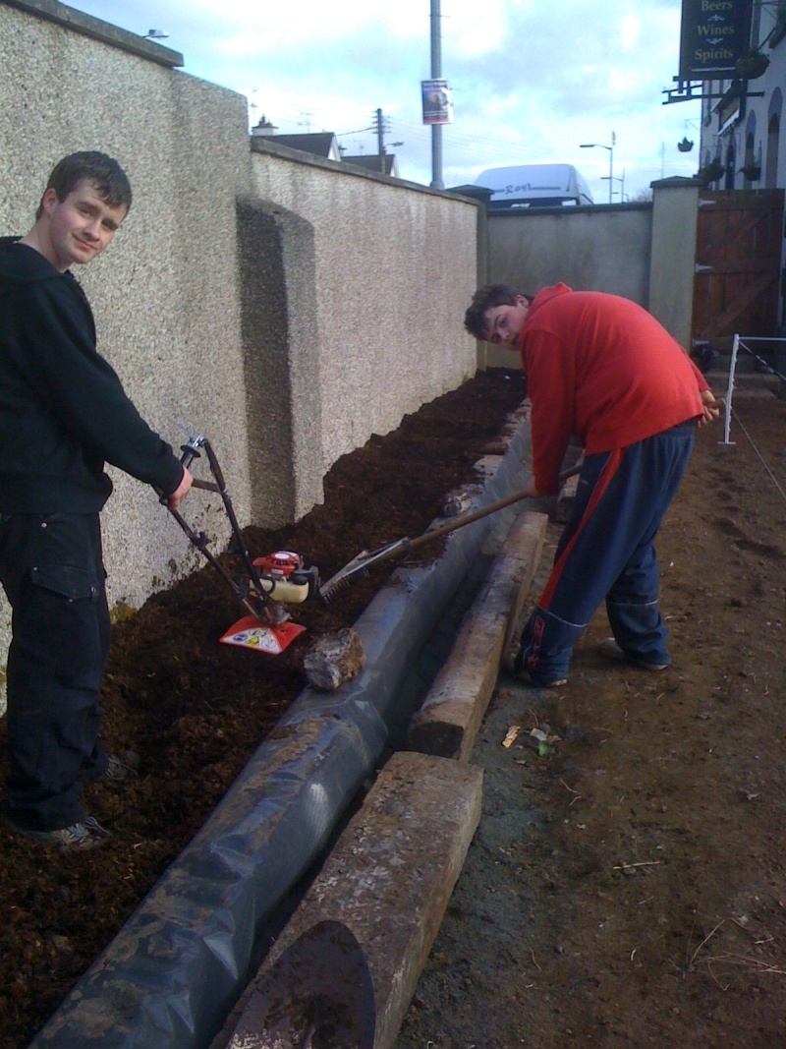
The Journey

Slide 10
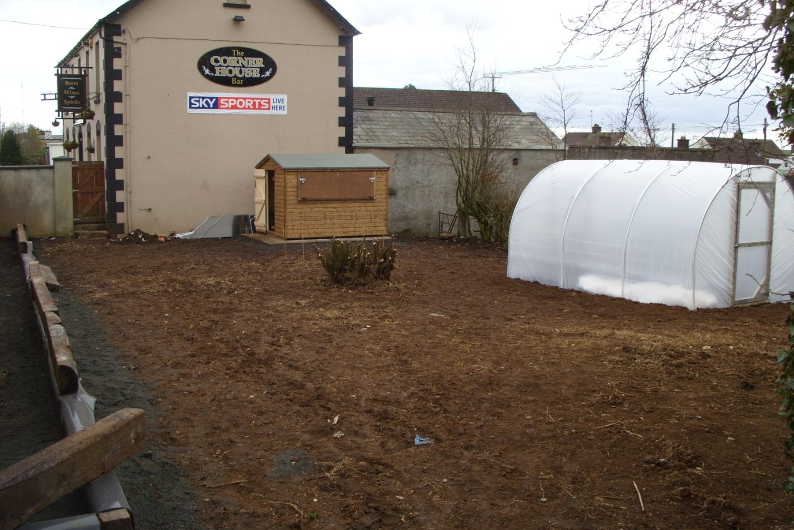
The Journey
Many hands make light work
15 young people aged 14 to 18 contributed over 700 hours in just over a year to make this happen!

Slide 11
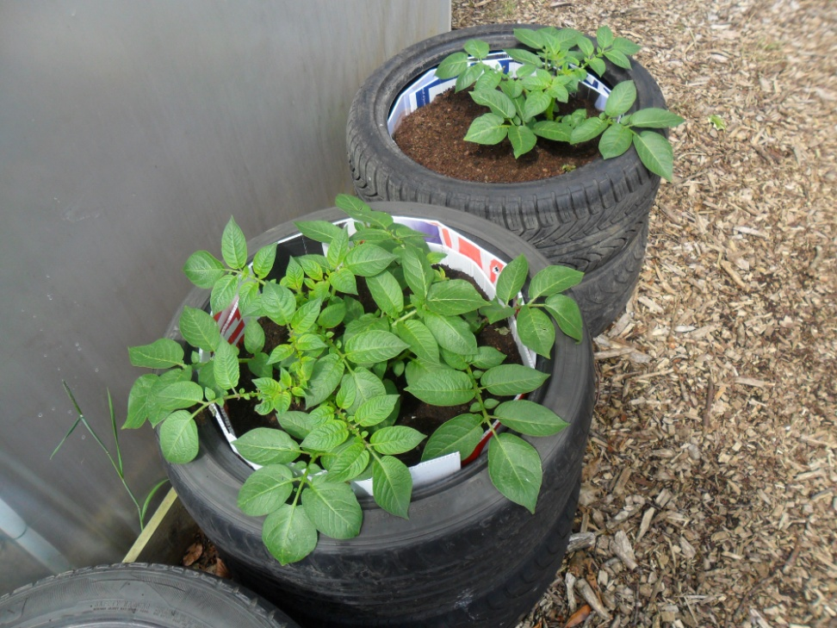
Political Potatoes?
Proof that politicians do indeed work for people after election time!

Slide 12
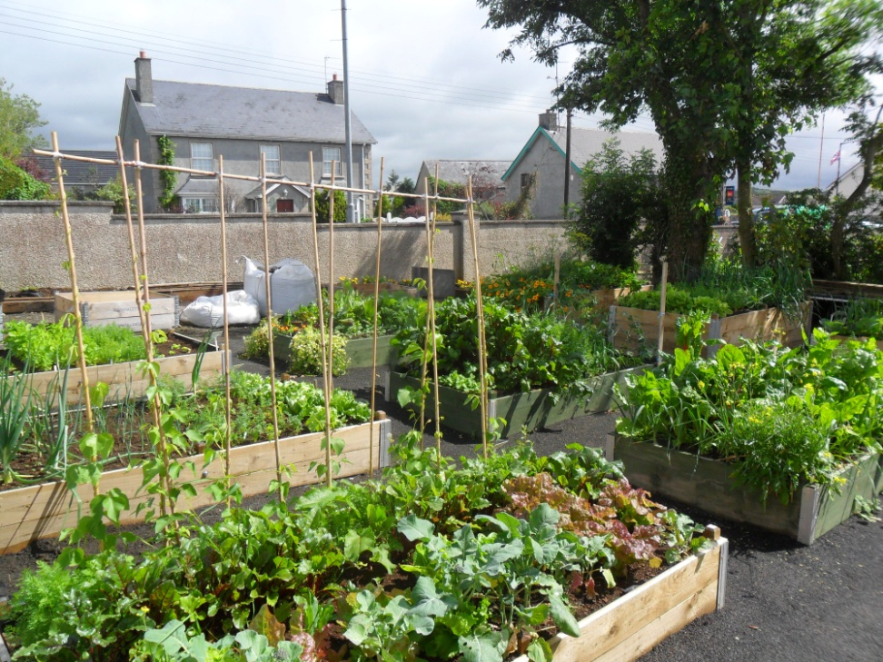
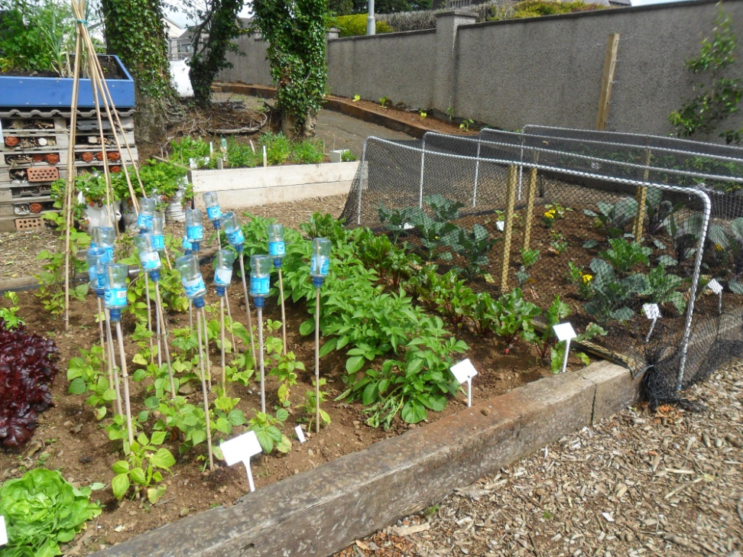
Access for all
Individuals and families
Cooperative growing

Slide 13
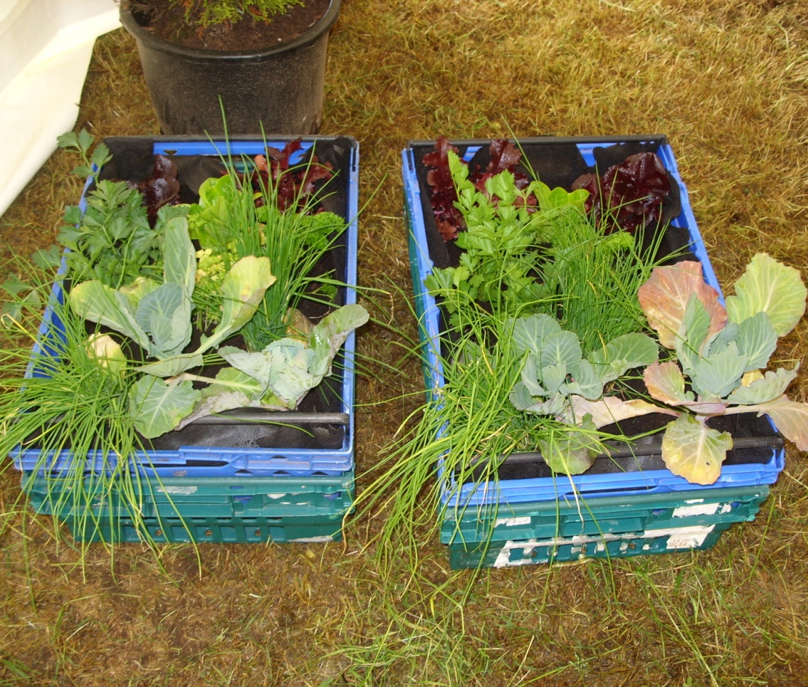
Bringing benefits to the community
Doorstep allotments, available to almost 70 elderly & vulnerable people in the community.
Delivered by young people aged 12-18

Slide 14
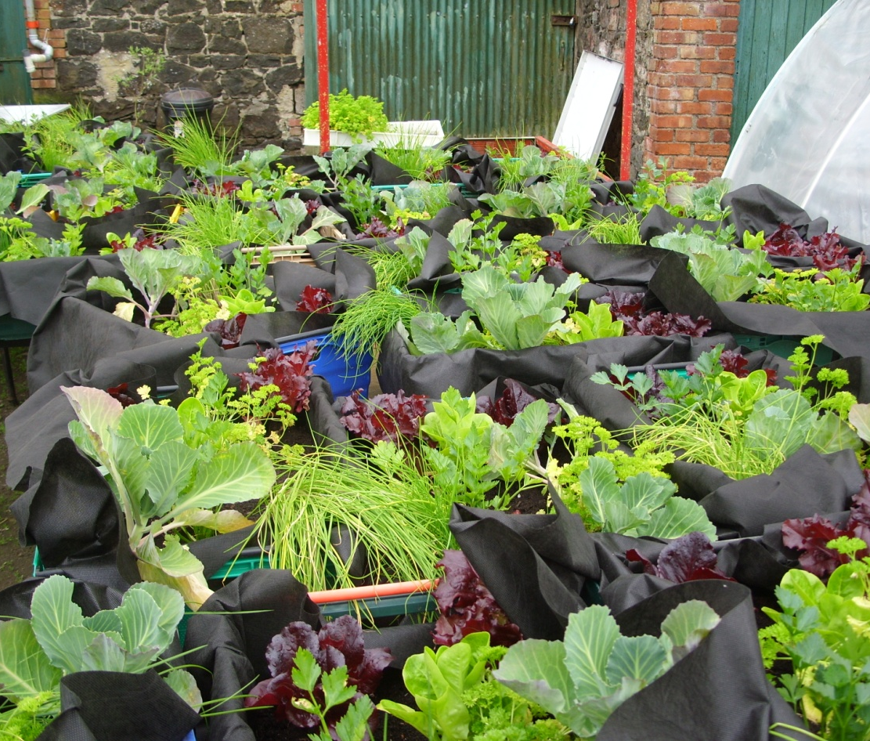
Doorstep allotments
Ready for delivery

Slide 15
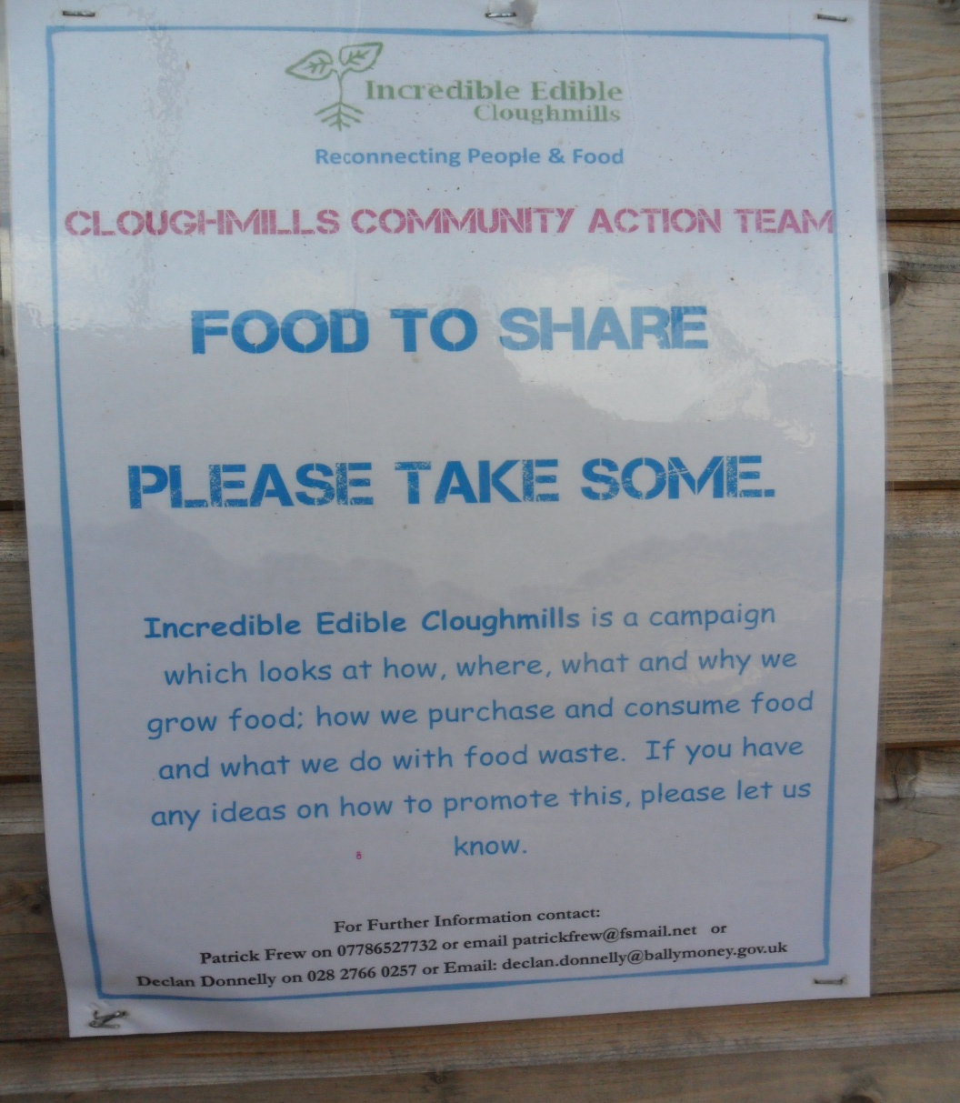
Incredible Edible Cloughmills/Food for Free

Slide 16
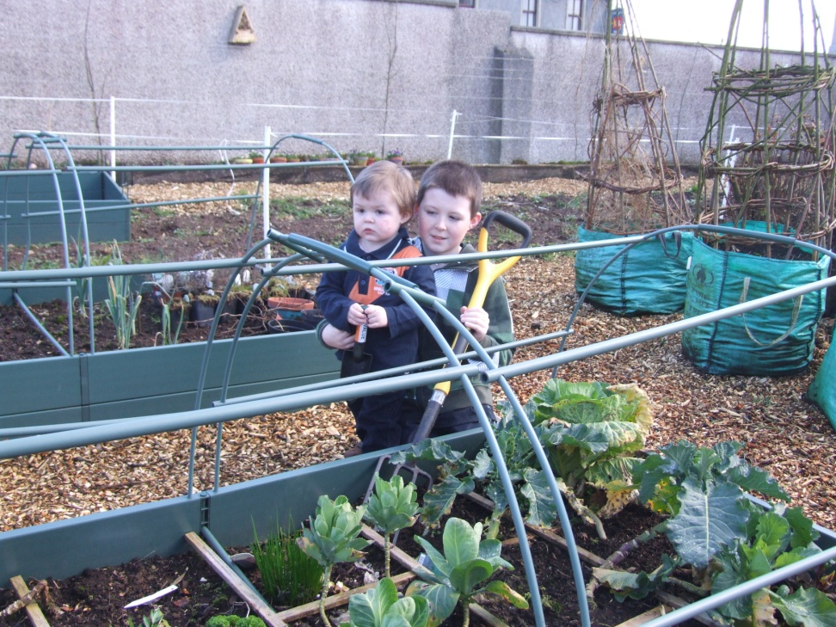
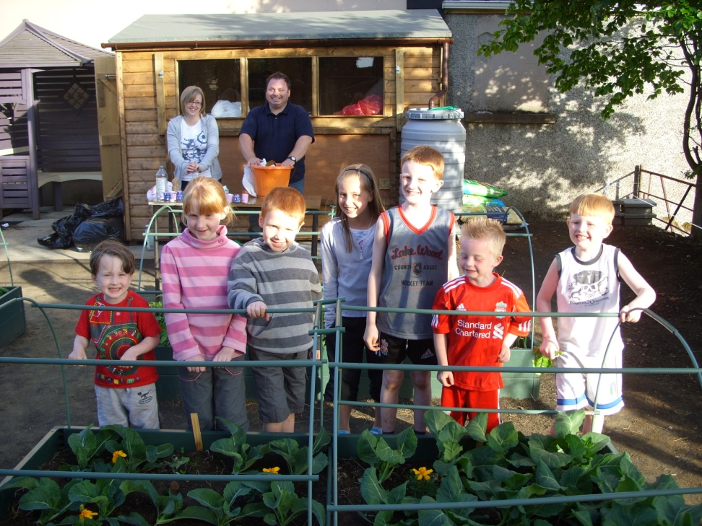
Making a difference in Cloughmills
Never too young to learn – ‘Muddy Boots Club’

Slide 17
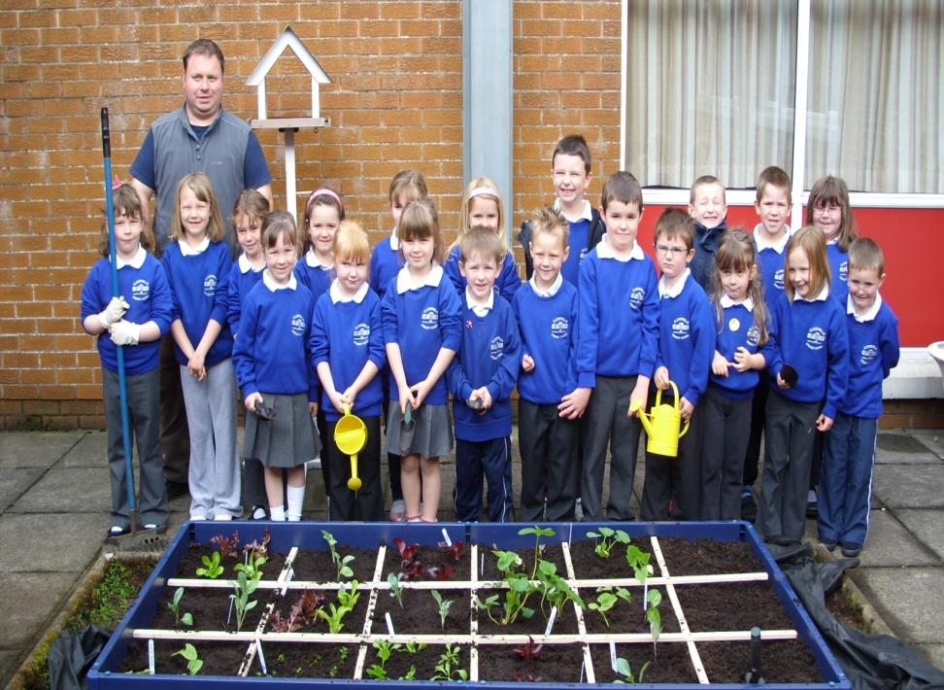
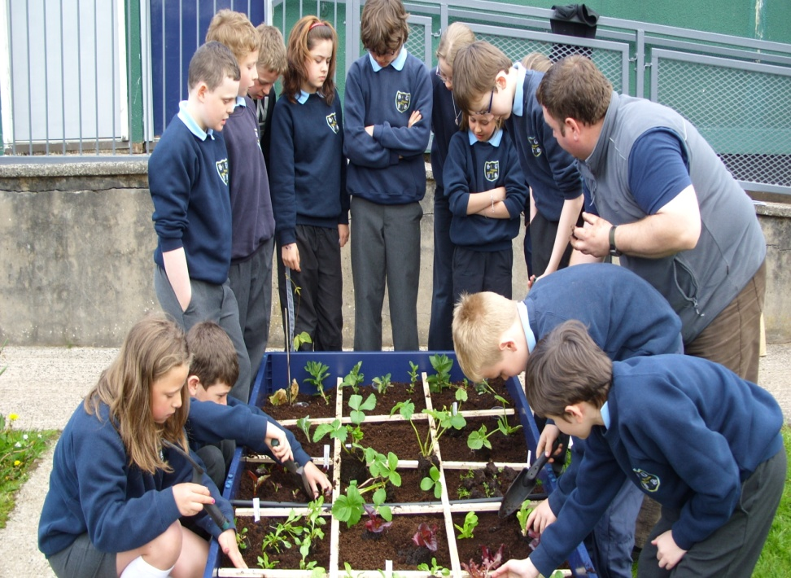
School food just got fresher!
Cloughmills & St Brigid’s PS get their hands dirty

