Slide 1
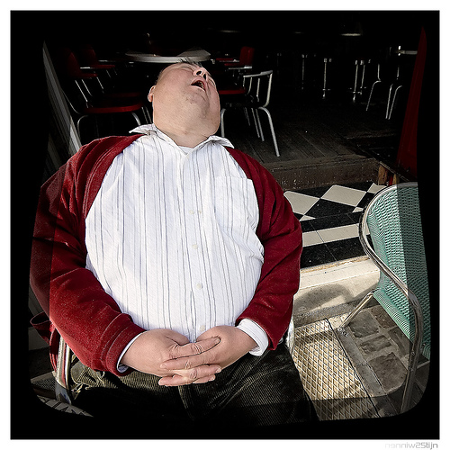
People driven; exciting
Notes:
Emma Harrison A4E 1986, 2000 employed
Headingley
Fordhall Farm - £500,000 through Share Issue. FC United of Manchester target £2m
Earth Centre
Yorkshire Food Restaurant

Slide 2
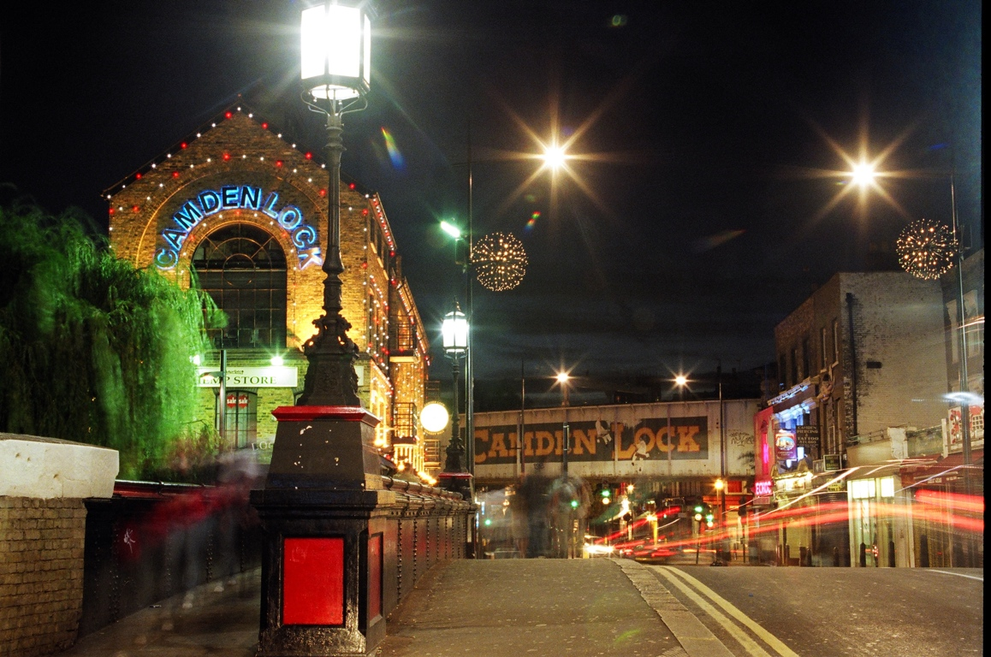
Keep it cheap

Slide 3
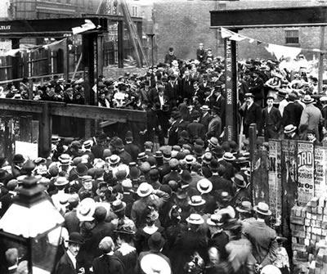
The Board and Community Engagement

Slide 4


Slide 5

Cost -- £100 to £200 per square foot
Fees
and
surveys
over 10%
of
costs
will
be

Slide 6
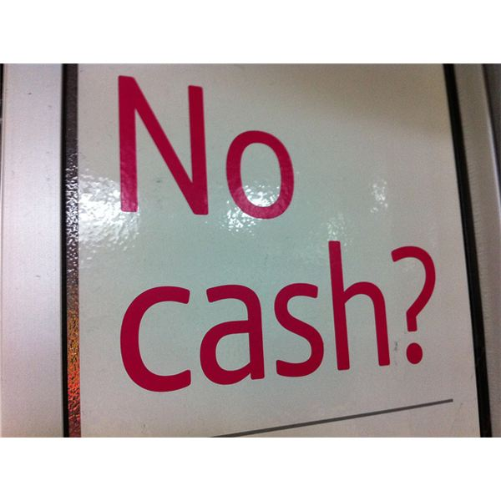

Slide 7
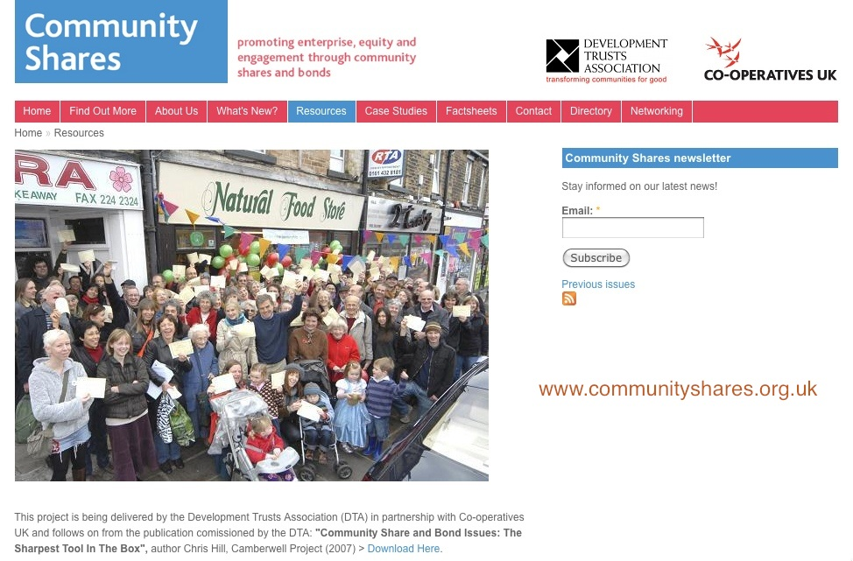

Slide 8
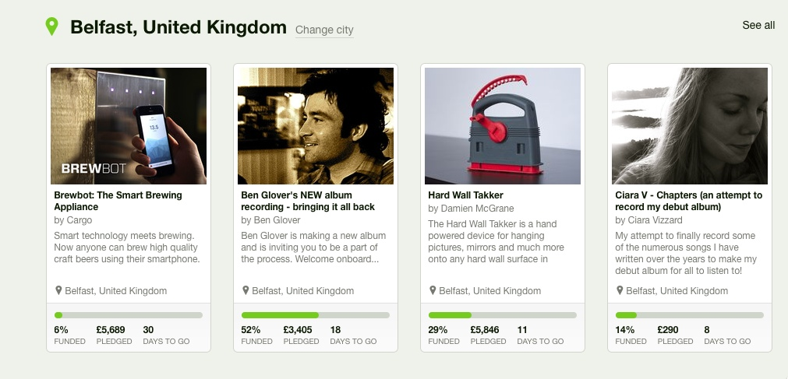
KICKSTARTER

Slide 9
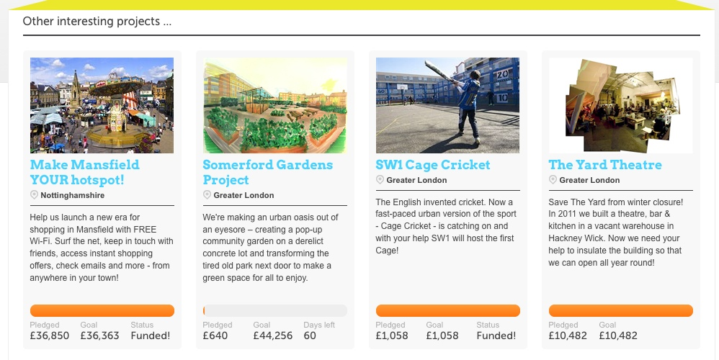
SPACEHIVE

Slide 10

Key Fund offers loans up to £150,000, structured to fit with income flows, and is prepared to take risks

Slide 11

lend 70% of the value of the building
but want security
Value = net rent income per year x 10

Slide 12
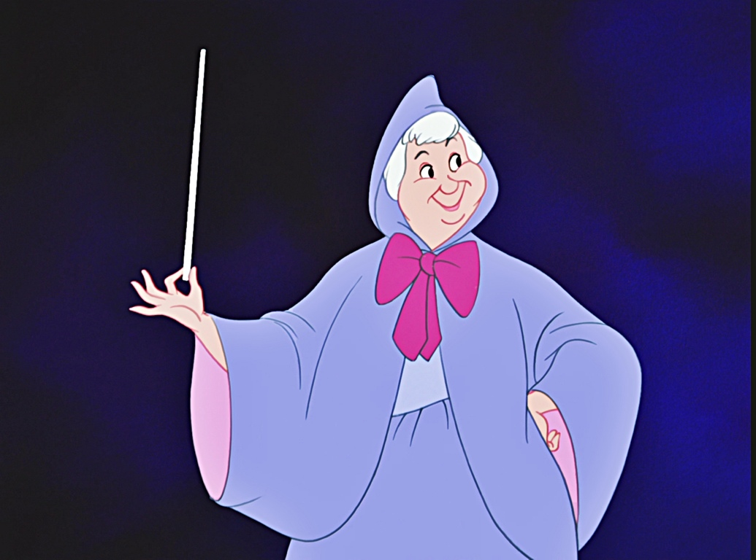
MORE MONEY NEEDED
Europe
Lottery
Trusts
Regen

Slide 13
LESSONS
Use the strength of co-operation and partnership to create an unstoppable force
A building may be beautiful, but what people do in it makes it exciting
Keep it simple and keep it cheap
Ignore the people who will make life better if you give them some money - stick with the doers
Live the dream - it’s more than a job

