Slide 1
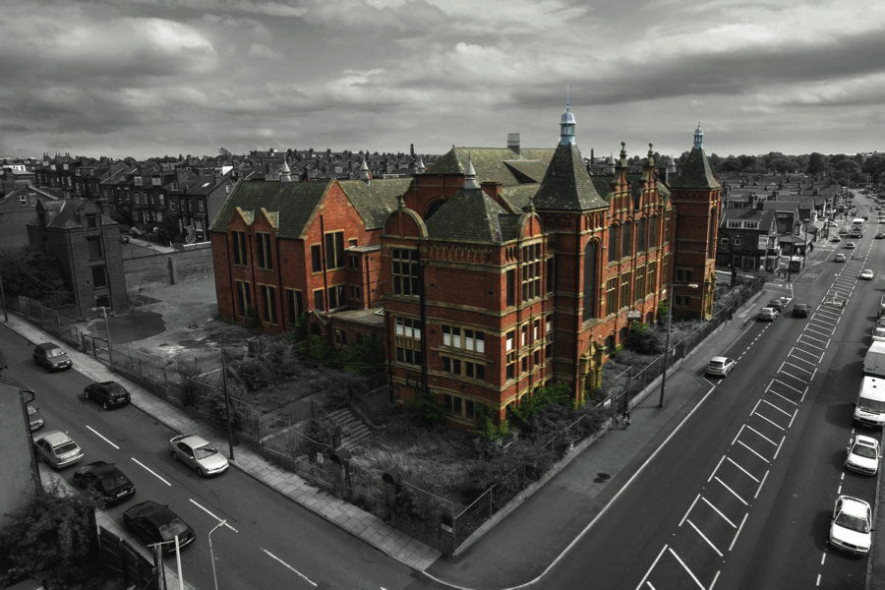

Slide 2
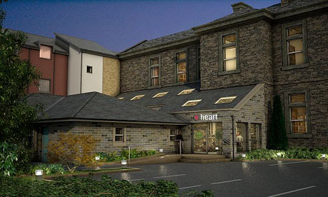
Headingley Enterprise and Arts Centre
1,000 members - 9,000 permanent residents
£1.2m project

Slide 3
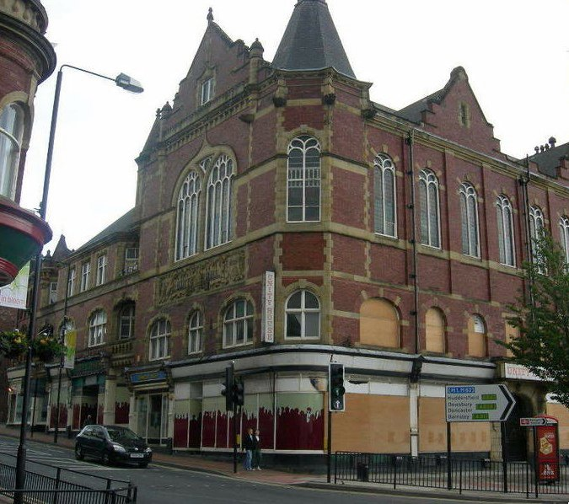
200 shareholders
Unity Hall, Wakefield
£4m project

Slide 4
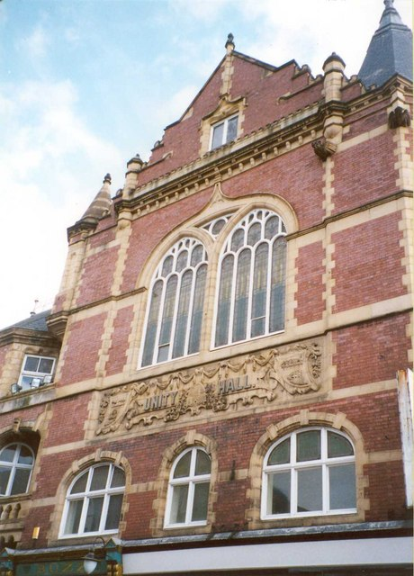
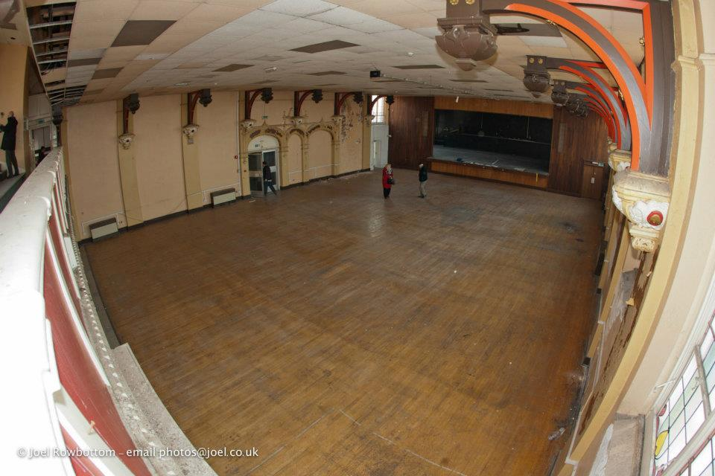
600 seater hall

Slide 5
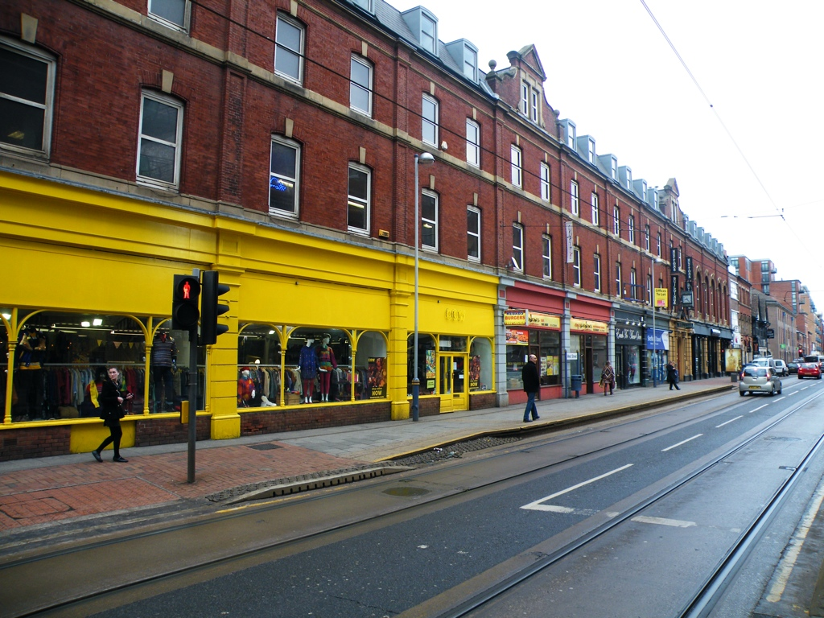
Huttons, West St,
Sheffield
WORKSHOPS
RETAIL
GALLERY
CONFERENCING
£1m project - no grants - 200 shareholders?

Slide 6
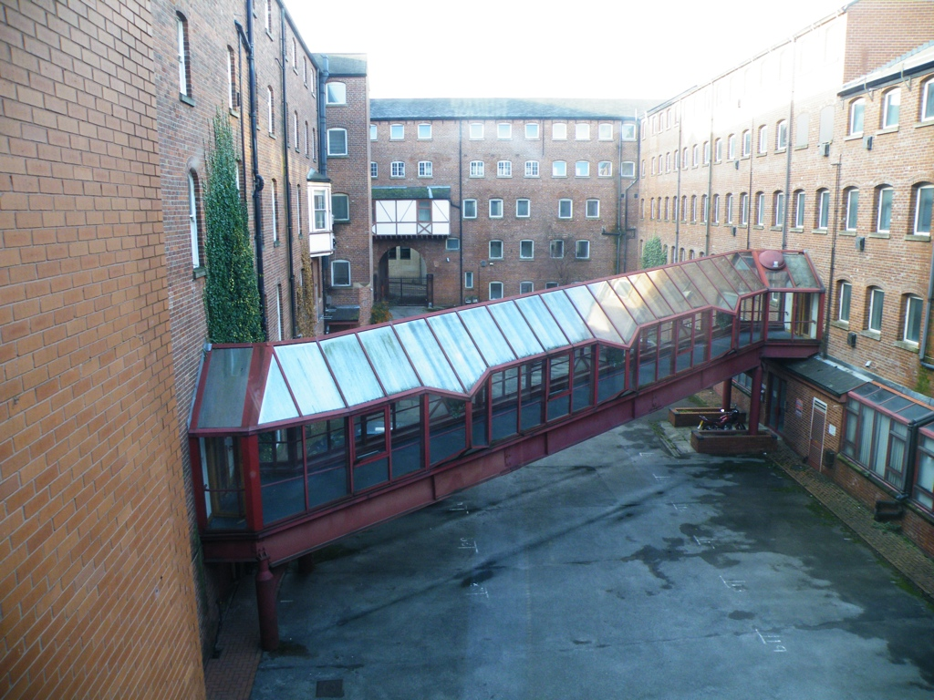
MORE WORKSHOP, OFFICE AND MEETING SPACE
BAKERS, MICRO BREWERY, CRAFT
CAFE / BAR
LANDSCAPED EVENTS AND SITTING AREA

Slide 7
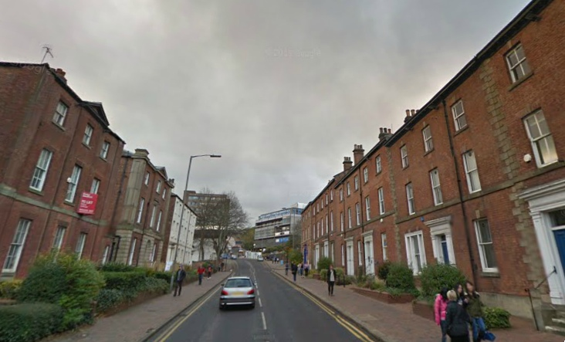
Glossop Rd, Sheffield
Activities and funding similar
Landlord completely different

Slide 8
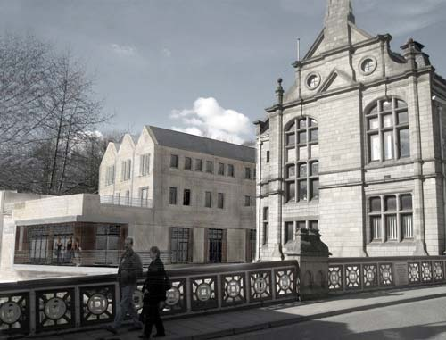
Hebden Bridge Town Hall
500 ‘friends’ in a town of 9,000
30 enterprise units, full within 3 months
£3.5m project

Slide 9
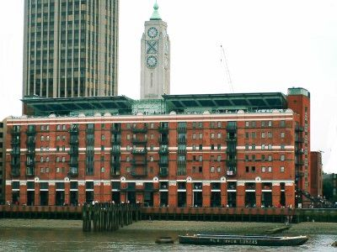
COIN STREET
13 acres, 50 shops, 220 homes, leisure centres etc

